Slide 1
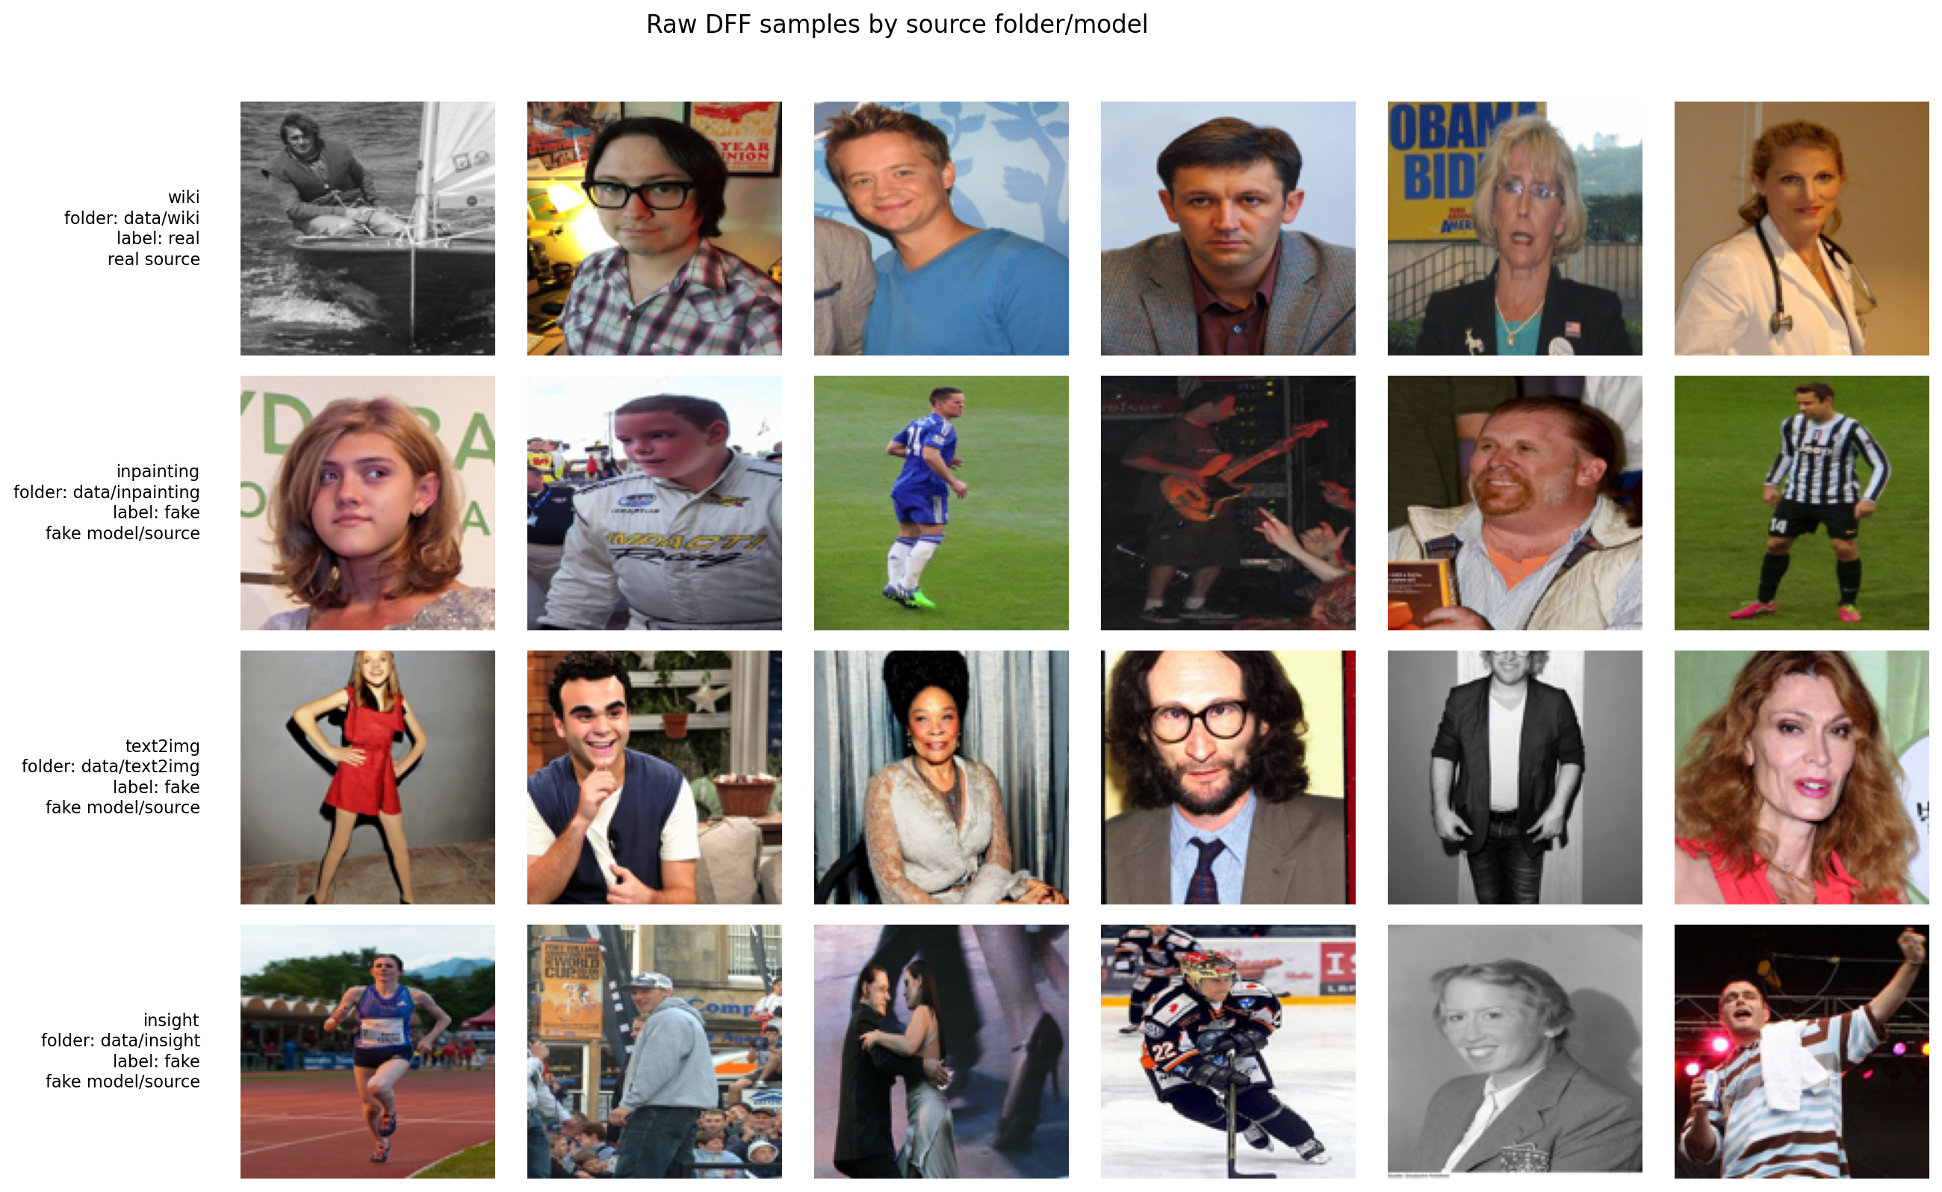
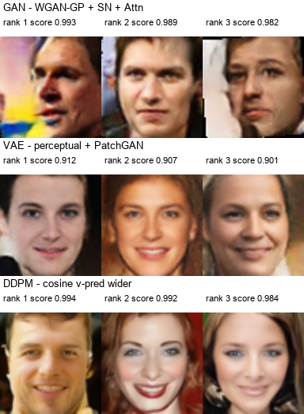
Real/Fake Face Classification
and Synthetic Face Generation
Classifier and Generator Pipelines for Face Image Analysis
Student/project name: [placeholder] Course: [placeholder] Date: [placeholder]
Classifier
Generator
Notes:
Purpose: open the presentation and frame the two complementary goals. Evidence: the split visual uses source samples from the classifier branch and curated final generator samples. Conclusion: the project combines detection and generation in one experimental story. Transition: map the two branches and the evidence used for each.

Slide 2
Project map
Opening
Part A: Classifier
real vs fake
Evidence
metrics, sources,
Grad-CAM, scaling
Face image
dataset
Part B: Generator
synthetic faces
Evidence
FID, grids,
quality vs speed
• One project, two pipelines.
• Each phase answers a design question.
• Final decisions are grounded in notebooks, logs, and saved figures.
2
Notes:
Purpose: show the deck structure. Evidence: a single dataset feeds the classifier and generator branches. Conclusion: both branches use their own evidence types but share a controlled experimental logic. Transition: turn the map into the main research questions.

Slide 3
Main questions
Opening
1
Can we reliably distinguish
real from fake faces?
2
Which preprocessing and
model choices improve
source generalization?
3
Which generator family gives
the best quality/speed
tradeoff?
The project is experimental: each notebook phase answers one design question.
3
Notes:
Purpose: define the questions that organize the story. Evidence: these questions map directly onto the classifier and generator notebooks. Conclusion: the deck is not a notebook tour; it is a sequence of experimental decisions. Transition: start with the classifier branch.

Slide 4
Part I - Classifier
Dataset discovery -> preprocessing -> baselines -> ablations -> Grad-CAM -> model families -> scaling
Notes:
Purpose: introduce the Part I - Classifier section. Evidence: this section groups the relevant notebooks and outputs. Conclusion: the next slides walk through the experimental decisions. Transition: begin with the section goal.

Slide 5
Classifier goal
Part I - Classifier
wiki
real
Binary classifier
Decision
real or fake
inpainting
text2img
insight
fake
• Goal: classify face images as real or fake.
• Challenge: avoid shortcuts from dimensions, color, background, or source-specific artifacts.
• Success means strong global metrics plus honest source-wise diagnostics.
The hard problem is not only accuracy; it is avoiding shortcut evidence.
5
Notes:
Purpose: define the classifier task. Evidence: source mapping from the dataset. Conclusion: the detector must be evaluated for both global performance and source behavior. Transition: inspect the dataset for shortcut risks.

Slide 6
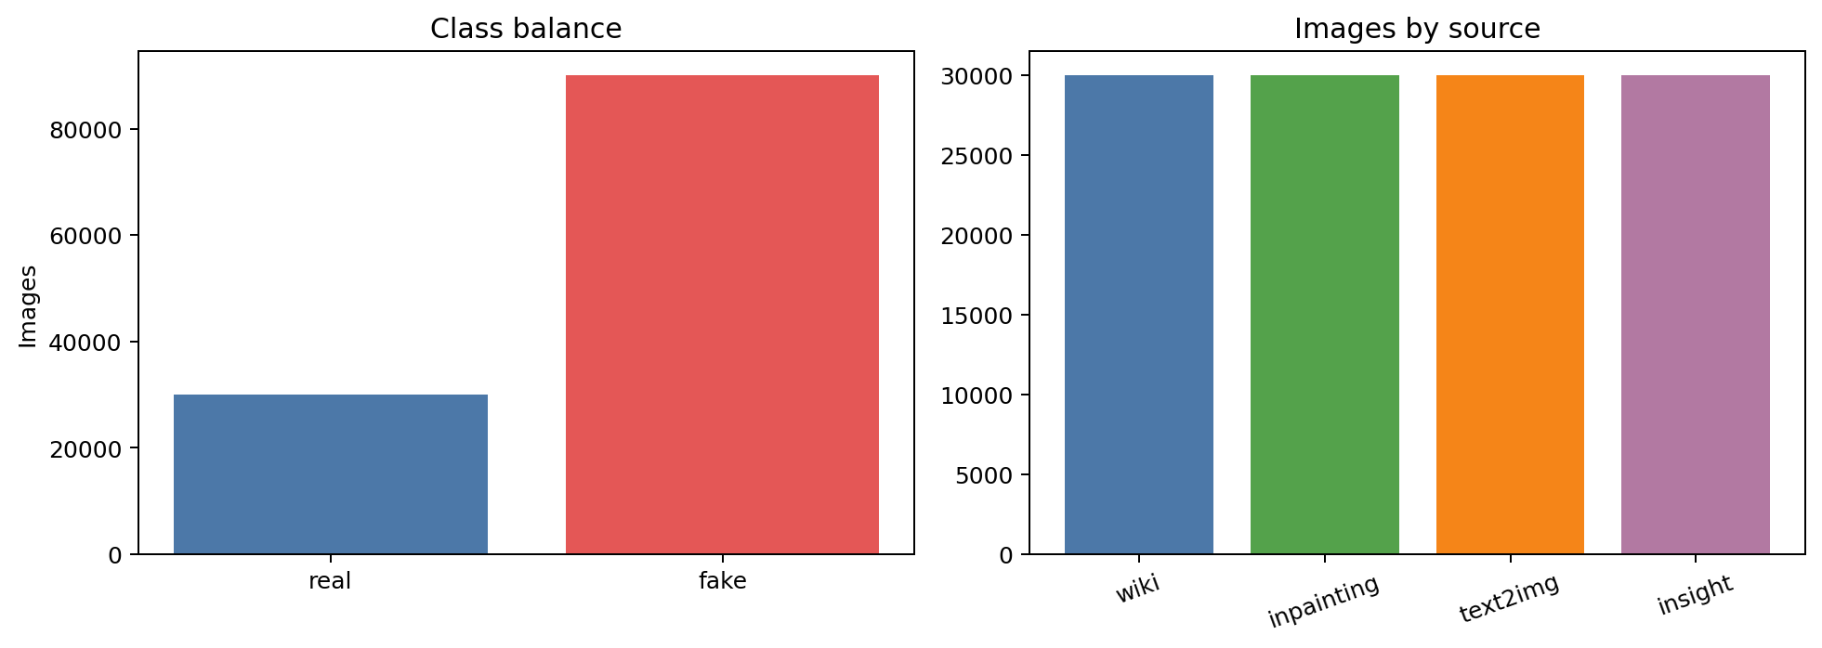
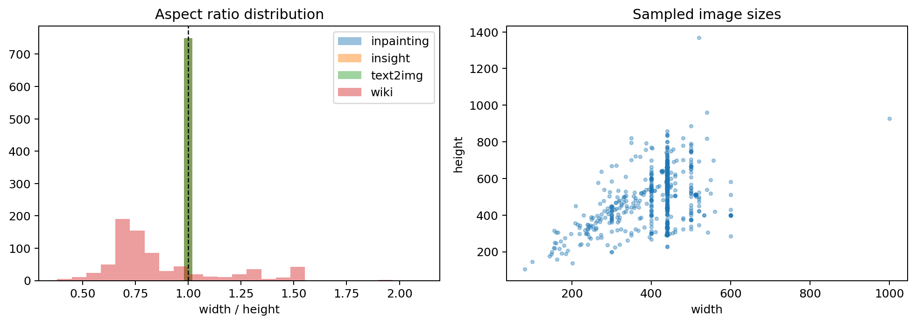
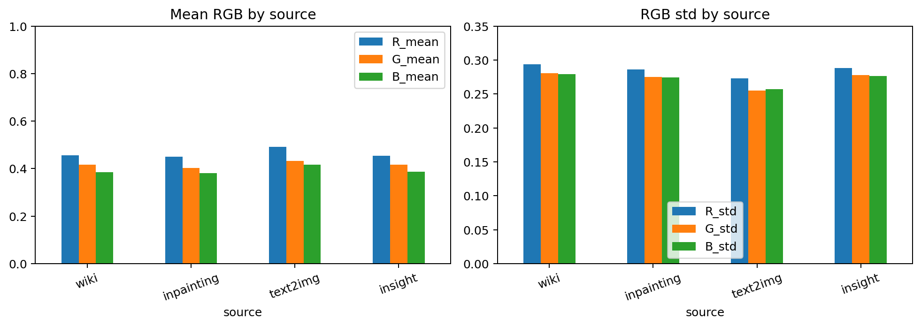
Dataset discovery exposes shortcut risks
Part I - Classifier
EDA purpose
Shortcut risks
• Map sources to labels.
• Check image dimensions and geometry.
• Check color distributions.
• Inspect identities and basenames.
Geometry
Color distribution
Identity / basename leakage
EDA identifies possible shortcuts before model training begins.
6
Notes:
Purpose: show why the EDA matters. Evidence: dataset composition, source samples, dimension profile, and color profile. Conclusion: the classifier might exploit artifacts unless preprocessing controls them. Transition: describe the preprocessing strategy.

Slide 7
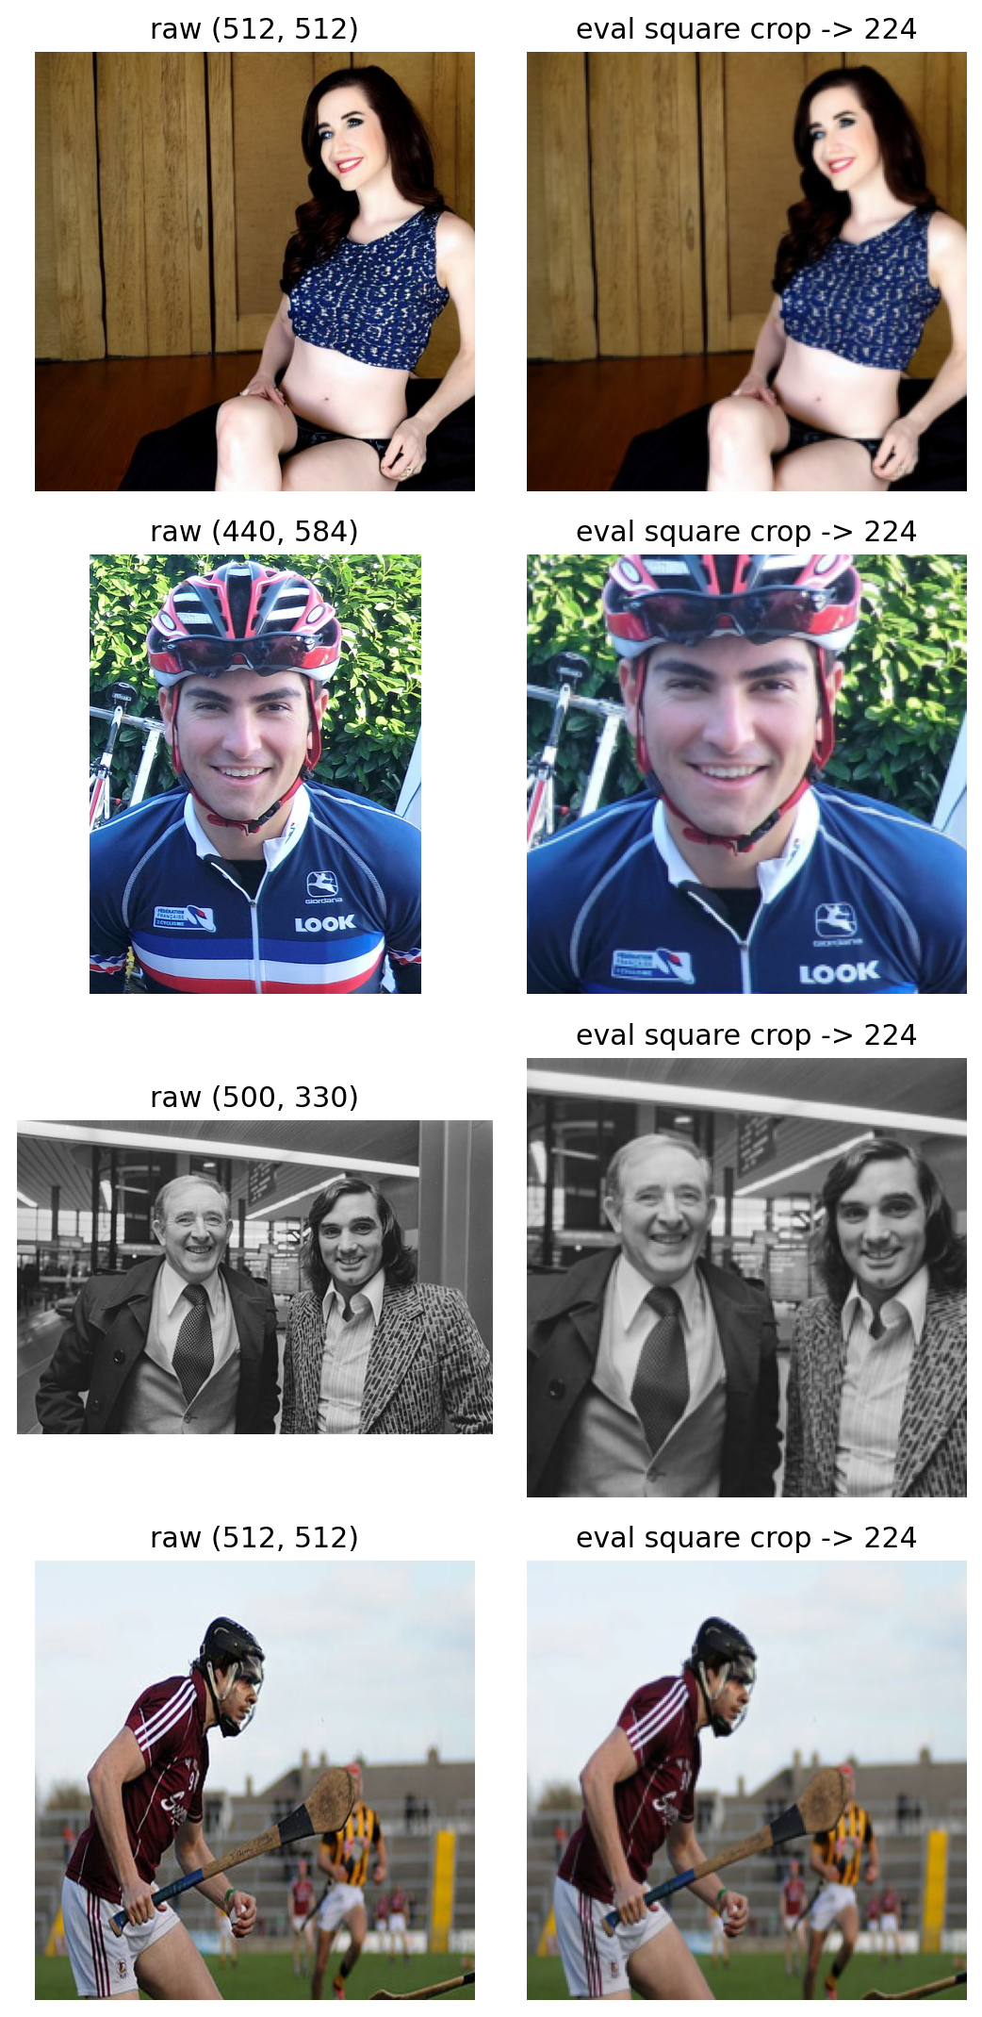
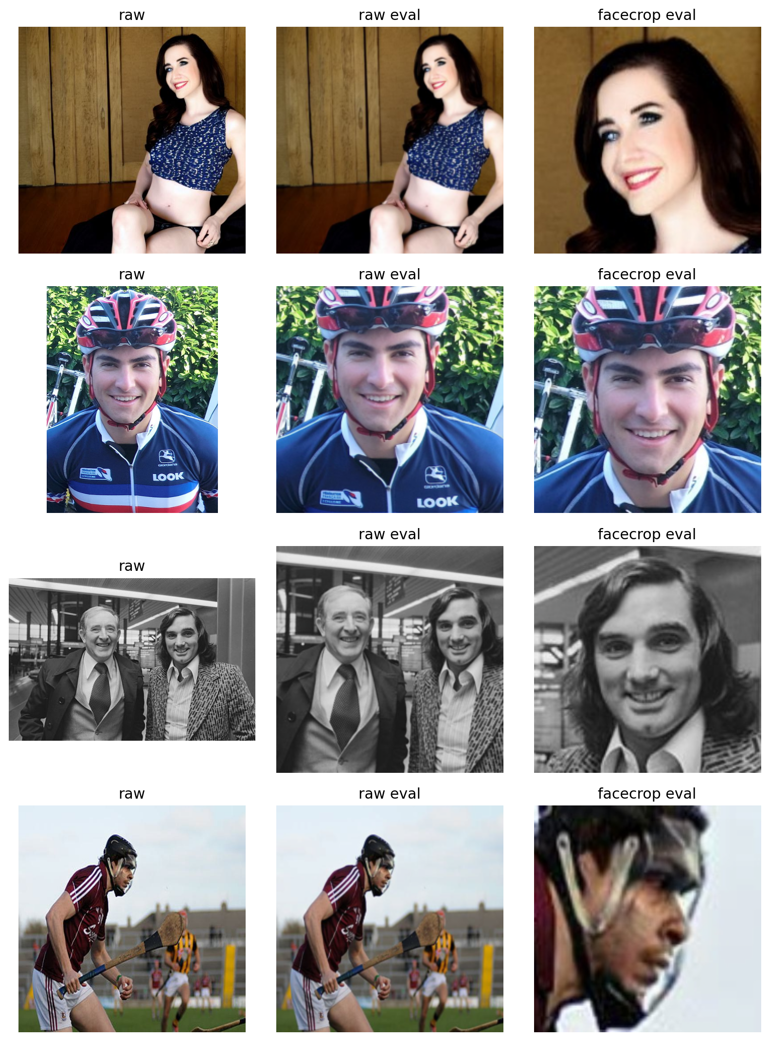
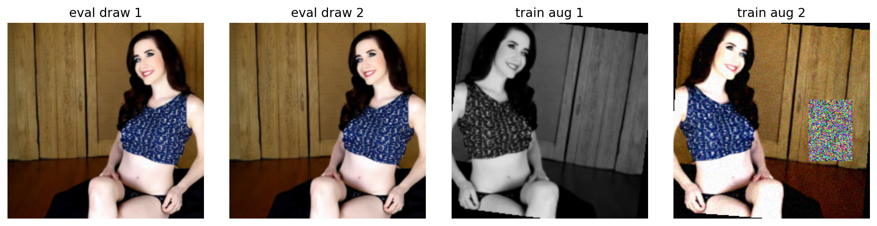
Preprocessing strategy controls the evidence
Part I - Classifier
raw image
square crop
resize
optional
facecrop
train-only
augmentation
normalized
tensor
Facecrop is a source-of-evidence decision, not just a cosmetic step.
7
Notes:
Purpose: explain how preprocessing controls the evidence seen by the model. Evidence: crop, facecrop, and train/eval transform figures. Conclusion: preprocessing decisions determine whether the classifier focuses on faces or artifacts. Transition: examine augmentation as a robustness tool and risk.

Slide 8
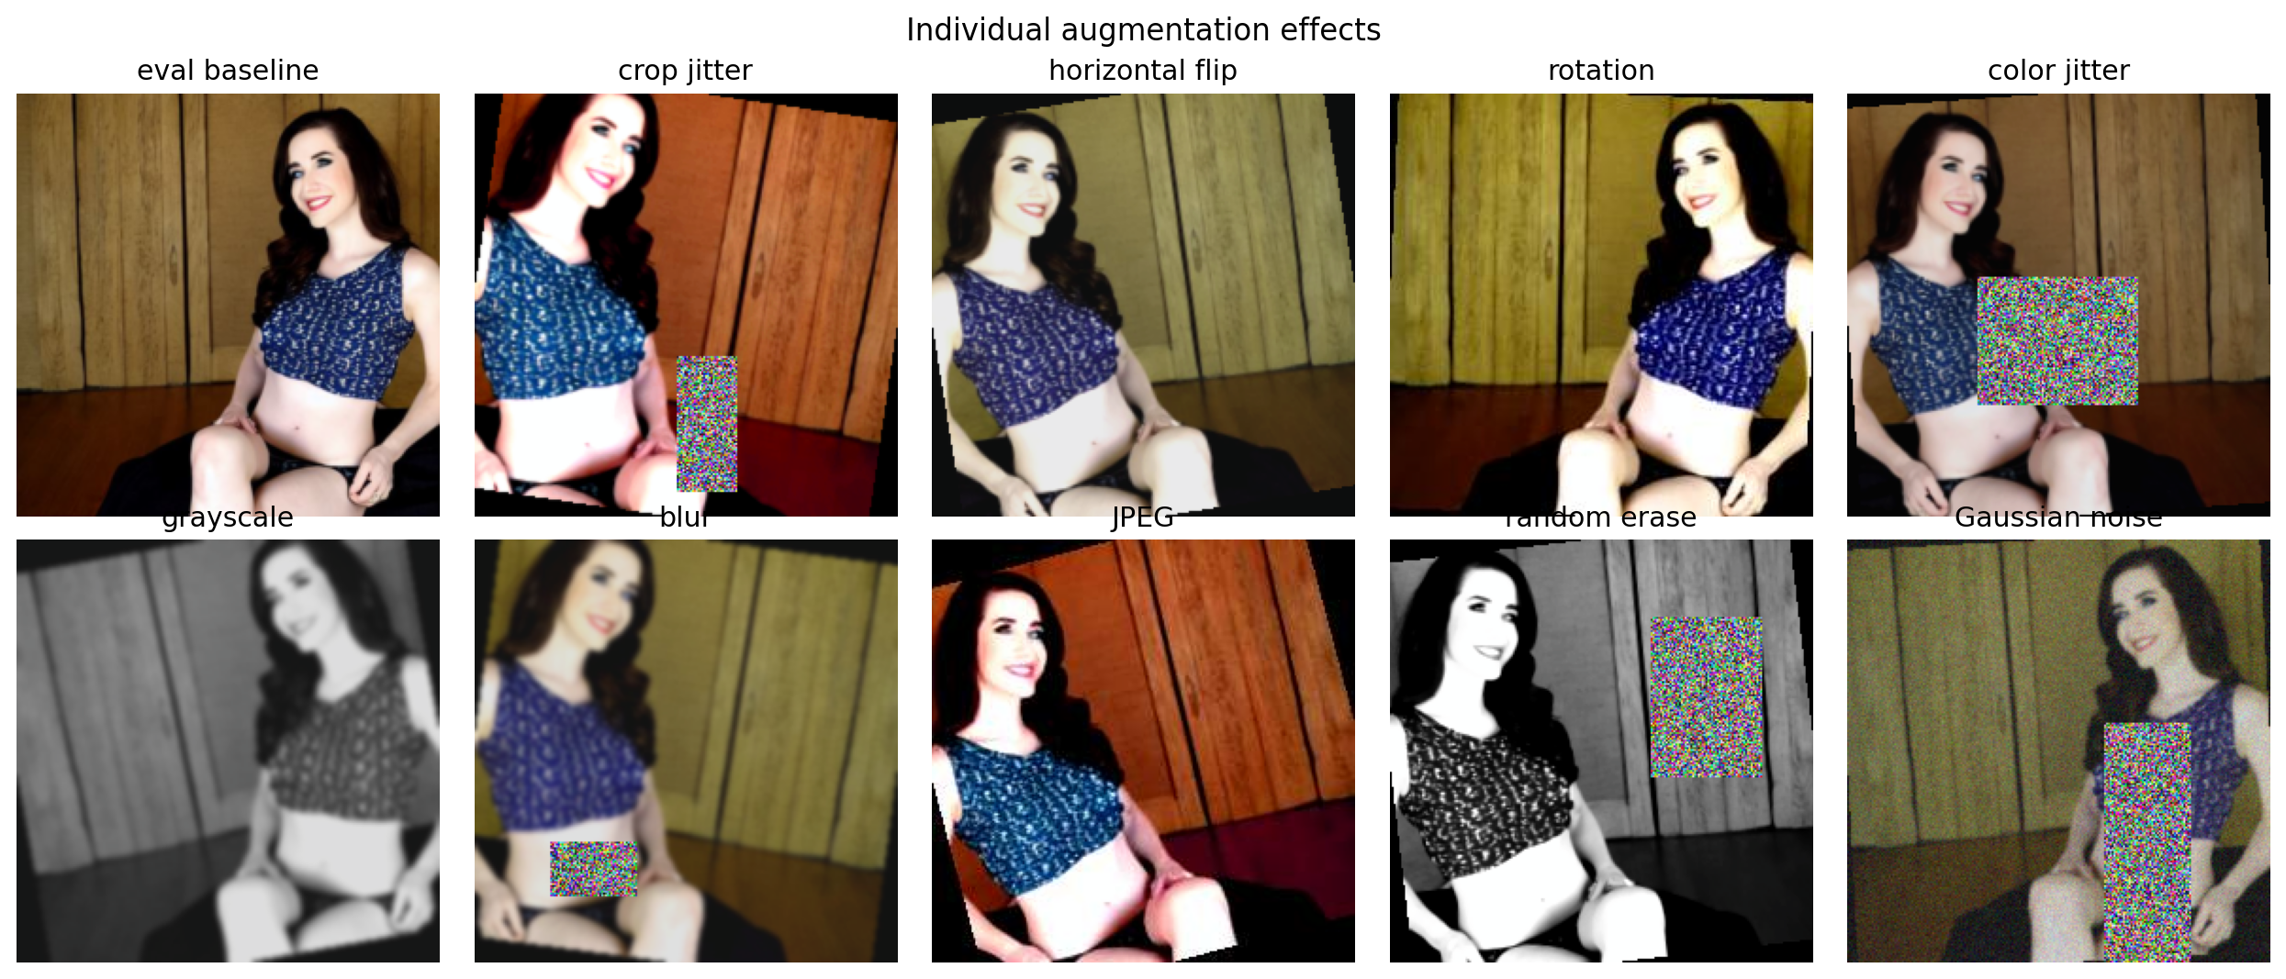
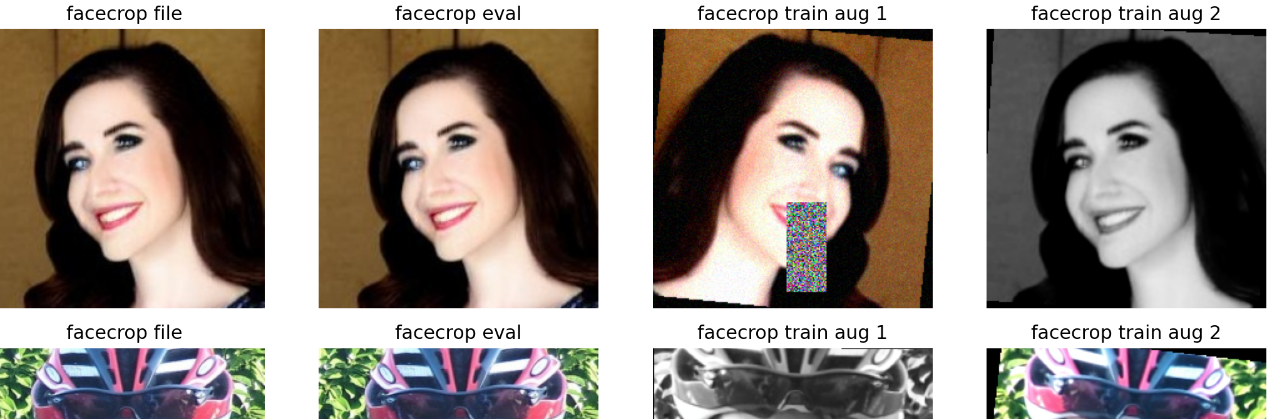
Augmentation helps only if it preserves useful cues
Part I - Classifier
Tested transformations
Risk
• flip
• rotation
• color jitter
• grayscale
• blur
• JPEG recompression
• random erase
• Gaussian noise
• Too much augmentation can remove fake cues.
• Small models can be over-regularized.
• Validation/test must avoid stochastic transforms.
Augmentation is evaluated as an ablation, not assumed to help.
8
Notes:
Purpose: make augmentation a controlled design variable. Evidence: augmentation gallery and facecrop augmentation examples. Conclusion: robustness augmentations must be tested, not assumed. Transition: establish the Phase 1 baseline before ablations.

Slide 9
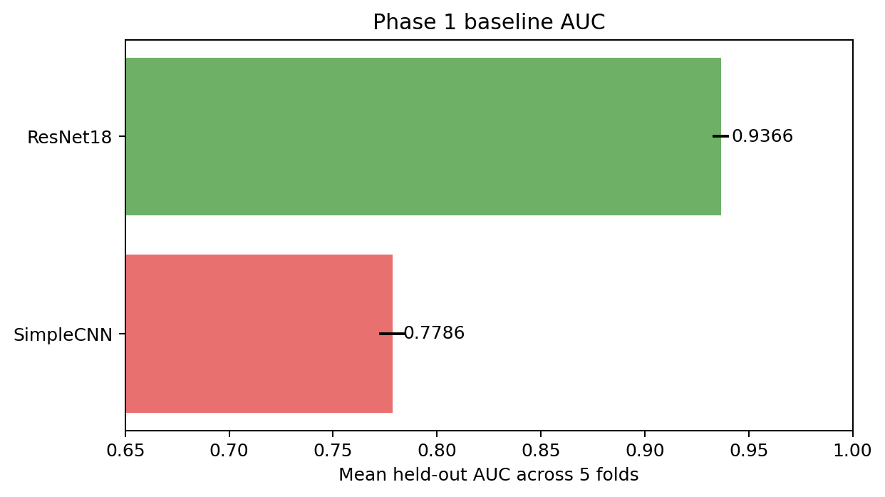
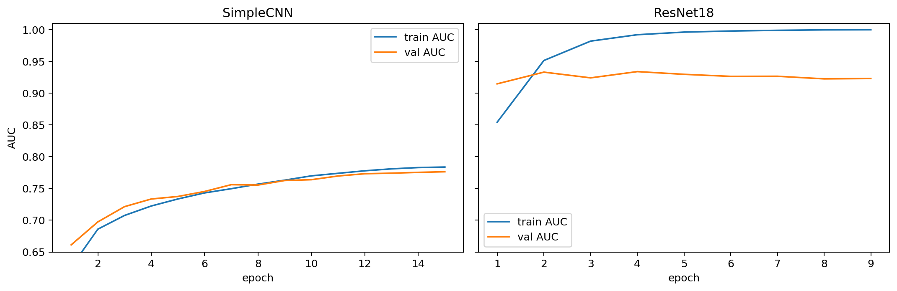
Phase 1 establishes controlled baselines
Part I - Classifier
Model
AUC
Accuracy
F1
SimpleCNN
0.7786
0.7039
0.7801
ResNet18
0.9366
0.8650
0.9073
Protocol
• seed 42
• 5 folds
• batch size 32
• learning rate 1e-4
• weight decay 1e-4
• T_max 15
• patience 5
Pretrained ResNet18 is a much stronger baseline than SimpleCNN.
9
Notes:
Purpose: establish the first controlled baseline. Evidence: five-fold metrics and AUC/training curves from 03_phase1_analysis. Conclusion: pretrained ResNet18 outperforms the simple CNN substantially. Transition: inspect why the baseline choice matters in errors and curves.

Slide 10
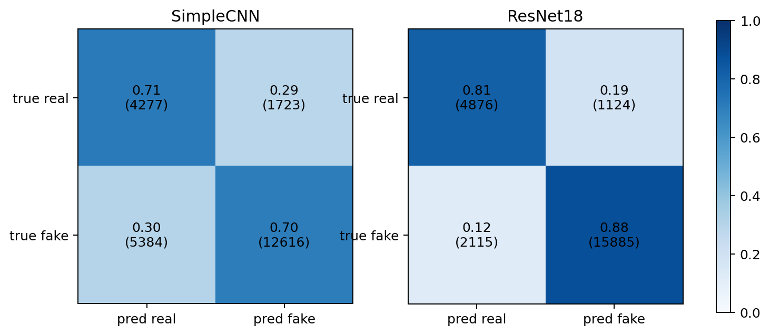
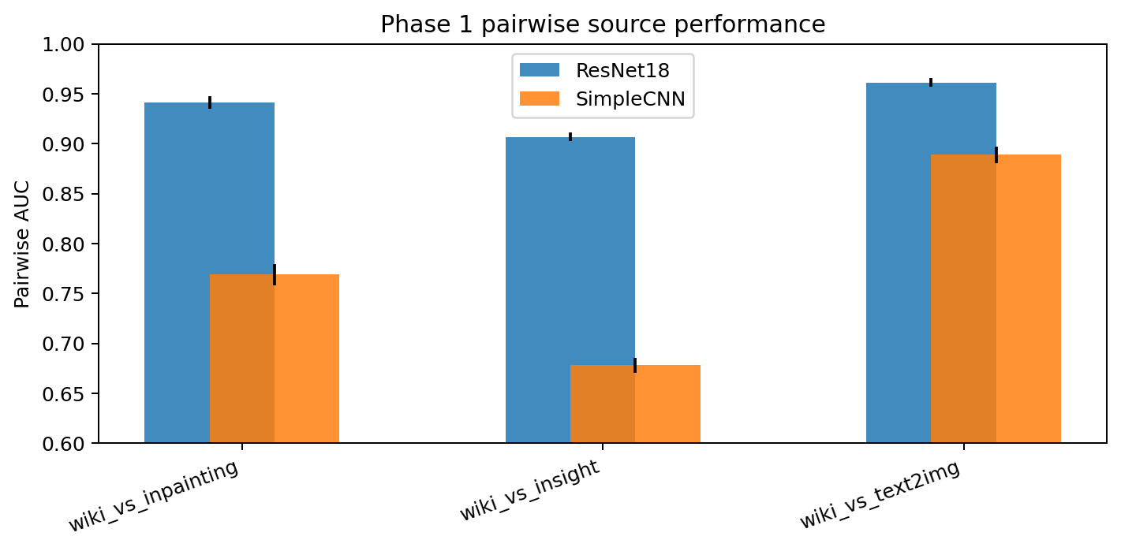
Architecture choice changes the error profile
Part I - Classifier
Readout
• SimpleCNN has limited feature capacity.
• ResNet18 benefits from pretrained visual features.
• ResNet18 reduces false-real and false-fake errors.
• Training curves show fast fitting with validation stabilization.
The baseline is architecture-sensitive, so ablations should start from ResNet18.
10
Notes:
Purpose: interpret the baseline comparison. Evidence: confusion matrices and pairwise AUC. Conclusion: architecture affects both global metrics and the error balance. Transition: use ResNet18 for the controlled Phase 2 ablations.

Slide 11
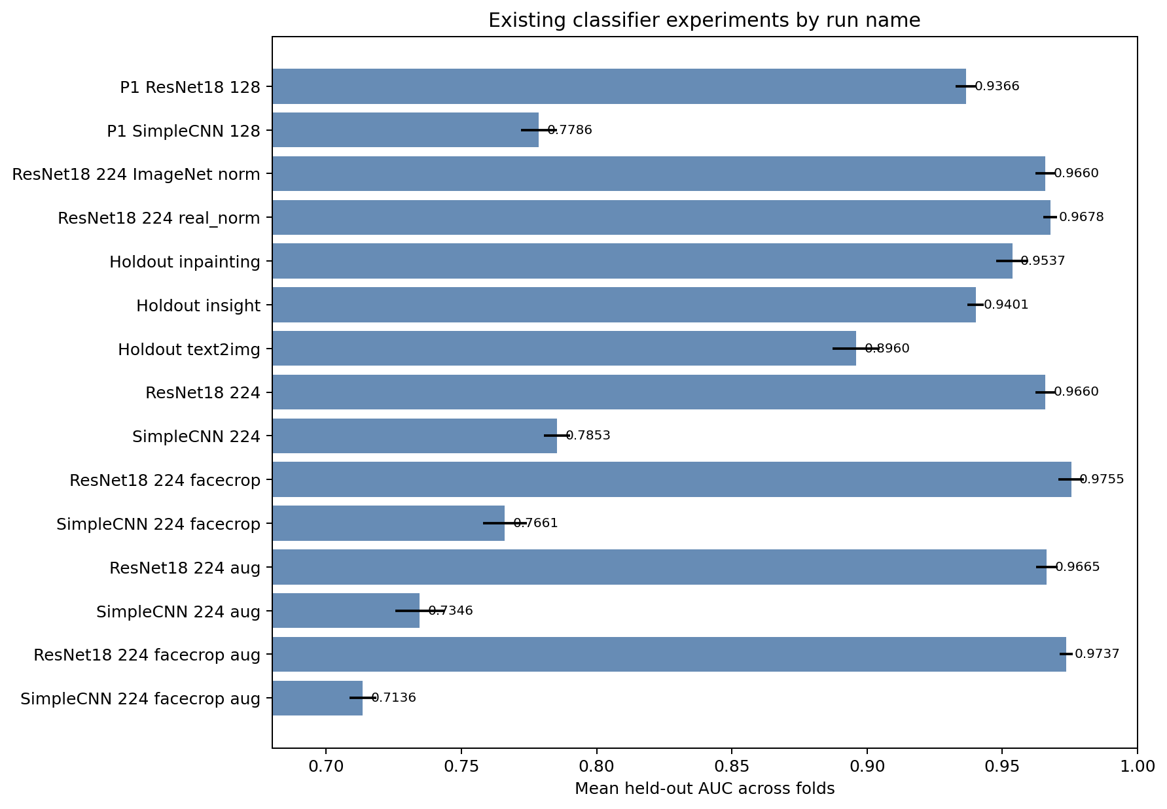
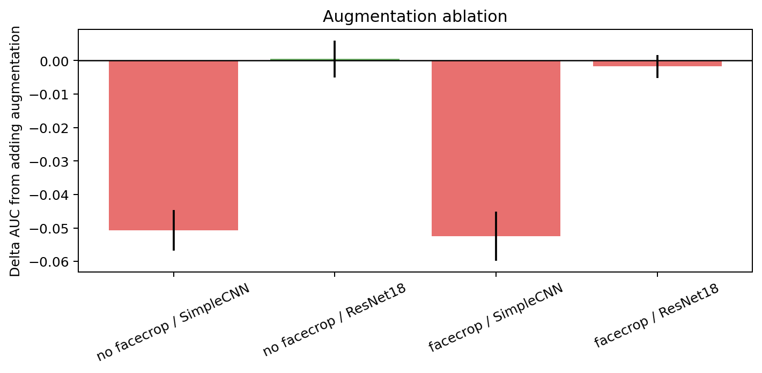
Phase 2 asks targeted ablation questions
Part I - Classifier
224x224 input
Normalization
Source holdouts
Facecrop
Augmentation
Phase 2 turns preprocessing choices into explicit decisions.
11
Notes:
Purpose: introduce Phase 2 as a controlled improvement chapter. Evidence: ranked AUC and augmentation delta figures. Conclusion: each ablation is tied to a design question. Transition: summarize the decisions produced by Phase 2.

Slide 12
Phase 2 decisions lock the classifier pipeline
Part I - Classifier
Choice
Decision
Evidence
Input size
224x224
ResNet18 AUC 0.9366 -> 0.9660
Face crop
Enable
p2c_resnet18_facecrop AUC 0.9755
Augmentation
Disable at 20%
Facecrop+aug AUC 0.9737; SimpleCNN drops
Normalization
ImageNet/default
real-norm only +0.0018 AUC
Source generalization
Report limitation
holdout text2img/insight drops
Best Phase 2 existing run: p2c_resnet18_facecrop, AUC 0.9755.
12
Notes:
Purpose: present the pipeline decisions from Phase 2. Evidence: phase2_story_summary.json and Phase 2 figures. Conclusion: the classifier pipeline moves forward with 224x224 facecrop and default normalization, without augmentation for this setting. Transition: examine the source holdout limitation explicitly.

Slide 13
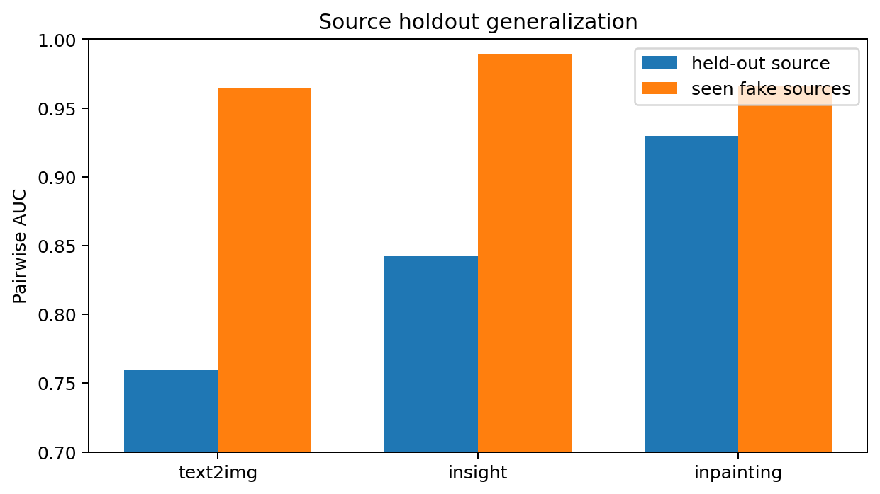
Source holdouts reveal imperfect generalization
Part I - Classifier
Held-out fake source
Pairwise AUC
text2img
0.7595
insight
0.8421
inpainting
0.9296
• Global metrics remain high, but leave-source-out tests are harder.
• Drops show that source-specific cues can still influence decisions.
• This limitation remains in the final classifier story.
High global AUC does not erase the source-generalization limitation.
13
Notes:
Purpose: avoid overstating classifier generalization. Evidence: Phase 2 source holdout results. Conclusion: the classifier can still learn source-specific cues. Transition: use Grad-CAM as qualitative localization evidence.

Slide 14
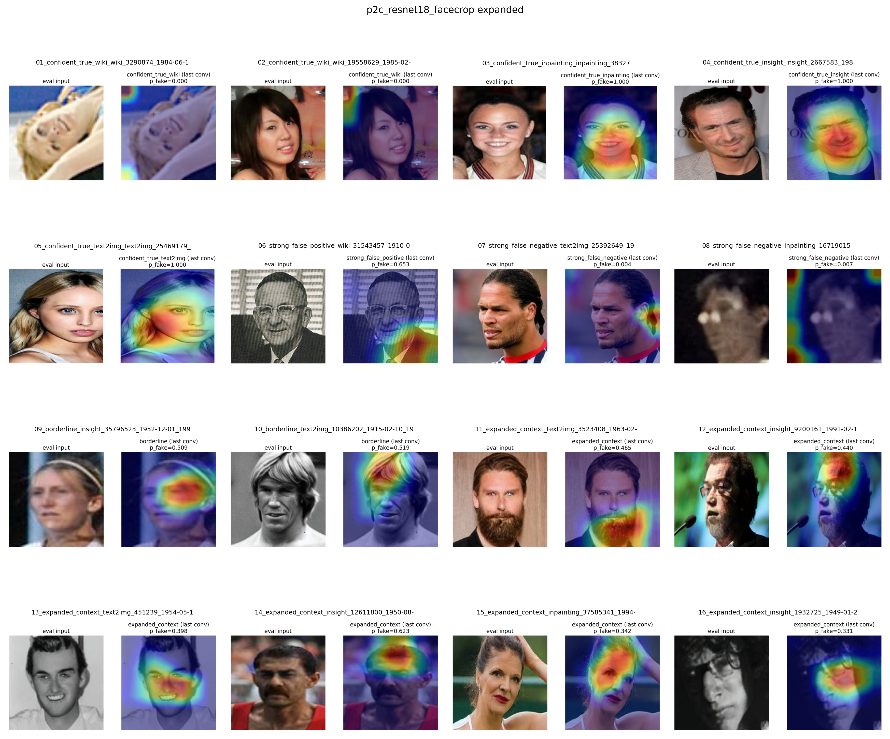
Grad-CAM is qualitative localization evidence
Part I - Classifier
Questions it answers
• Is the model looking near the face?
• Does preprocessing shift attention away from background?
• Do false positives or false negatives expose suspicious cues?
Important constraint
• Grad-CAM does not prove causality.
• It supports interpretability, not a new metric.
Grad-CAM helps diagnose attention, but it is not causal proof.
14
Notes:
Purpose: introduce Grad-CAM correctly. Evidence: final facecrop Grad-CAM panel. Conclusion: attention localization supports diagnosis but not causal claims. Transition: compare Grad-CAM behavior across pipeline stages.

Slide 15
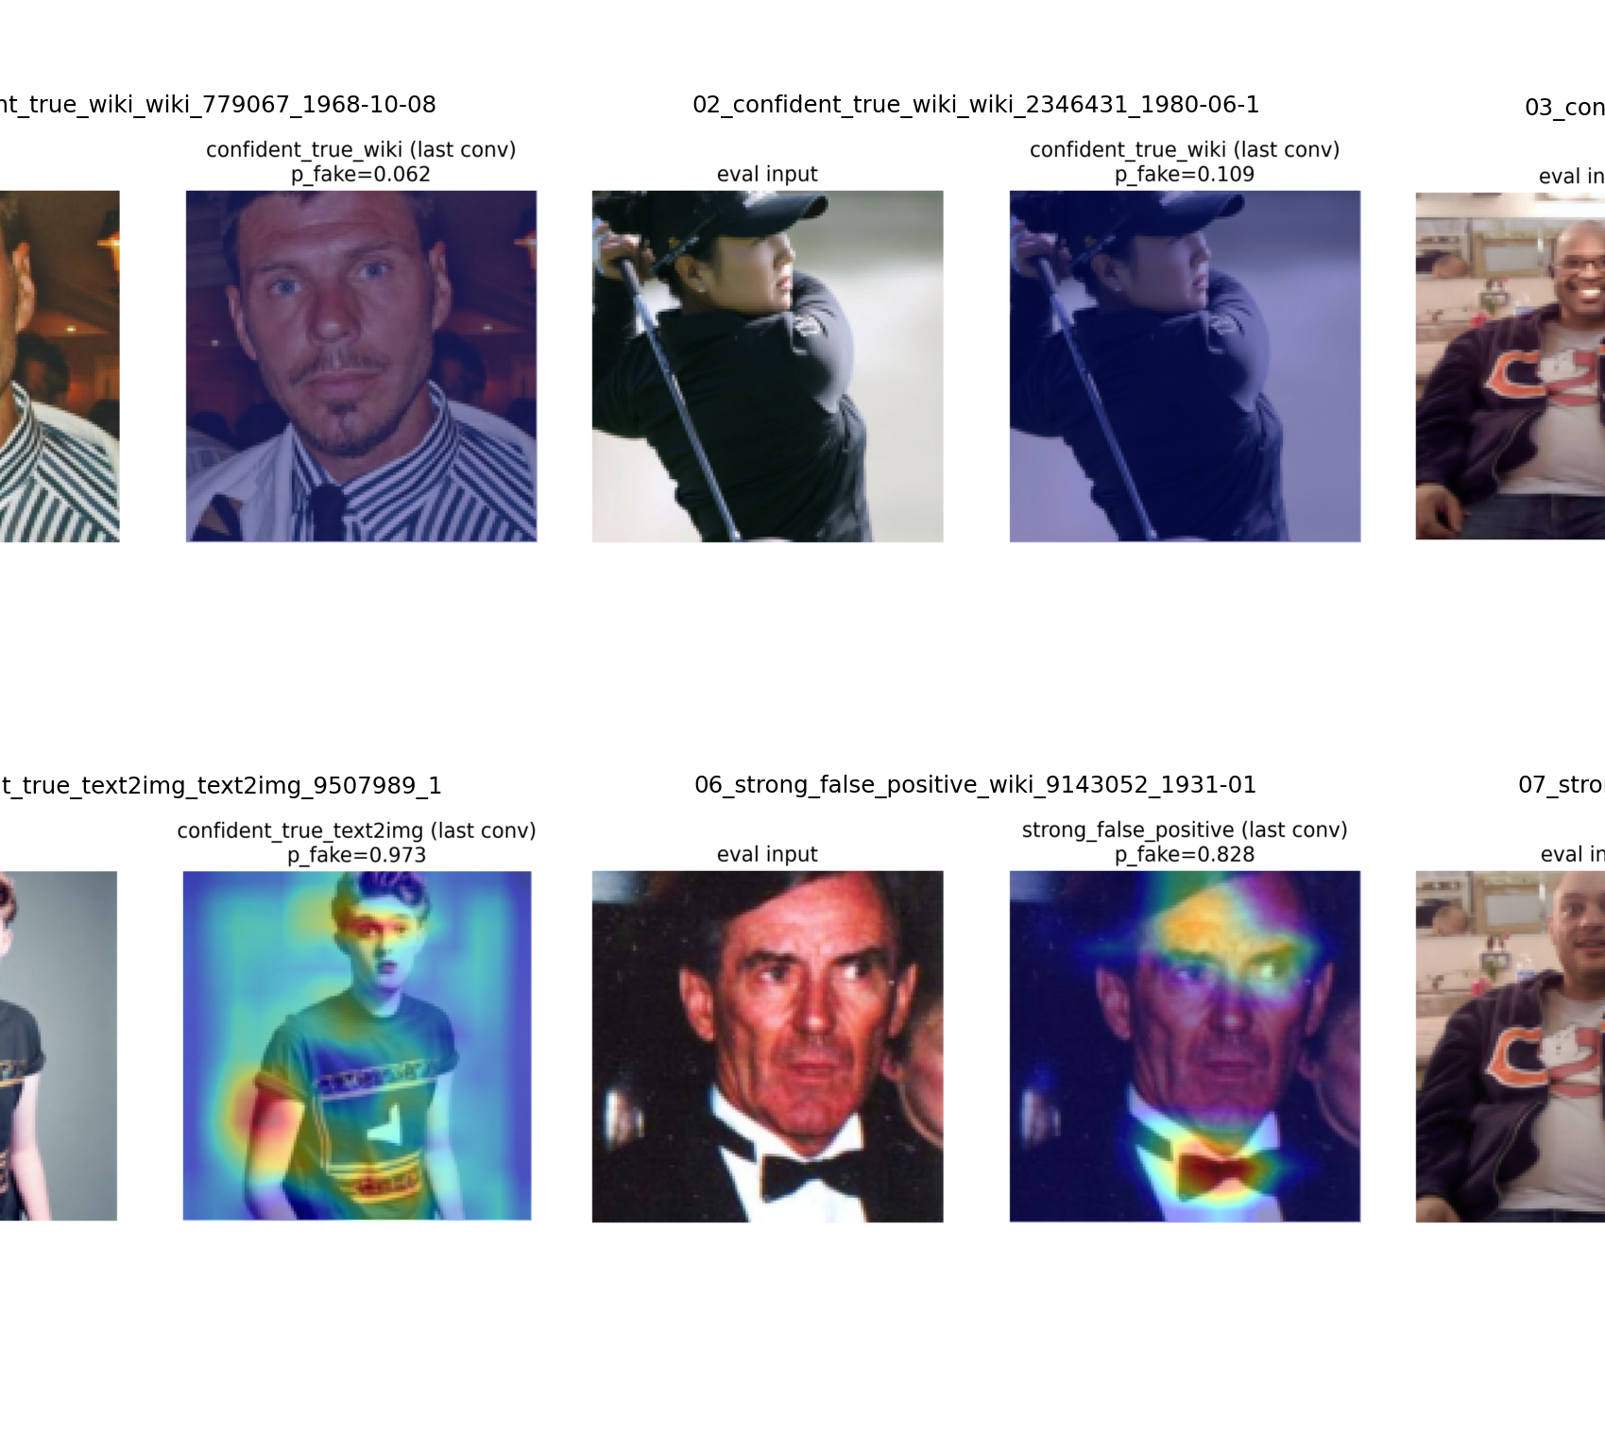
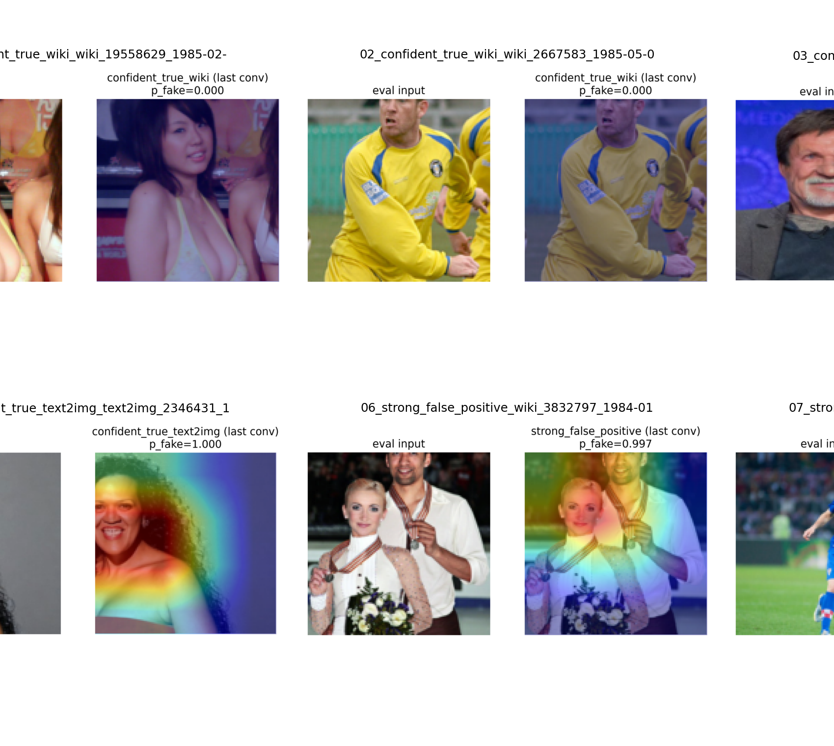
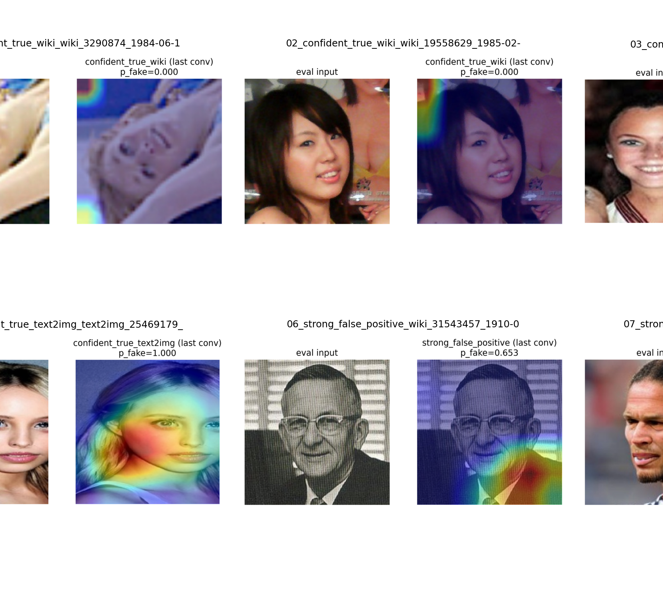
Grad-CAM attention evolves with the pipeline
Part I - Classifier
• Attention appears to move from broad/global artifacts toward face regions as the pipeline improves.
• The source-holdout limitation remains and should not be hidden.
Interpretability supports the preprocessing decision, but not causality.
15
Notes:
Purpose: show qualitative evolution across classifier phases. Evidence: Grad-CAM panels for baseline and improved pipelines. Conclusion: preprocessing appears to focus attention more on face regions, but source generalization remains imperfect. Transition: test whether stronger backbones improve the detector.

Slide 16
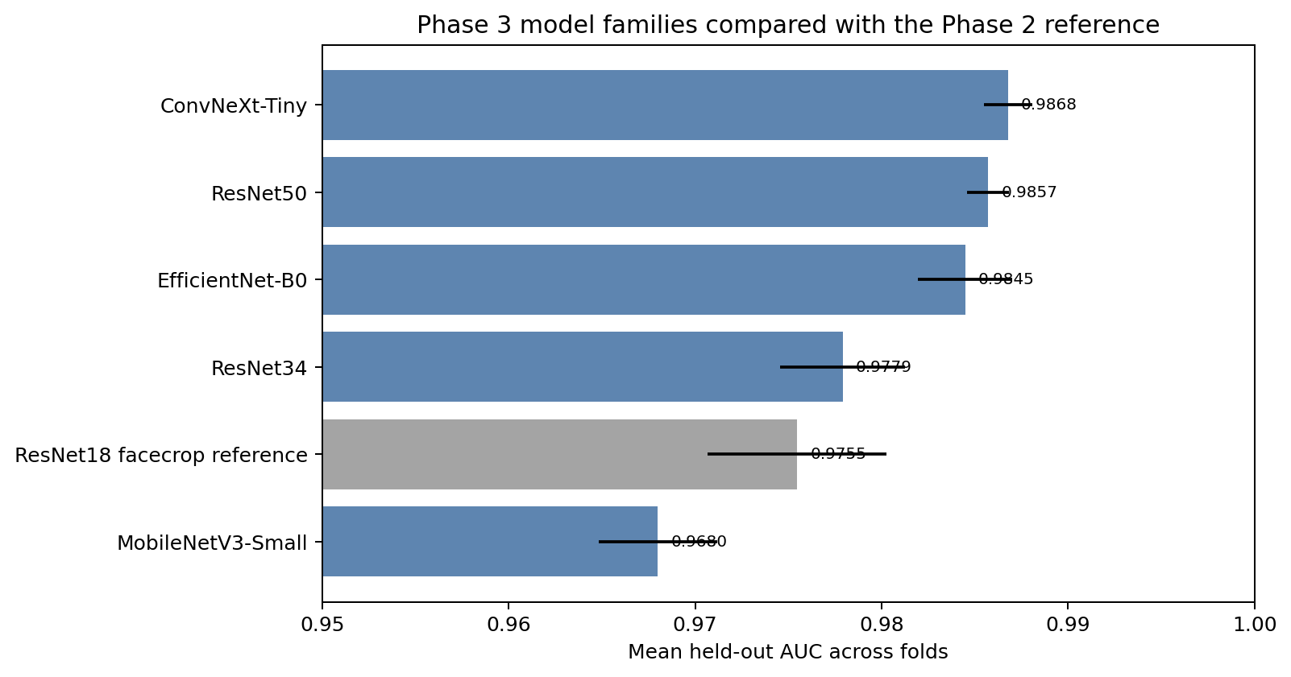
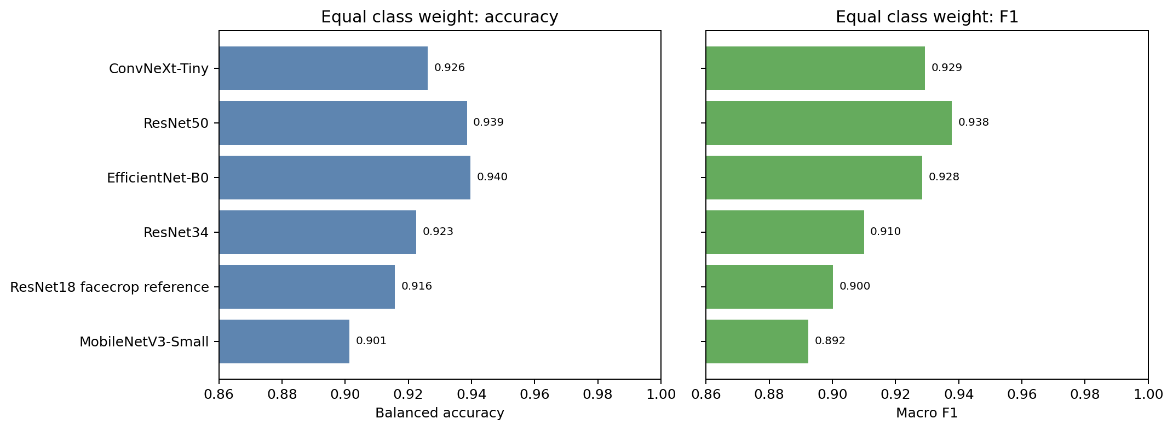
Phase 3 tests stronger pretrained backbones
Part I - Classifier
Compared backbones
• ResNet18 facecrop reference
• ResNet34
• ResNet50
• EfficientNet-B0
• MobileNetV3-Small
• ConvNeXt-Tiny
Question
• Does a stronger pretrained family improve the detector after preprocessing is settled?
Phase 3 separates preprocessing gains from backbone gains.
16
Notes:
Purpose: introduce model-family comparison. Evidence: ranked AUC and balanced metrics figures. Conclusion: after preprocessing is chosen, the next decision is backbone capacity and inductive bias. Transition: summarize the Phase 3 results.

Slide 17
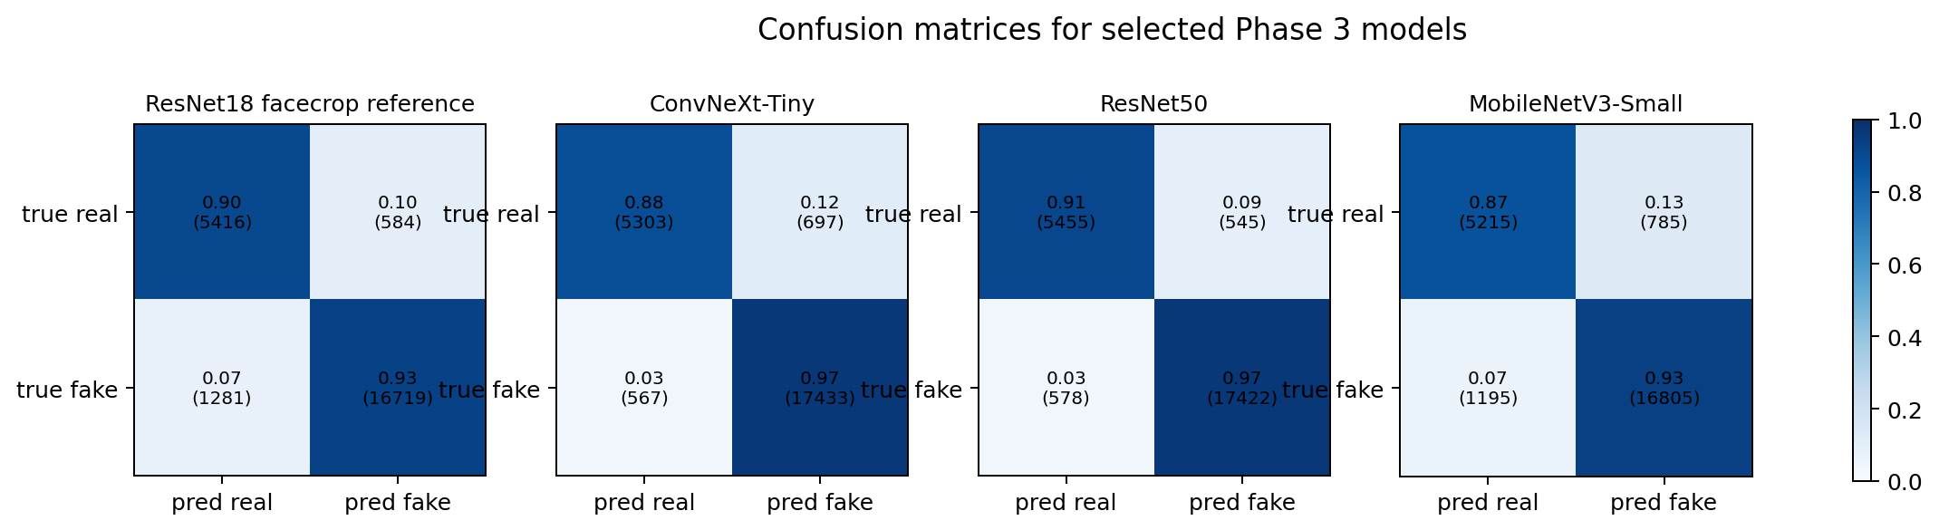
Phase 3 results: ConvNeXt leads AUC, ResNet50 leads Acc/F1
Part I - Classifier
Model
AUC
Accuracy
F1
ConvNeXt-Tiny
0.9868
0.9473
0.9650
ResNet50
0.9857
0.9532
0.9688
EfficientNet-B0
0.9845
0.9450
0.9628
ResNet34
0.9779
0.9305
0.9529
MobileNetV3-Small
0.9680
0.9175
0.9443
Model selection depends on priority: AUC favors ConvNeXt; Acc/F1 favors ResNet50.
17
Notes:
Purpose: present Phase 3 metrics. Evidence: model family table and selected confusion matrices. Conclusion: ConvNeXt has the highest AUC while ResNet50 has the strongest accuracy/F1 profile. Transition: inspect source-wise behavior for the stronger models.

Slide 18
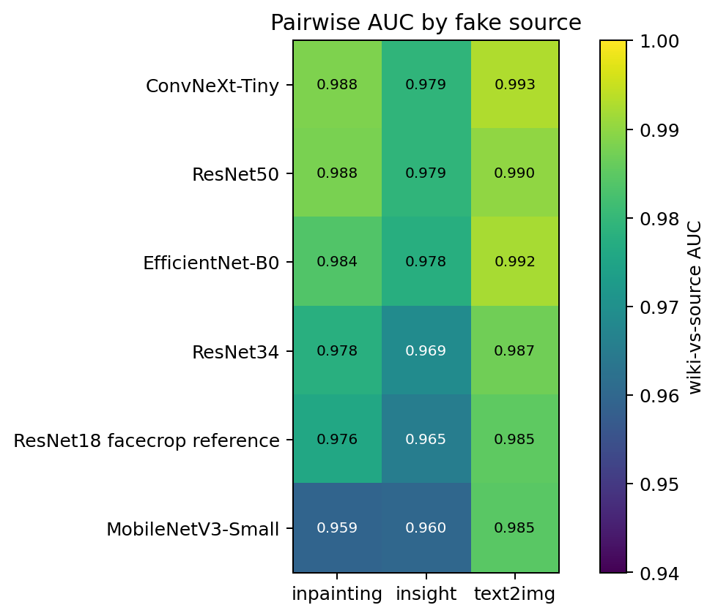
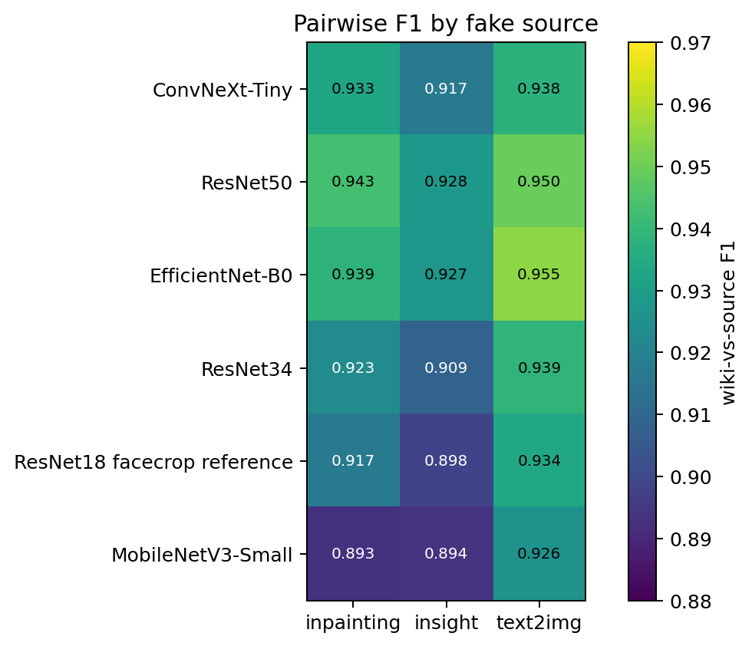
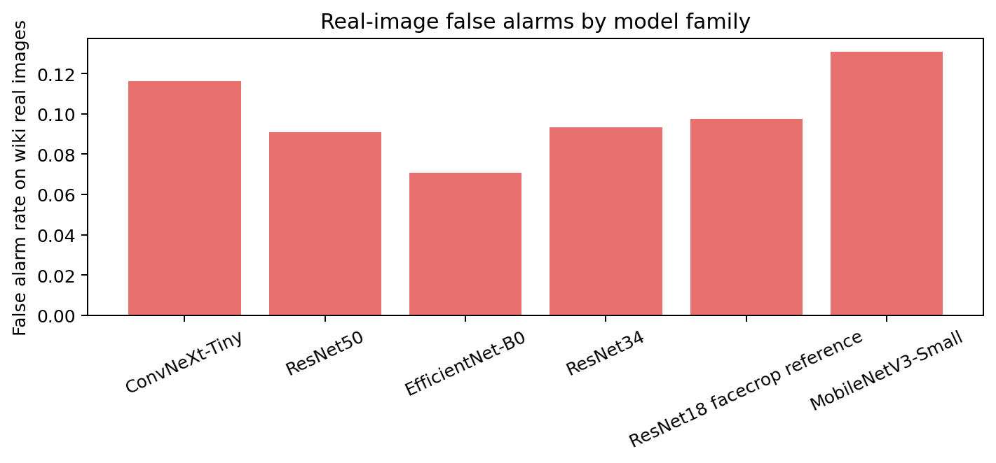
Stronger backbones improve but do not remove source effects
Part I - Classifier
Source behavior improves, but source generalization remains a limitation.
18
Notes:
Purpose: evaluate source-wise behavior after model family changes. Evidence: pairwise AUC/F1 heatmaps and false-alarm diagnostics. Conclusion: stronger backbones reduce some source gaps but do not eliminate the limitation. Transition: test whether more data improves the best families.

Slide 19
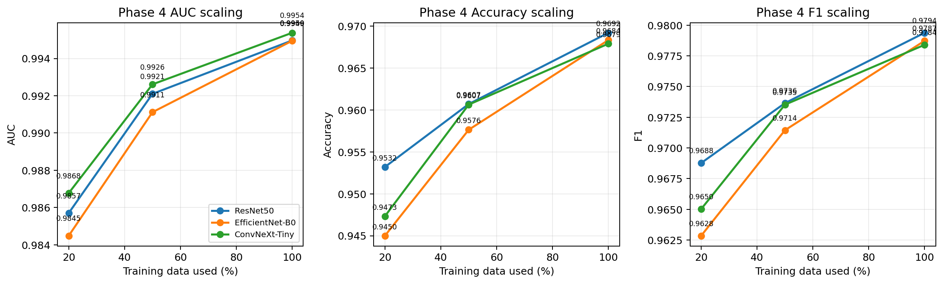
Phase 4 tests whether more data scales the best families
Part I - Classifier
Compared at 50% and 100%
• ResNet50
• EfficientNet-B0
• ConvNeXt-Tiny
Why this matters
• Separates architecture choice from data scale.
• Tests whether Phase 3 conclusions hold with more data.
• Uses Phase 3 20% rows as scaling anchors.
Scaling is a separate experimental question from architecture selection.
19
Notes:
Purpose: introduce data scaling. Evidence: global scaling curves. Conclusion: the strongest backbones need to be evaluated at larger data fractions. Transition: show the 100% data results.

Slide 20
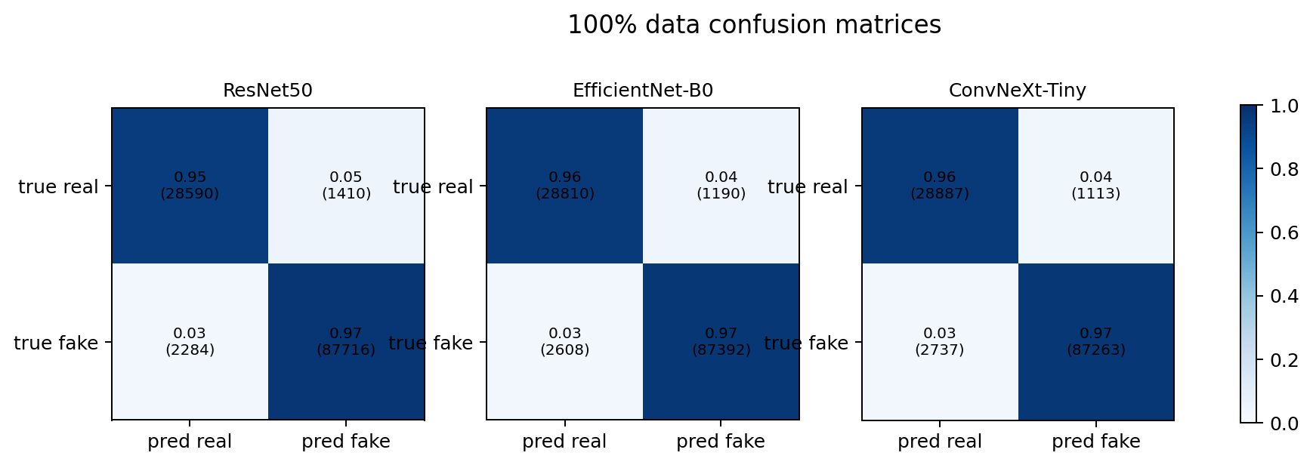
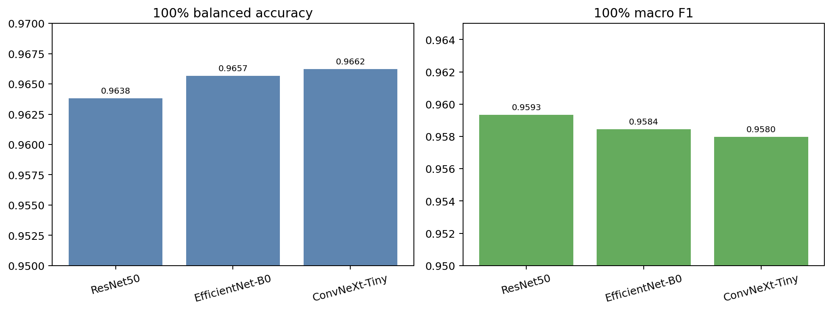
Phase 4 results: all strong backbones scale
Part I - Classifier
100% model
AUC
Accuracy
F1
Balanced Acc
ResNet50
0.9950
0.9692
0.9794
0.9638
EfficientNet-B0
0.9949
0.9684
0.9787
0.9657
ConvNeXt-Tiny
0.9954
0.9679
0.9784
0.9662
ConvNeXt keeps top AUC; ResNet50 keeps top Accuracy/F1; choice depends on operating priority.
20
Notes:
Purpose: present final scaling metrics. Evidence: Phase 4 logs and 100% figures. Conclusion: all strong backbones improve with scale; ConvNeXt leads AUC and balanced accuracy, while ResNet50 leads accuracy/F1. Transition: make the final classifier decision with the source-truth nuance.

Slide 21
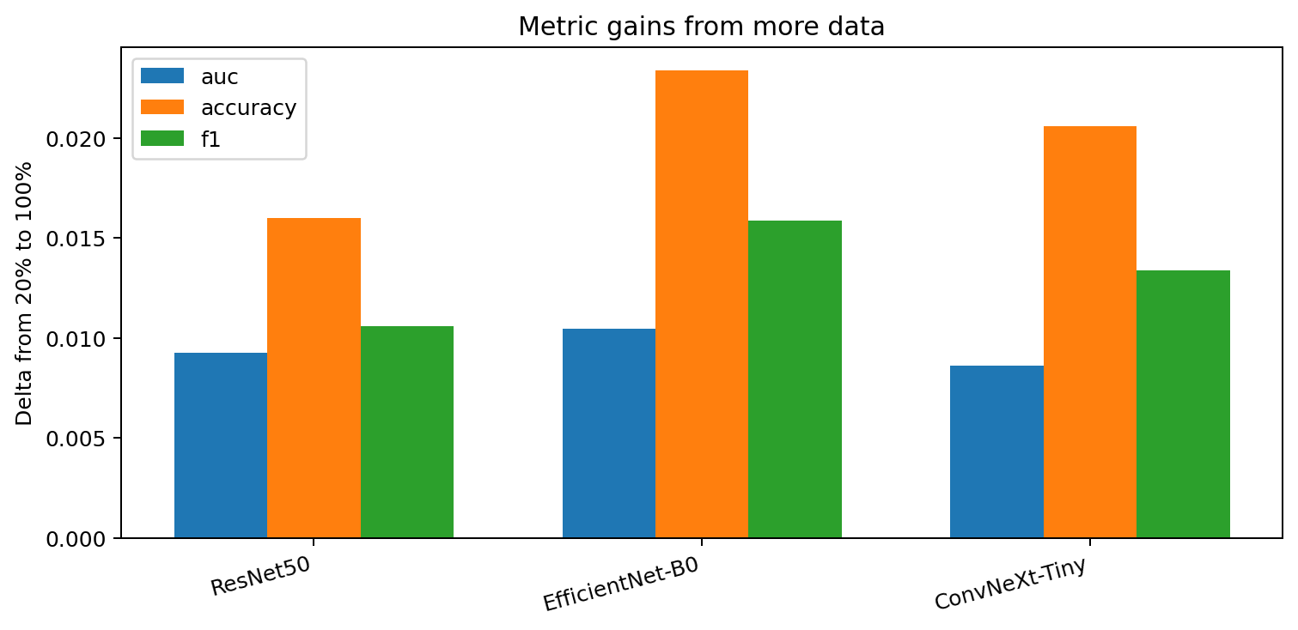
Final classifier decision depends on the operating target
Part I - Classifier
Priority
Selected model
Reason
Highest AUC / balanced accuracy
ConvNeXt-Tiny 100%
AUC 0.9954; balanced accuracy 0.9662
Highest Accuracy / F1
ResNet50 100%
Accuracy 0.9692; F1 0.9794
Locked pipeline choices
• 224x224 input
• facecrop enabled
• ImageNet/default normalization
• augmentation disabled for this setting
• source generalization reported as limitation
Best ResNet50 result: AUC 0.9950, accuracy 0.9692, F1 0.9794.
21
Notes:
Purpose: state the final classifier decision without hiding the source-truth nuance. Evidence: Phase 4 story summary and logs. Conclusion: ConvNeXt is best for AUC/balanced accuracy, while ResNet50 is best for accuracy/F1 and is reported as the practical ResNet-family result. Transition: move to the generator branch.

Slide 22
Part II - Generator
Phase 0 sanity check -> Phase 1 pipeline lock-in -> GAN/VAE/DDPM branches -> final comparison -> showcase
Notes:
Purpose: introduce the Part II - Generator section. Evidence: this section groups the relevant notebooks and outputs. Conclusion: the next slides walk through the experimental decisions. Transition: begin with the section goal.

Slide 23
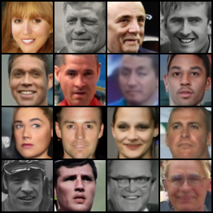
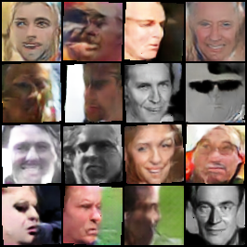
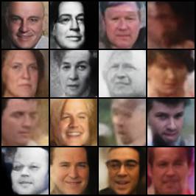
Generator goal
Part II - Generator
real face dataset
generative model
synthetic faces
Evaluation evidence
• sample grids
• training progression
• FID
• quality versus speed
• final selected samples
The generator branch optimizes sample quality, speed, and stability.
23
Notes:
Purpose: introduce the generator branch. Evidence: final sample grids and evaluation criteria. Conclusion: generator decisions use both quantitative FID and qualitative grids. Transition: show how the generator phases branch after pipeline selection.

Slide 24
Generator roadmap with parallel branches
Part II - Generator
Phase 0
baseline sanity check
Phase 1
pipeline selection
Phase 2
GAN progression
Phase 3
VAE progression
Phase 4
DDPM progression
Phase 5
final family comparison
Phase 6
selected sample showcase
24
Notes:
Purpose: make the branch structure explicit. Evidence: the generator notebooks are organized as a pipeline selection followed by three parallel model-family branches. Conclusion: GAN, VAE, and DDPM are not sequential improvements over each other; they are parallel forks after Phase 1. Transition: start with Phase 0 baseline sanity checks.

Slide 25
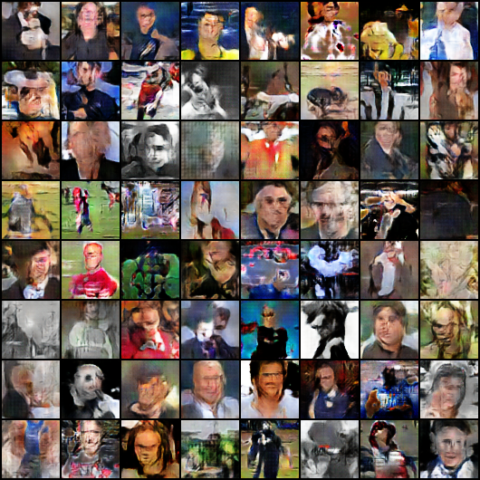
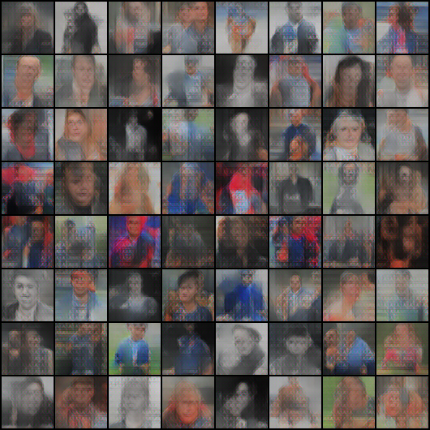
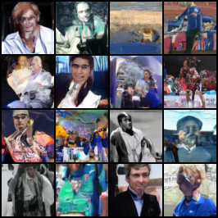
Phase 0 sanity check: loops work, data is the bottleneck
Part II - Generator
• Raw or weakly aligned images.
• Minimal WGAN, VAE, and DDPM training loops.
• No FID tracked in Phase 0; evidence is loss behavior and rough grids.
Training loops work, but raw data quality is the bottleneck.
25
Notes:
Purpose: summarize Phase 0 sanity checks. Evidence: saved sample grids from p0_wgan, p0_vae, and p0_ddpm. Conclusion: the model loops run, but data preparation limits quality. Transition: fix the pipeline before comparing model families.

Slide 26


Phase 1 selects the data pipeline
Part II - Generator
Ablation
Options tested
Resolution
64x64 vs 128x128
Alignment
raw/full vs MTCNN-aligned
Augmentation
hflip/full augmentation variants
Dataset mixing
aligned-only vs combined
Key result and decision
• p1c_dcgan_full_aug FID@50 = 33.4.
• Phase 1 remains a proxy comparison.
• Decision: MTCNN-aligned crops, 64x64, aligned-only, family-specific augmentation.
Pipeline quality is selected before model-family comparison.
26
Notes:
Purpose: show why Phase 1 exists. Evidence: Phase 1 logs and sample grids. Conclusion: data alignment and pipeline choices are decided before model families are compared. Transition: explain why alignment matters.

Slide 27
Alignment reduces variance the model should not learn
Part II - Generator
MTCNN-aligned
crops
Alignment lets capacity go to faces rather than framing, pose, and scale variance.
27
Notes:
Purpose: explain the main pipeline lever. Evidence: raw/full and aligned sample grids. Conclusion: alignment is the strongest pipeline decision because it reduces nuisance variance. Transition: once the pipeline is locked, the generator branches fork.

Slide 28
Three parallel generator branches
Part II - Generator
Locked pipeline
from Phase 1
GAN
adversarial generation
and stability
VAE
latent representation
and composite losses
DDPM
iterative denoising
and sample quality
Phases 2, 3, and 4 are forks after pipeline selection, not sequential replacements.
28
Notes:
Purpose: make the parallel-branch structure explicit before diving into details. Evidence: Phase 2, Phase 3, and Phase 4 notebooks are separate family progressions. Conclusion: comparisons across branches happen only later in Phase 5. Transition: begin with the GAN branch.

Slide 29
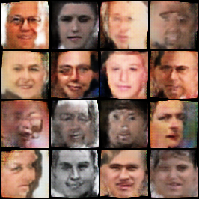
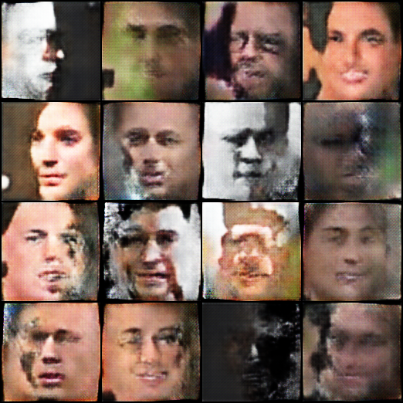
GAN branch: stability package is the breakthrough
Part II - Generator
GAN recipe
Best FID
Progression
• 2.1 DCGAN baseline
• 2.2 WGAN-GP
• 2.3 spectral norm + GroupNorm + self-attention
• 2.4 stabilized recipe at 128x128
DCGAN baseline
429.3
WGAN-GP
421.3
+ SN + GroupNorm + Attention
110.1
128x128 same recipe
186.0
Changing the objective alone was not enough; stabilization changed the outcome.
29
Notes:
Purpose: summarize the GAN branch. Evidence: Phase 2 logs and sample grids. Conclusion: the key improvement is the stabilization package rather than only changing the objective. Transition: inspect visual progression including collapsed gray grids.

Slide 30

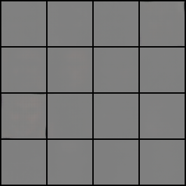
GAN grids show collapse before stabilization
Part II - Generator
• Gray grids in early GAN runs are actual saved outputs, not missing images.
• The selected GAN recipe is 64x64 WGAN-GP + spectral norm + GroupNorm + self-attention.
The selected GAN recipe is the stabilized 64x64 branch.
30
Notes:
Purpose: show the visual evidence behind the GAN decision. Evidence: four Phase 2 GAN grids. Conclusion: GAN quality improves after stabilization; early gray grids are part of the negative result. Transition: move to the VAE branch.

Slide 31
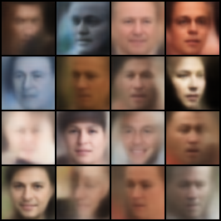
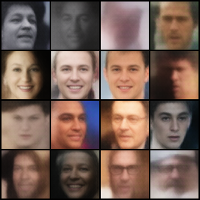
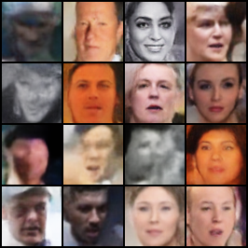
VAE branch: perceptual and adversarial losses add detail
Part II - Generator
VAE recipe
Best FID
Progression
• Baseline optimizes reconstruction and KL.
• Perceptual loss targets visual similarity.
• PatchGAN adds local adversarial detail.
MSE + KL
88.4
+ perceptual loss
68.2
+ PatchGAN adversarial loss
50.1
Perceptual and adversarial losses are complementary.
31
Notes:
Purpose: summarize the VAE branch. Evidence: Phase 3 logs and sample grids. Conclusion: perceptual and adversarial losses improve FID relative to the baseline VAE. Transition: compare prior samples and reconstructions.

Slide 32
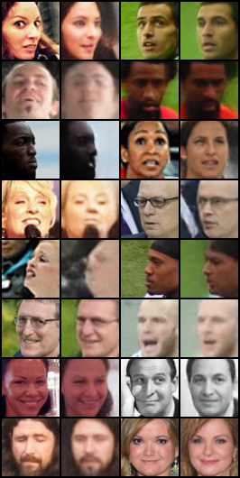
VAE visuals: fast and stable, but smoother
Part II - Generator
• VAE training is stable and fast.
• Generated faces remain smoother than GAN/DDPM samples.
• Best suited for reconstruction and prototyping rather than final sample quality.
VAE is the fastest/prototyping branch, not the final quality winner.
32
Notes:
Purpose: provide qualitative context for VAE results. Evidence: prior samples and reconstruction grids. Conclusion: VAE is useful for stable latent representation and prototyping but not best final quality. Transition: move to the DDPM branch.

Slide 33
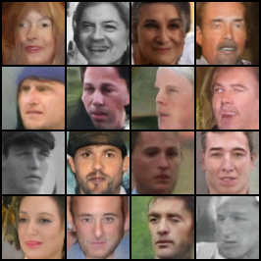
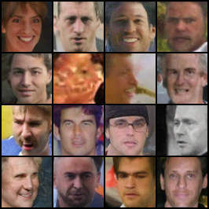
DDPM branch: v-prediction is the major gain
Part II - Generator
DDPM recipe
Best FID
Progression
linear / epsilon
134.5
• linear schedule + epsilon prediction
• cosine schedule
• v-prediction
• wider backbone
cosine / epsilon
132.3
cosine / v-prediction
34.5
wider DDPM
30.0
Width helps after the schedule and target are improved.
33
Notes:
Purpose: summarize DDPM progression. Evidence: Phase 4 logs and sample grids. Conclusion: v-prediction is the largest gain, then width helps further. Transition: clarify how to read DDPM grids.

Slide 34
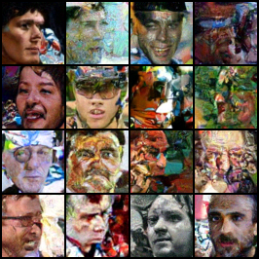
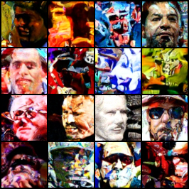
DDPM grids show distribution-level improvement
Part II - Generator
• DDPM samples are generated from stochastic reverse diffusion.
• Unlike GAN/VAE previews with fixed latent codes, DDPM grids can show fresh samples at each checkpoint unless exact noise is fixed and stored.
• Therefore, progression shows distribution-level improvement, not the same identities being refined.
Do not interpret DDPM progression as the same faces improving over time.
34
Notes:
Purpose: prevent a common DDPM interpretation error. Evidence: DDPM sample grids across variants. Conclusion: sample grids show distribution-level quality trends, not same-identity refinement. Transition: reunite all branches in the final comparison.

Slide 35
Phase 5 reunites the three generator families
Part II - Generator
GAN
WGAN-GP + SN +
GroupNorm + attention
VAE
MSE + KL + perceptual
+ PatchGAN
DDPM
cosine + v-prediction
+ wider U-Net
Phase 5
final cross-family comparison
• FID and training time are compared only for the final recipes.
• Final grids provide qualitative evidence alongside FID.
Only Phase 5 is the final cross-family comparison.
35
Notes:
Purpose: show where the generator branches reunite. Evidence: Phase 5 final recipes. Conclusion: cross-family conclusions are based on final recipes, not intermediate branch results. Transition: present final Phase 5 metrics.

Slide 36
Final generator metrics: DDPM wins quality
Part II - Generator
Family
Best FID
Train time
Decision readout
DDPM
19.0
667.1 min
• Best quality: DDPM.
• Best quality/speed compromise: GAN.
• Fastest/prototyping: VAE.
GAN
22.0
316.9 min
VAE
46.2
50.2 min
DDPM has the best FID; GAN is close with roughly half the training time.
36
Notes:
Purpose: present final cross-family metrics. Evidence: Phase 5 logs. Conclusion: DDPM wins quality, GAN is the best speed-quality compromise, and VAE is fastest. Transition: visualize the quality-versus-speed tradeoff.

Slide 37
Quality versus speed separates the use cases
Part II - Generator
FID lower is better
DDPM
19.0 / 667.1m
GAN
22.0 / 316.9m
VAE
46.2 / 50.2m
Readout
• DDPM wins FID.
• GAN is close at lower cost.
• VAE is fastest but lower quality.
training time
Model family choice depends on whether quality or training cost is prioritized.
37
Notes:
Purpose: visualize the Phase 5 tradeoff. Evidence: FID and train time from Phase 5 logs. Conclusion: DDPM is best for quality, GAN is close with less time, and VAE is fastest. Transition: show final sample grids for qualitative evidence.

Slide 38
Final sample grids provide qualitative evidence
Part II - Generator
• FID evaluates distribution-level similarity.
• Grids provide qualitative evidence of face realism and artifacts.
• They should be read together, not as separate rankings.
Final grids support the FID story while keeping qualitative inspection visible.
38
Notes:
Purpose: show final qualitative evidence. Evidence: Phase 5 final sample grids. Conclusion: qualitative grids align with the quantitative ranking but remain complementary evidence. Transition: explain the Phase 6 showcase curation.

Slide 39
Phase 6 curates examples for presentation only
Part II - Generator
Candidate pool
Count
Heuristic signals
20 grids per architecture
60 grids
• exposure
• contrast
• detail/sharpness
• color
16 images per grid
320 per model
GAN + VAE + DDPM total
960 candidates
Selected for display
top 3 per model
Constraint
• This is curation for presentation, not a scientific metric.
• It does not replace distribution-level FID.
Phase 6 showcase is not a metric and does not imply new training.
39
Notes:
Purpose: clarify what the final showcase is and is not. Evidence: phase6_final_showcase notebook and selected_top3 files. Conclusion: curation supports presentation but not scientific ranking. Transition: show the curated panel.

Slide 40
Showcase panel: selected top-three samples
Part II - Generator
Visual ranking readout
• DDPM: strongest quality in final FID and curated examples.
• GAN: close quality with lower train time.
• VAE: smoother and more conservative samples.
Interpretation
• The panel is for visual communication.
• It supports but does not replace Phase 5 metrics.
The showcase supports the final ranking: DDPM best quality, GAN close, VAE smoother.
40
Notes:
Purpose: display the final selected samples. Evidence: generator/outputs/samples/final_showcase/phase5_top3_panel.png. Conclusion: the panel visually supports the final generator ranking while remaining a curated showcase. Transition: combine classifier and generator conclusions.

Slide 41
What we learned
Final conclusions
Classifier
Generator
• Strong pretrained classifiers are needed.
• Facecrop and 224x224 improve performance.
• ResNet50 leads accuracy/F1; ConvNeXt leads AUC/balanced accuracy.
• Source generalization remains the main limitation.
• Raw images are not enough; pipeline quality matters.
• GAN stability required spectral norm + GroupNorm + attention.
• VAE improves with perceptual + adversarial losses.
• DDPM wins quality through v-prediction and width.
Controlled ablations matter as much as model family choice.
41
Notes:
Purpose: consolidate learning across both branches. Evidence: final classifier and generator results from logs and figures. Conclusion: careful experimental design drove the final decisions. Transition: summarize those decisions in one table.

Slide 42
Final decisions
Final conclusions
Branch
Decision
Final evidence
Classifier
224x224 facecrop; ImageNet/default normalization; augmentation disabled for current setting
ResNet50: AUC 0.9950, Acc 0.9692, F1 0.9794; ConvNeXt: AUC 0.9954
Generator
DDPM best quality; GAN speed-quality compromise; VAE fastest/prototype
DDPM FID 19.0; GAN FID 22.0; VAE FID 46.2
Limitations
Source generalization and qualitative sample inspection remain important
Holdout drops; showcase is curated, not a metric
Final decisions are based on logs, saved figures, and notebooks; no new training is claimed.
42
Notes:
Purpose: present the final decisions in one compact table. Evidence: final classifier Phase 4 logs and generator Phase 5 logs. Conclusion: the project has defensible final choices for both branches. Transition: state limitations explicitly.

Slide 43
Limitations
Final conclusions
Classifier limitations
Generator limitations
• Source-specific cues remain possible.
• Grad-CAM is qualitative, not causal.
• Performance may change on unseen fake generators.
• FID is useful but incomplete.
• Final showcase is curated, not distribution-level evidence.
• Compute budget affects DDPM and higher-resolution GAN results.
The strongest results still need careful interpretation outside the provided test setting.
43
Notes:
Purpose: state limitations without minimizing them. Evidence: source holdout results and curated showcase method. Conclusion: the project results are strong within the evaluated setting but should not be overstated. Transition: close with the project takeaway.

Slide 44
Closing takeaway
Careful preprocessing and controlled ablations are as important as model choice.
The classifier becomes reliable through stronger pretrained backbones and scaling, while the generator reaches best quality through the DDPM branch.
Questions?
Notes:
Purpose: close the presentation. Evidence: the entire story shows controlled decisions in both branches. Conclusion: the core lesson is that pipeline design and ablations are central to both reliable classification and high-quality generation. Transition: open for questions.

