Slide 1
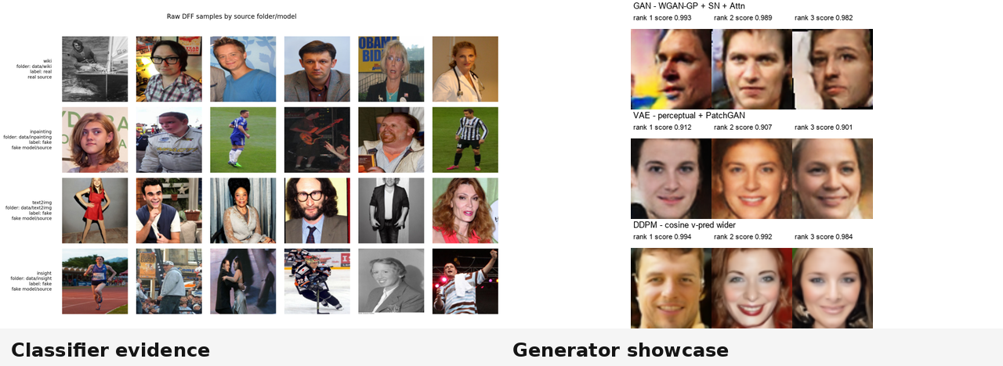
Real/Fake Face Classification
and Synthetic Face Generation
Classifier and Generator Pipelines for Face Image Analysis
Student / project name: [placeholder]
Course: [placeholder]
Date: [placeholder]
Notes:
Purpose: Frame the project as two complementary goals.
Evidence: The split visual cues classifier evidence on the left side of the project and generated face samples on the right.
Conclusion: The deck tells one experimental story: detect fake faces and synthesize faces from a controlled data pipeline.
Transition: Move to the project map that connects the two parts.

Slide 2
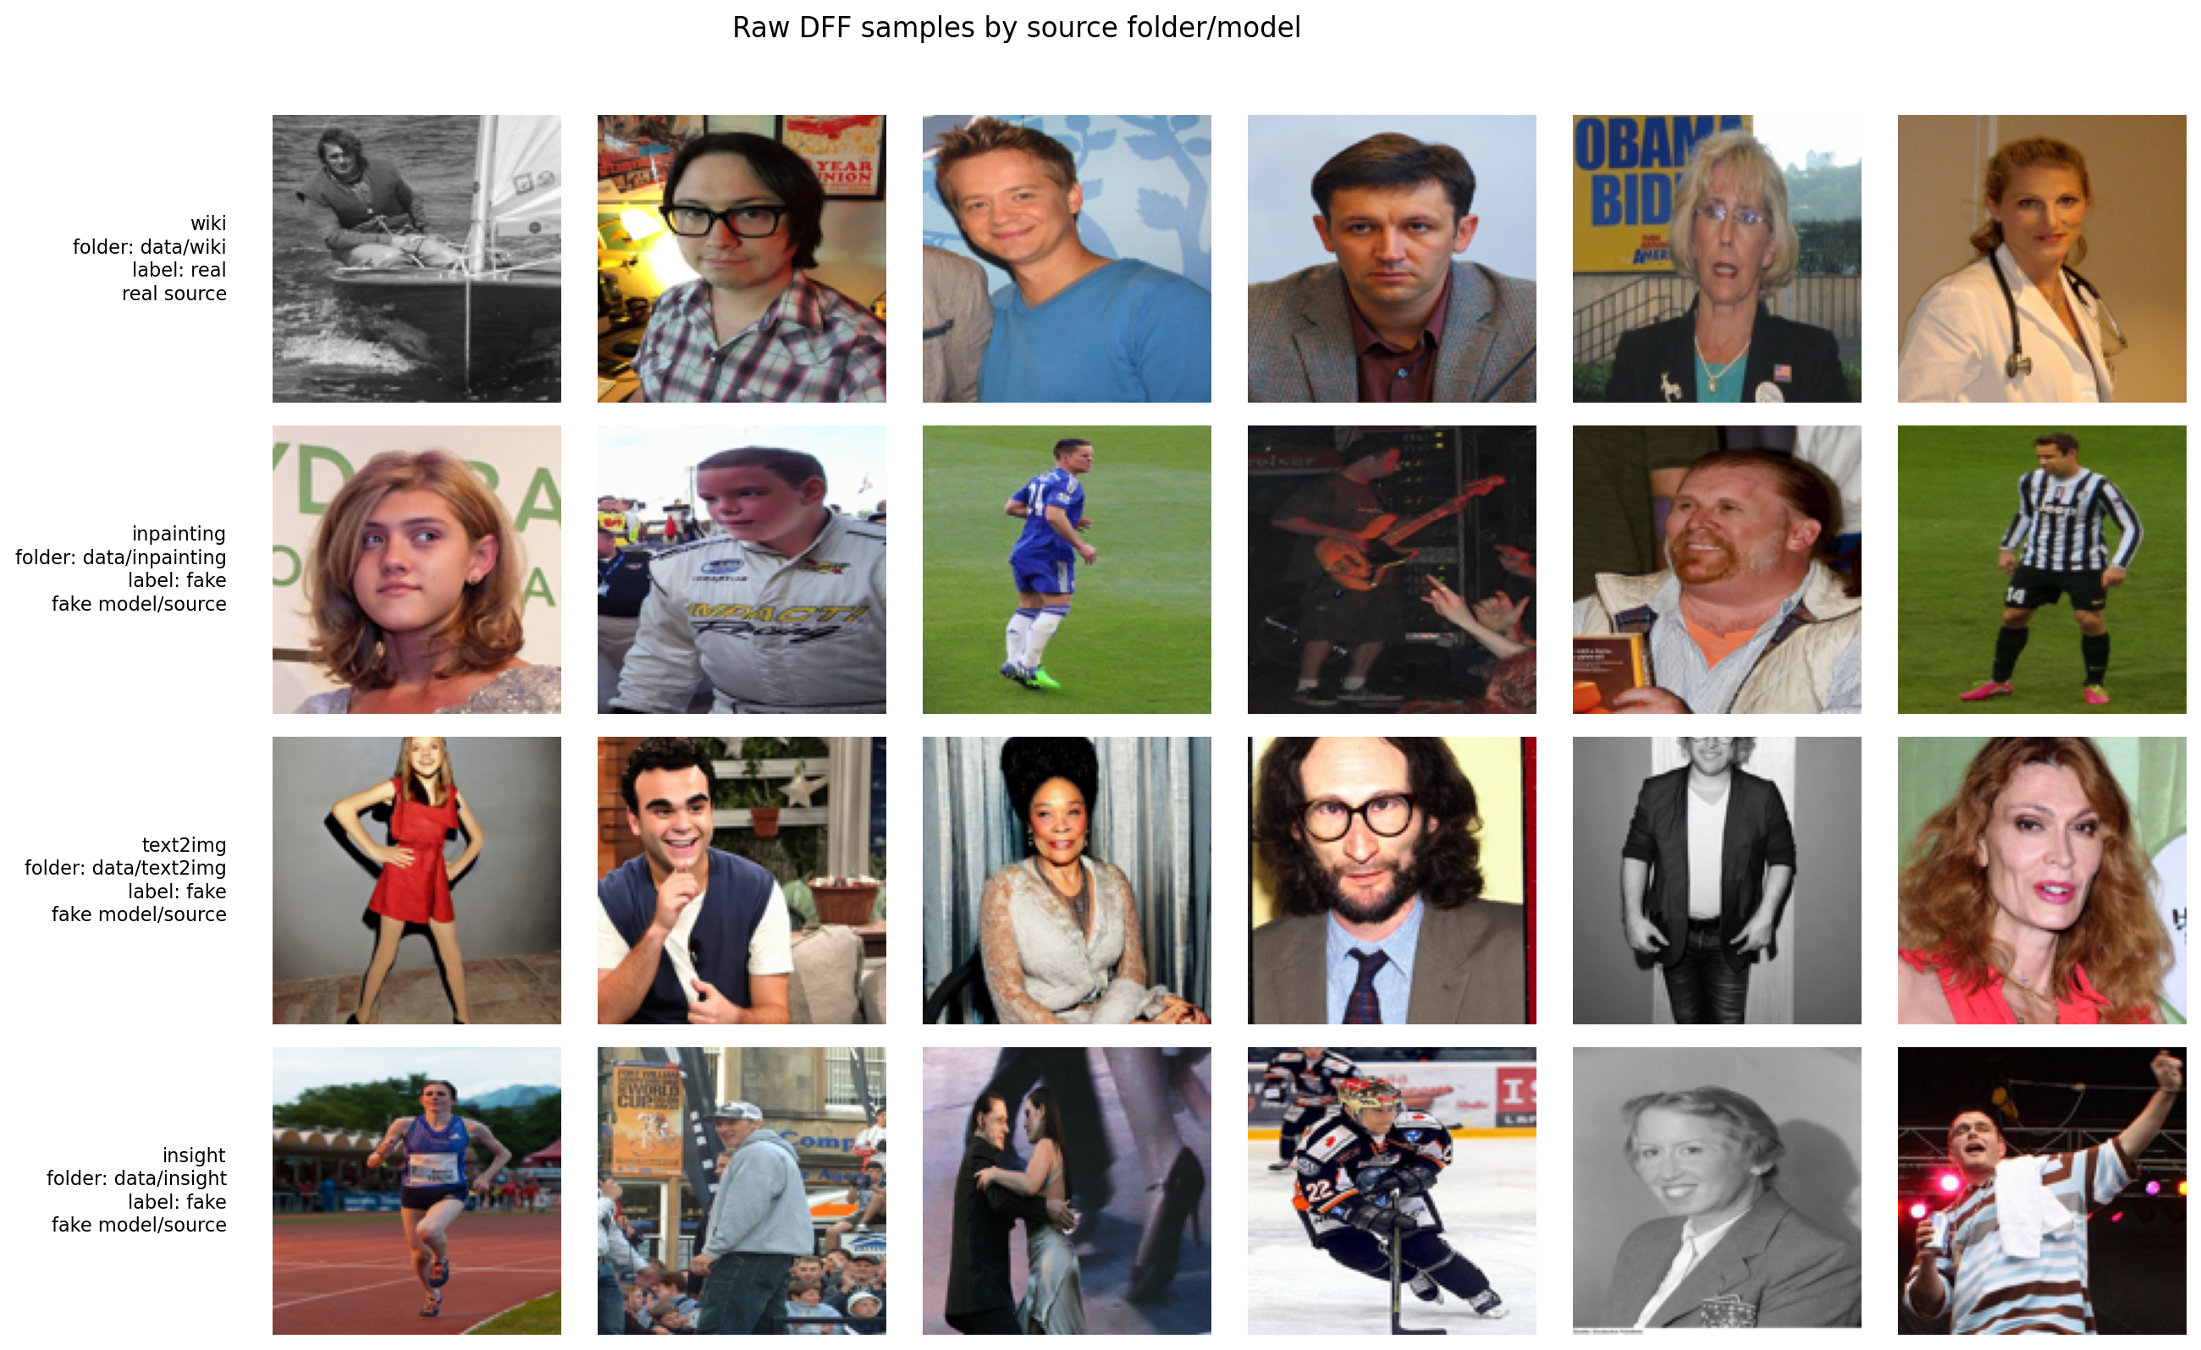
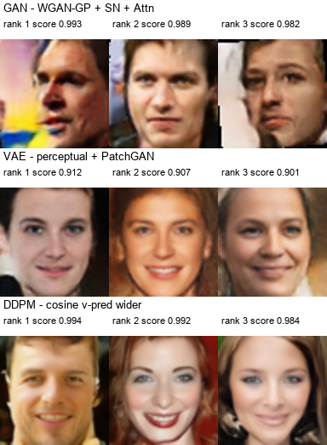
Project map
Part A: Classifier
Shared input
• Input: real + fake images
• Goal: detect fake images
• Evidence: metrics, source behavior, Grad-CAM, scaling
• Face image dataset
• Source-aware experimental design
Classifier source grid
Part B: Generator
• Input: real face dataset
• Goal: synthesize face samples
• Evidence: FID, grids, progression, selected samples
Generator final showcase
One dataset supports two linked questions: detection and synthesis.
Opening
2
Notes:
Purpose: Show how the project branches into classifier and generator tracks.
Evidence: The slide uses the provided source grid and final generator showcase to connect inputs to outputs.
Conclusion: Both branches rely on controlled evidence, not isolated notebook summaries.
Transition: Next, state the three main research questions.

Slide 3
Main questions
1
2
3
• Can we reliably distinguish real from fake face images?
• Which preprocessing and model choices improve source generalization?
• Which generative model family gives the best quality/speed tradeoff?
The project is experimental: each notebook phase answers one design question.
Opening
3
Notes:
Purpose: Define the presentation spine before the evidence.
Evidence: The three questions map directly to classifier reliability, source generalization, and generator quality versus cost.
Conclusion: Every later phase is interpreted as a decision point.
Transition: Enter the classifier branch first.

Slide 4
Part I - Classifier
Dataset discovery → preprocessing → baselines → ablations → Grad-CAM → model families → scaling
Notes:
Purpose: Introduce the Part I - Classifier section.
Evidence: The section divider separates the story into its major branch.
Conclusion: The next slides walk through controlled phases rather than notebook summaries.
Transition: Start with the goal and source structure.

Slide 5
Classifier goal: detect real vs fake faces
Real source
Binary classifier
Core challenge
• wiki → real label
• Predict real/fake
• Avoid shortcuts
• Generalize across fake sources
• High global metrics are not enough
• The detector must not simply learn source-specific artifacts
Fake sources
• inpainting → fake
• text2img → fake
• insight → fake
Examples by source
The classifier is evaluated as a source-aware detector, not just a binary scorer.
Part I - Classifier
5
Notes:
Purpose: Define the classification task and the sources involved.
Evidence: The source mapping is from the EDA and the provided sample grid.
Conclusion: The main risk is shortcut learning across source-specific artifacts.
Transition: Next, use EDA to reveal dataset composition and possible shortcuts.

Slide 6
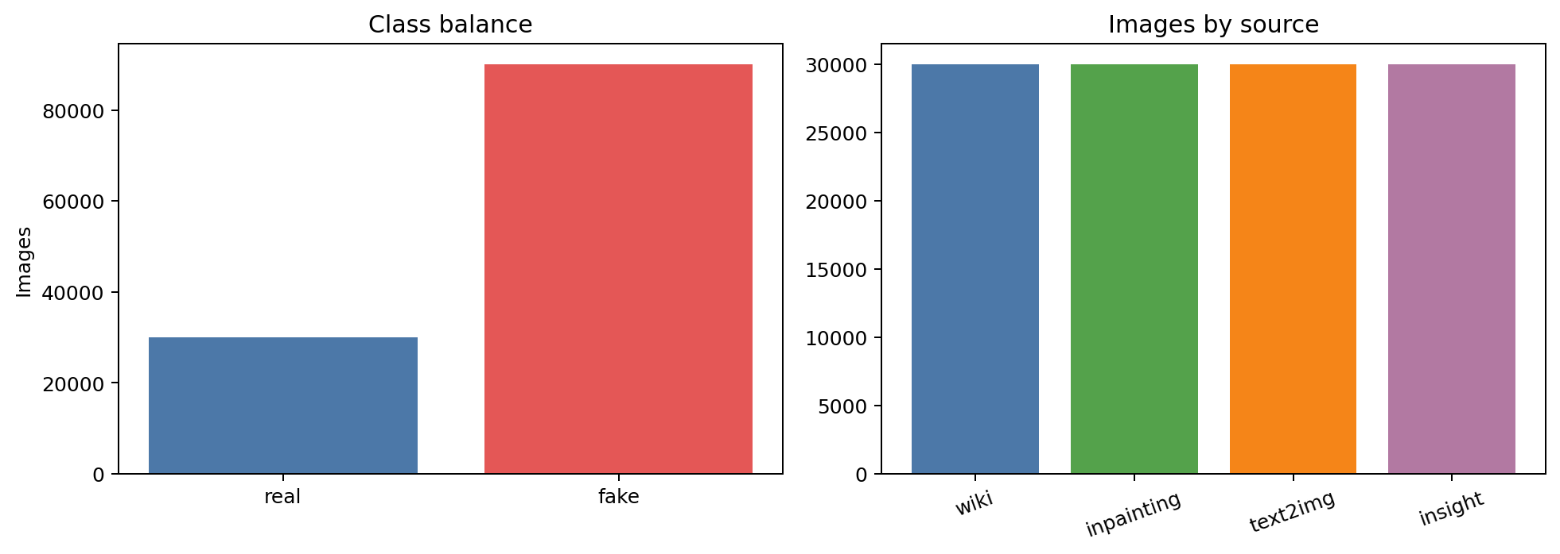
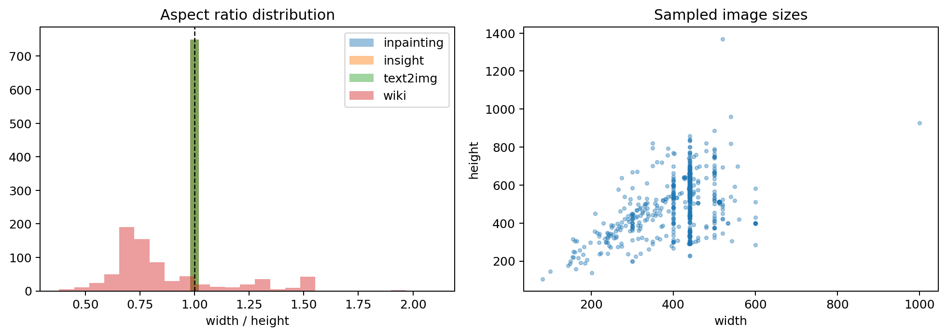
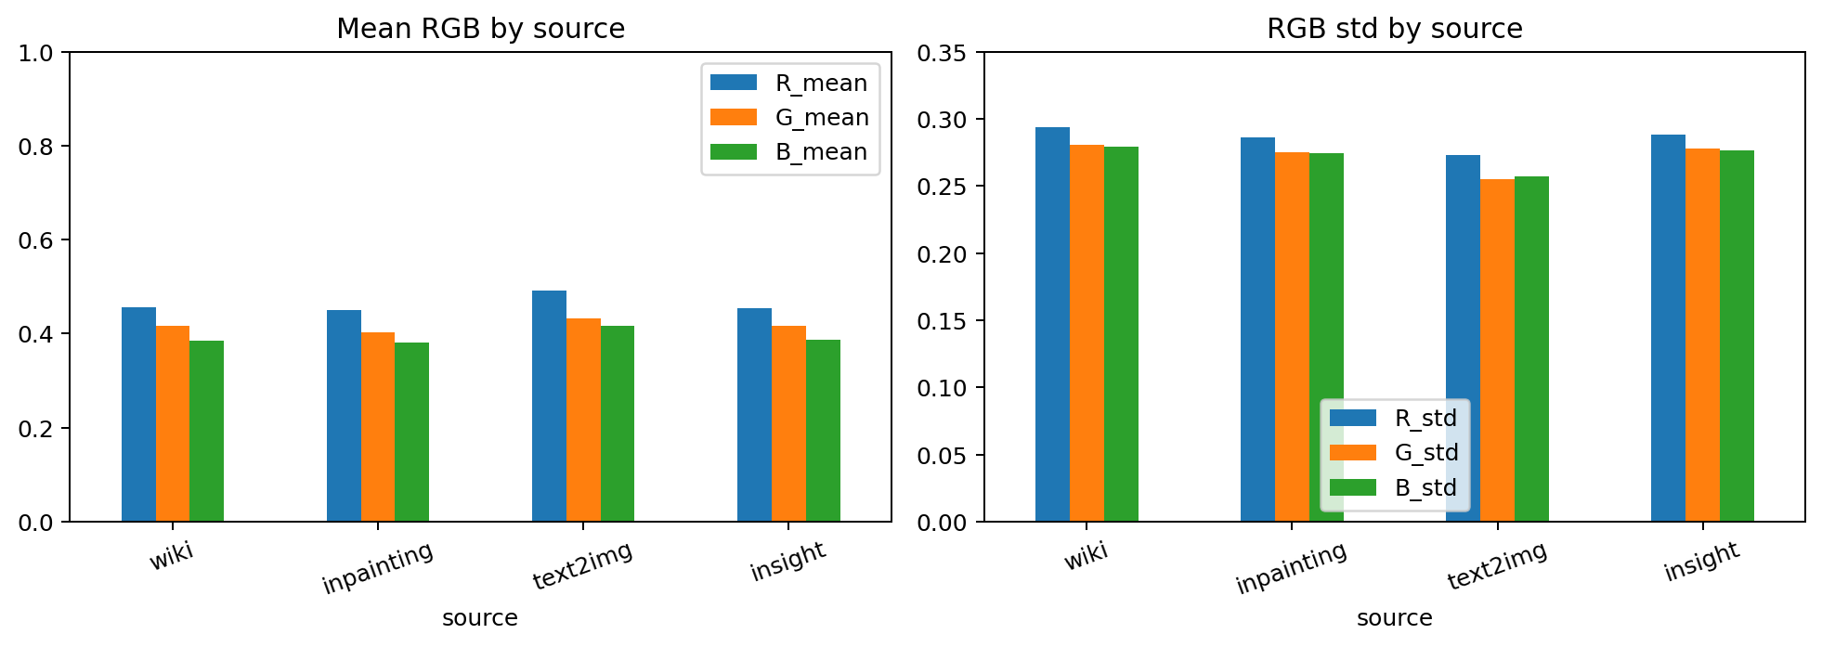
Dataset discovery identifies shortcut risks
Dataset composition
Dimension / geometry profile
Color profile
Geometry risk
Color risk
Leakage risk
• Dimension and framing artifacts can become shortcuts
• Color distributions can differ by source
• Basename or identity overlap can inflate results
Before training, the detector must learn fake evidence, not dataset artifacts.
Part I - Classifier
6
Notes:
Purpose: Show that EDA is an experimental control step.
Evidence: Composition, dimension, and color plots expose ways a classifier could use non-semantic artifacts.
Conclusion: EDA motivates strict preprocessing and source-aware evaluation.
Transition: Next, specify the preprocessing strategy that reduces these risks.

Slide 7
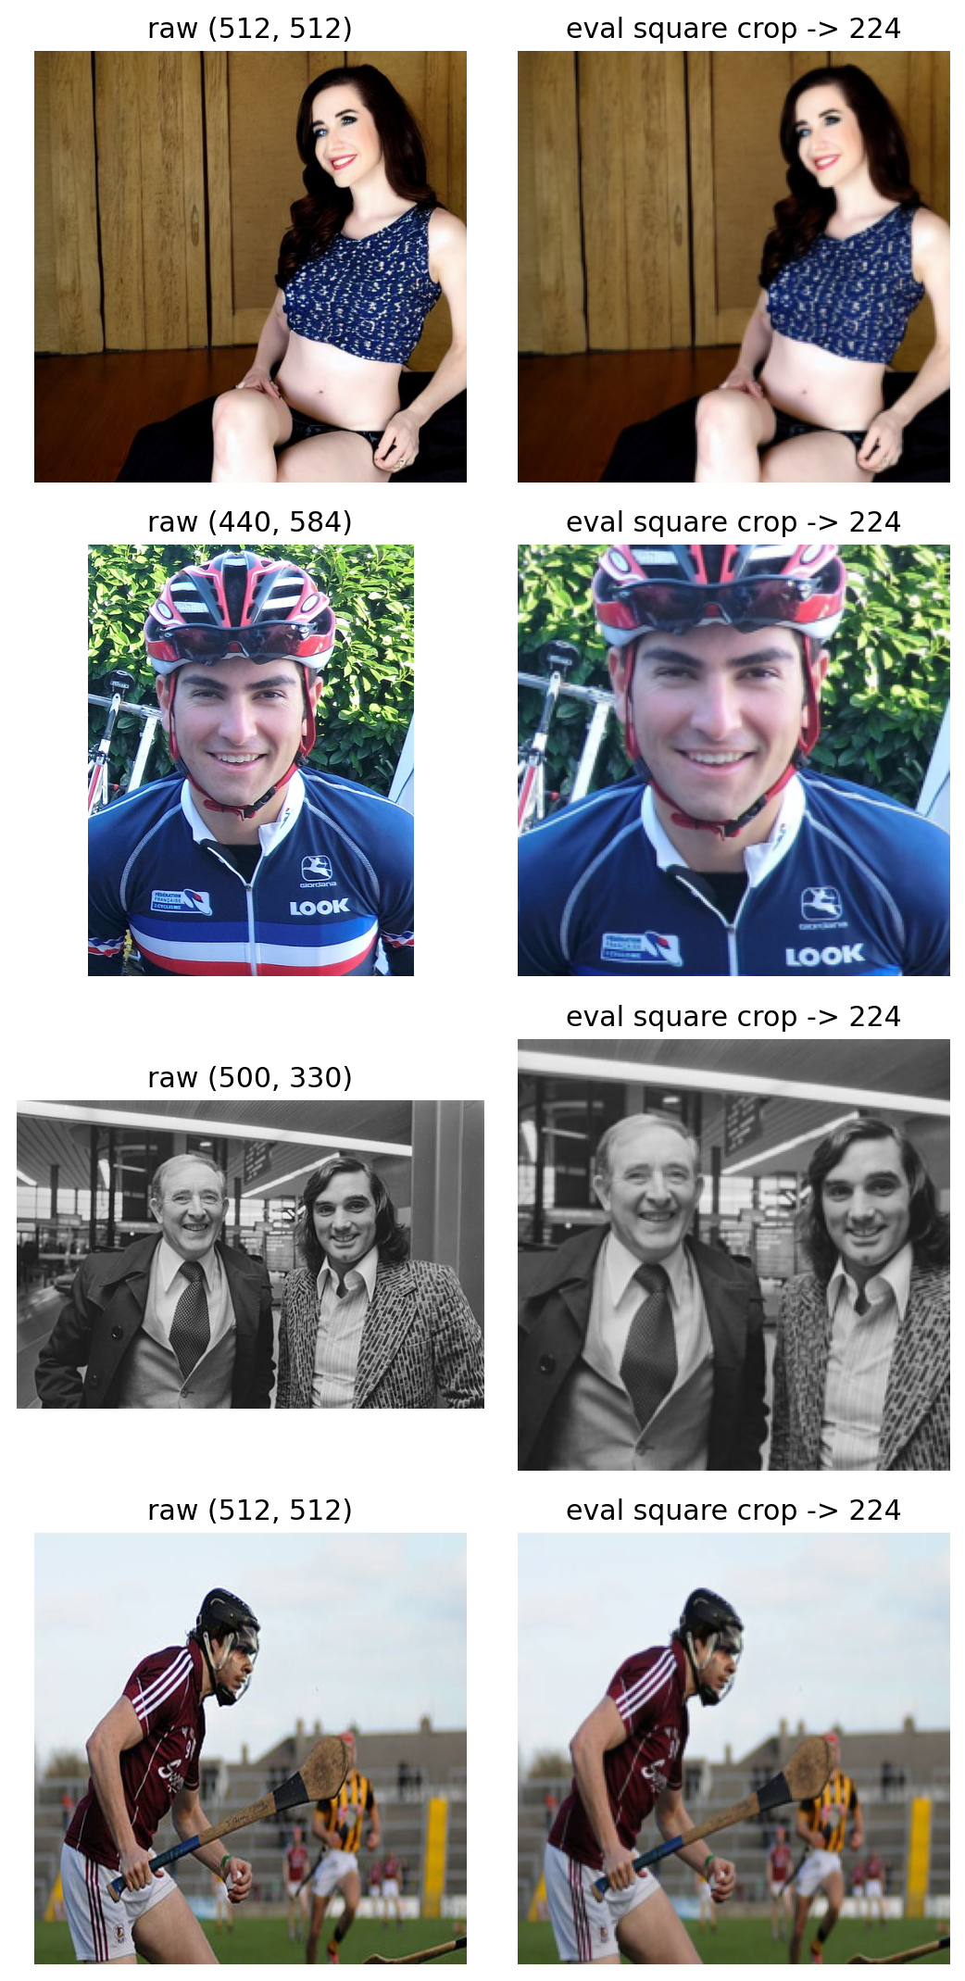
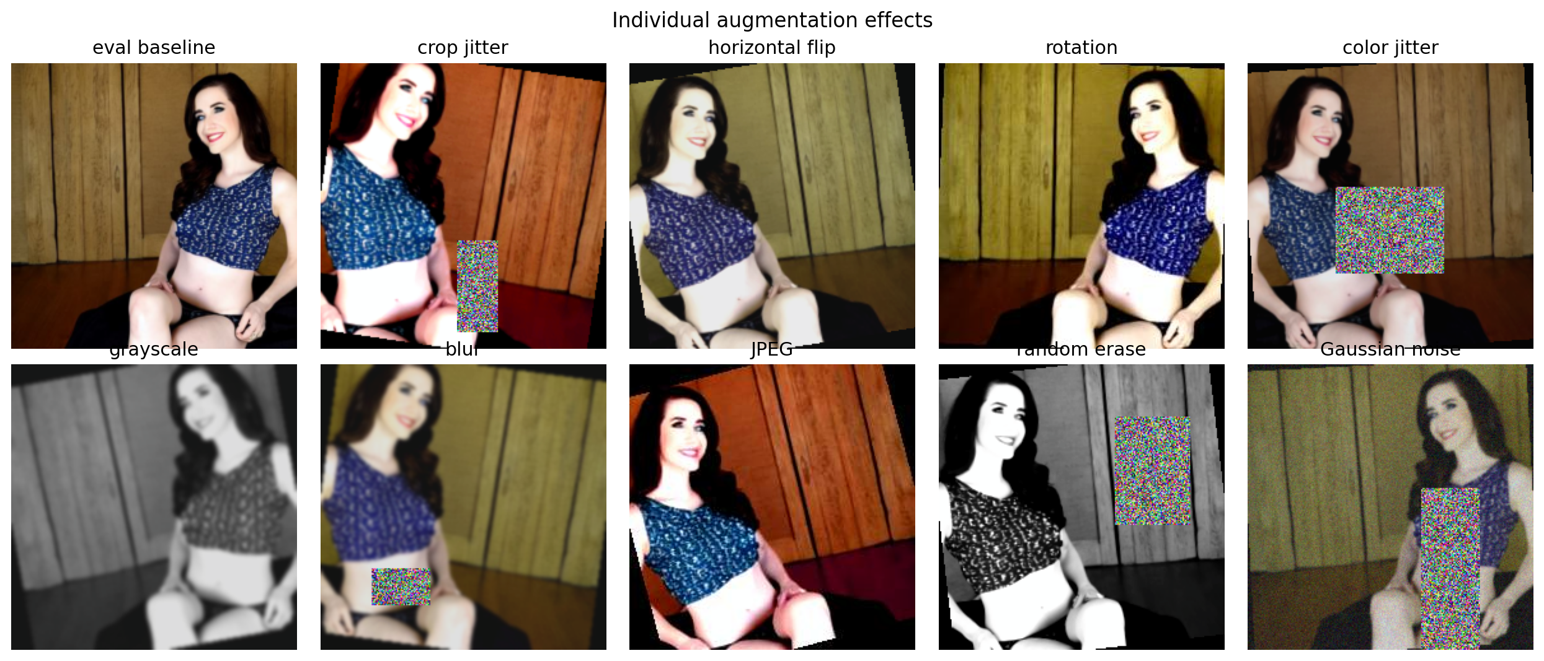
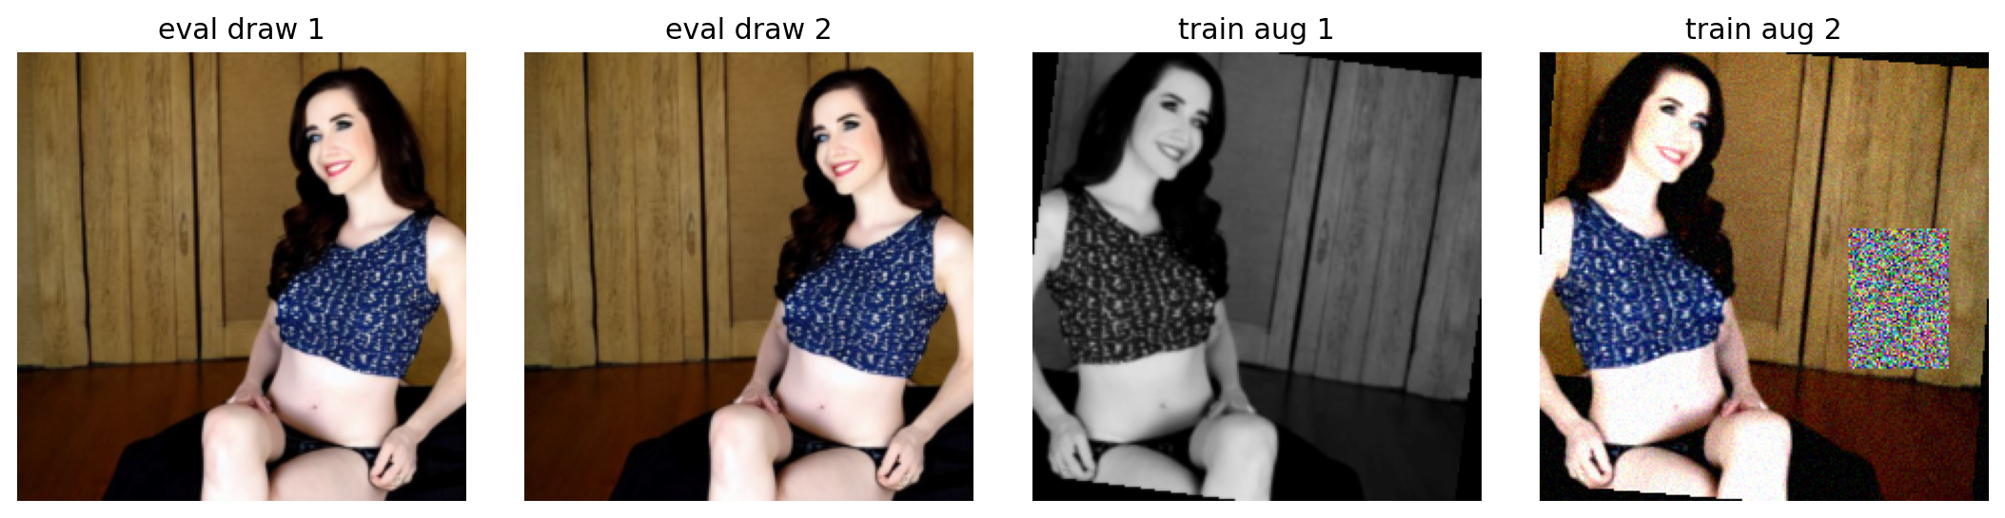
Preprocessing separates signal from augmentation
Square crop + resize
Train vs eval transform
Augmentation gallery
Train path
Eval path
Augmentation risk
• square crop/resize
• optional facecrop
• stochastic augmentation
• normalization
• square crop/resize
• optional facecrop
• no stochastic aug
• normalization
• Robustness can improve
• Too much augmentation can erase fake cues or over-regularize small models
Validation and test use train=False: no stochastic augmentation.
Part I - Classifier
7
Notes:
Purpose: Explain the preprocessing logic and why train and evaluation paths differ.
Evidence: The preprocessing figures show crop/resize, train/eval differences, and augmentation examples.
Conclusion: Augmentation is a robustness tool, but its value must be proven empirically.
Transition: Next, establish the controlled Phase 1 baseline.

Slide 8
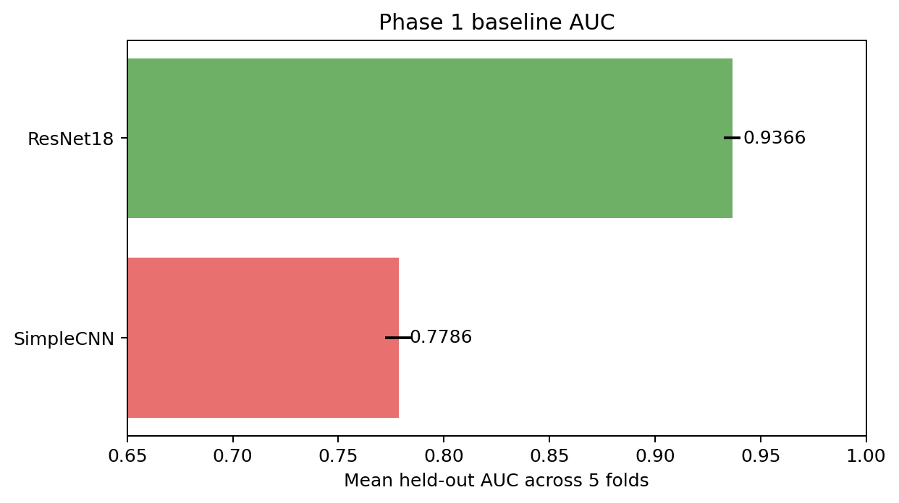
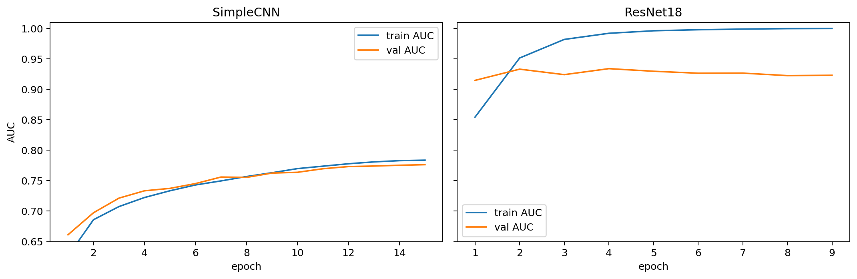
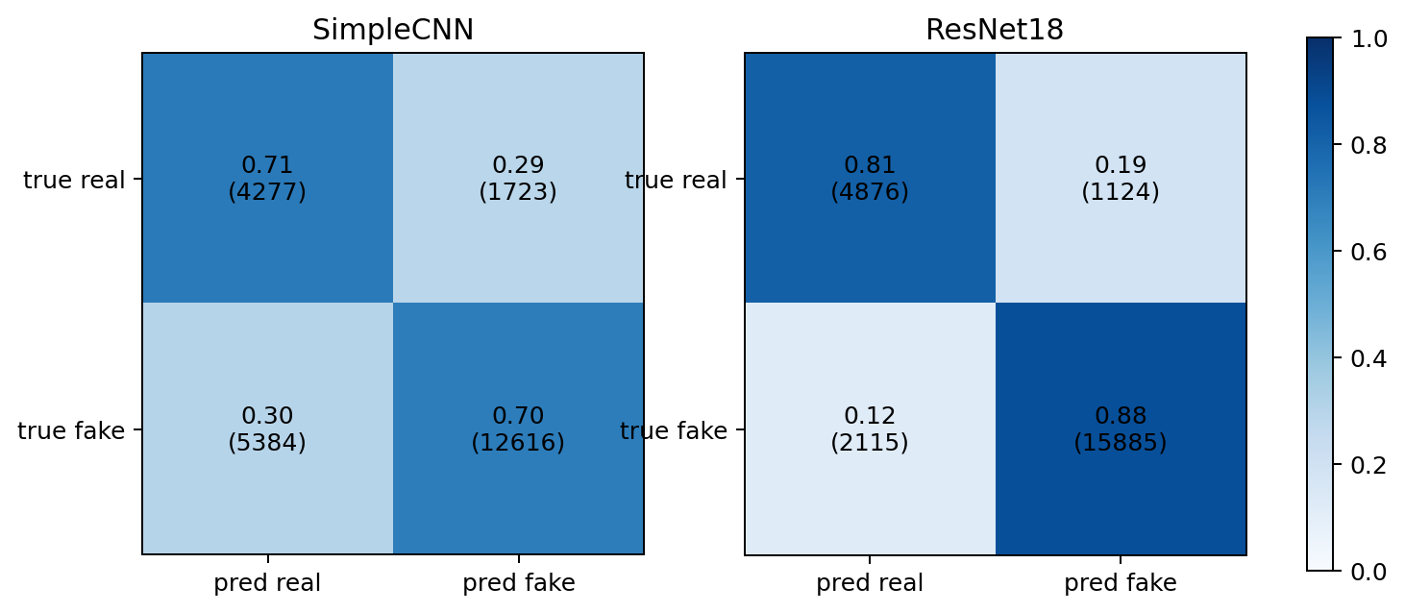
Phase 1 establishes controlled baselines
Protocol
Model
AUC
Accuracy
F1
• seed 42
• 5 folds
• batch size 32
• learning rate 1e-4
• weight decay 1e-4
• T_max 15; patience 5
SimpleCNN
0.7786
0.7039
0.7801
ResNet18
0.9366
0.8650
0.9073
Fold AUC summary
Training curves
Confusion matrices
Pretrained ResNet18 is a much stronger baseline than SimpleCNN.
Part I - Classifier
8
Notes:
Purpose: Set the first controlled comparison and its training protocol.
Evidence: The table and Phase 1 plots come from the Phase 1 analysis and logs.
Conclusion: ResNet18 dominates SimpleCNN on AUC, accuracy, and F1.
Transition: Next, interpret why that baseline changes error behavior.

Slide 9
Architecture changes the error balance
AUC curves: capacity and convergence
Confusion readout
SimpleCNN
ResNet18
Decision
• Limited feature capacity
• Mistakes in both directions
• Pretrained low/mid-level features
• Fits quickly and generalizes better
• Use pretrained backbone as the controlled baseline for ablations
The baseline choice is architecture-sensitive.
Part I - Classifier
9
Notes:
Purpose: Interpret the Phase 1 plots rather than just report metrics.
Evidence: Training curves and confusion matrices show faster convergence and better balanced errors for ResNet18.
Conclusion: The ablation chapter should therefore use ResNet18 as the main controlled reference.
Transition: Next, ask which preprocessing decisions further improve it.

Slide 10
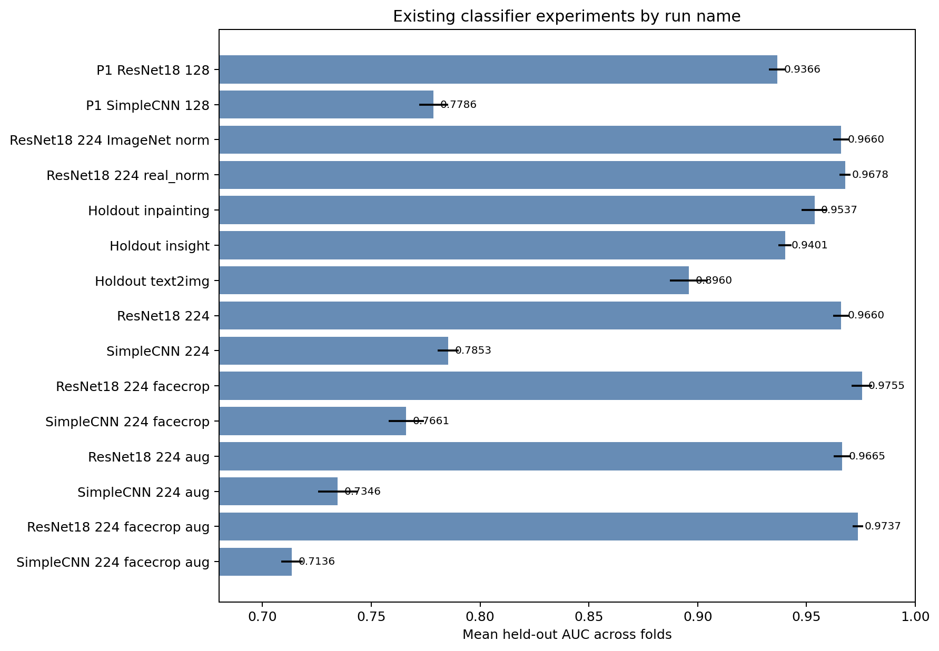
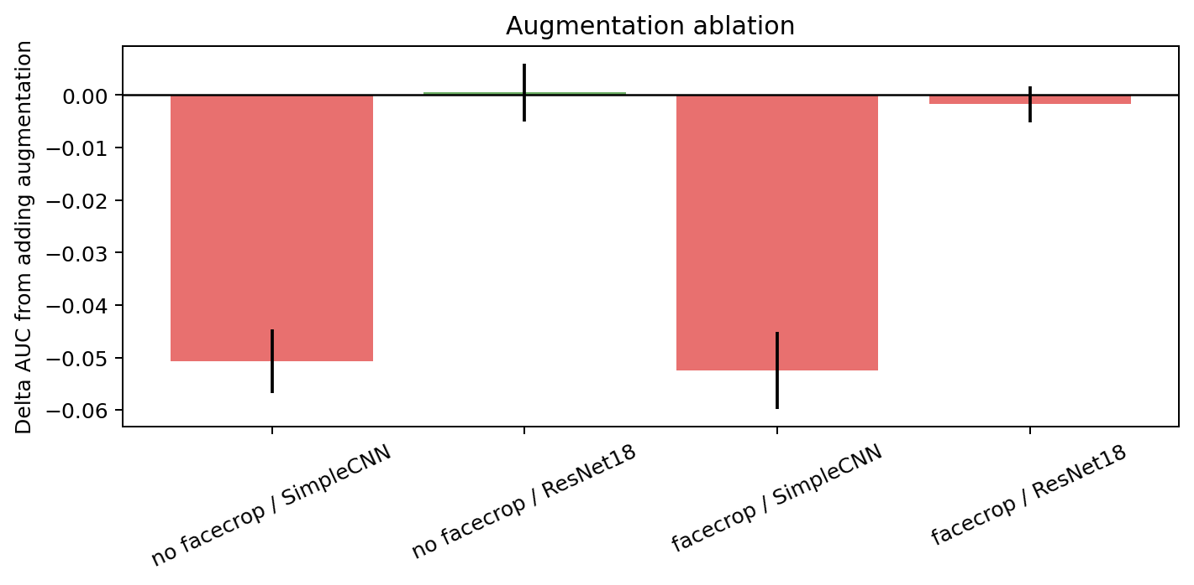
Phase 2 asks five ablation questions
224 x 224
Normalization
Source holdout
• Does higher input size help?
• Does real-norm matter?
• Do hidden shortcuts appear?
Facecrop
Augmentation
• Does focusing on face evidence help?
• Does robustness training help?
Ranked AUC evidence
Augmentation delta
Phase 2 is a controlled improvement chapter, not a model zoo.
Part I - Classifier
10
Notes:
Purpose: Show Phase 2 as a set of design questions.
Evidence: The ranked AUC and augmentation delta figures summarize ablation evidence.
Conclusion: Each ablation should lead to a pipeline decision.
Transition: Next, summarize the decisions with their supporting values.

Slide 11
Phase 2 locks the classifier pipeline
Decision
Evidence
Outcome
Input size
ResNet18 AUC 0.9366 → 0.9660
Use 224 x 224
Face crop
p2c_resnet18_facecrop AUC 0.9755
Enable facecrop
Augmentation
Facecrop+aug slightly below facecrop-only; SimpleCNN drops
Disable at current 20% setting
Normalization
Real-norm small gain; less aligned with pretrained weights
Use ImageNet/default
Generalization
Holdout text2img and insight drop
Report limitation
Facecrop and 224x224 are kept; augmentation is not used for the current setting.
Part I - Classifier
11
Notes:
Purpose: Convert Phase 2 ablations into explicit design decisions.
Evidence: The values are taken from Phase 1 and Phase 2 logs and figures.
Conclusion: The strongest practical preprocessing setting is 224x224 with facecrop and default/ImageNet normalization.
Transition: Next, make the source-holdout limitation explicit.

Slide 12
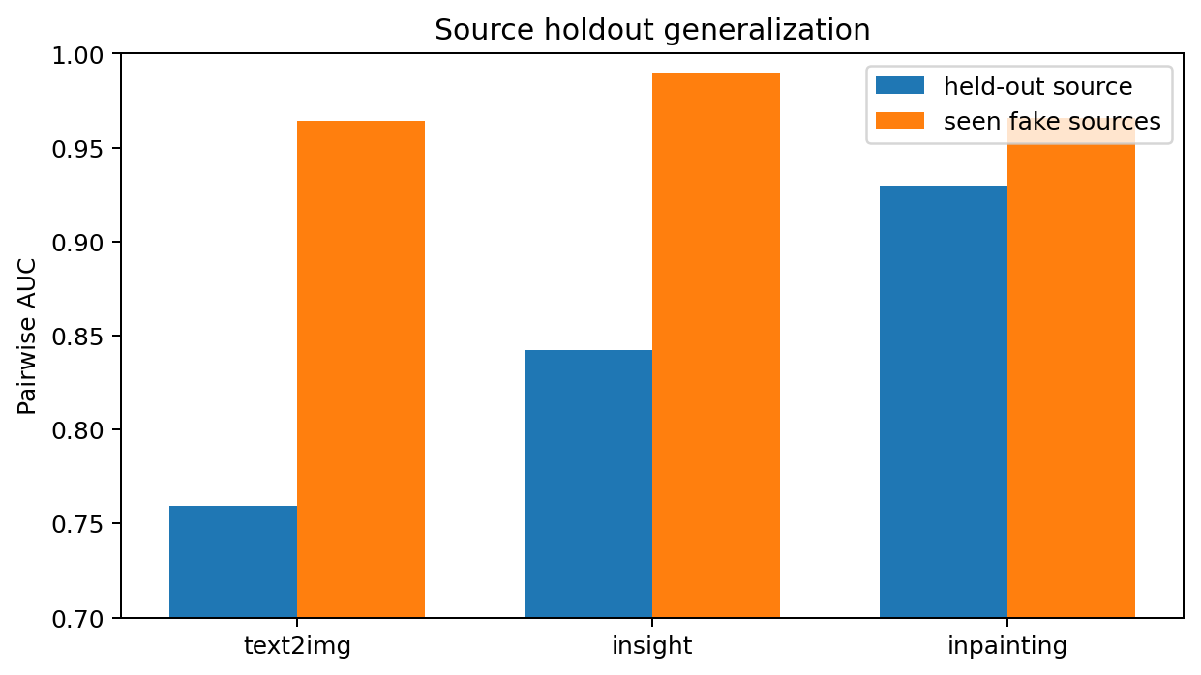
Source holdouts expose incomplete generalization
Held-out fake source
Pairwise AUC
text2img
0.7595
insight
0.8421
inpainting
0.9296
Interpretation
• Global metrics remain high
• Held-out fake sources reveal source-specific cues
Source holdout evidence
High global AUC does not remove the source-generalization limitation.
Part I - Classifier
12
Notes:
Purpose: Highlight the most important negative classifier result.
Evidence: The holdout plot and pairwise AUCs show reduced performance on unseen fake source families.
Conclusion: The model may still rely on source-specific cues.
Transition: Next, use Grad-CAM to inspect where the model looks.

Slide 13
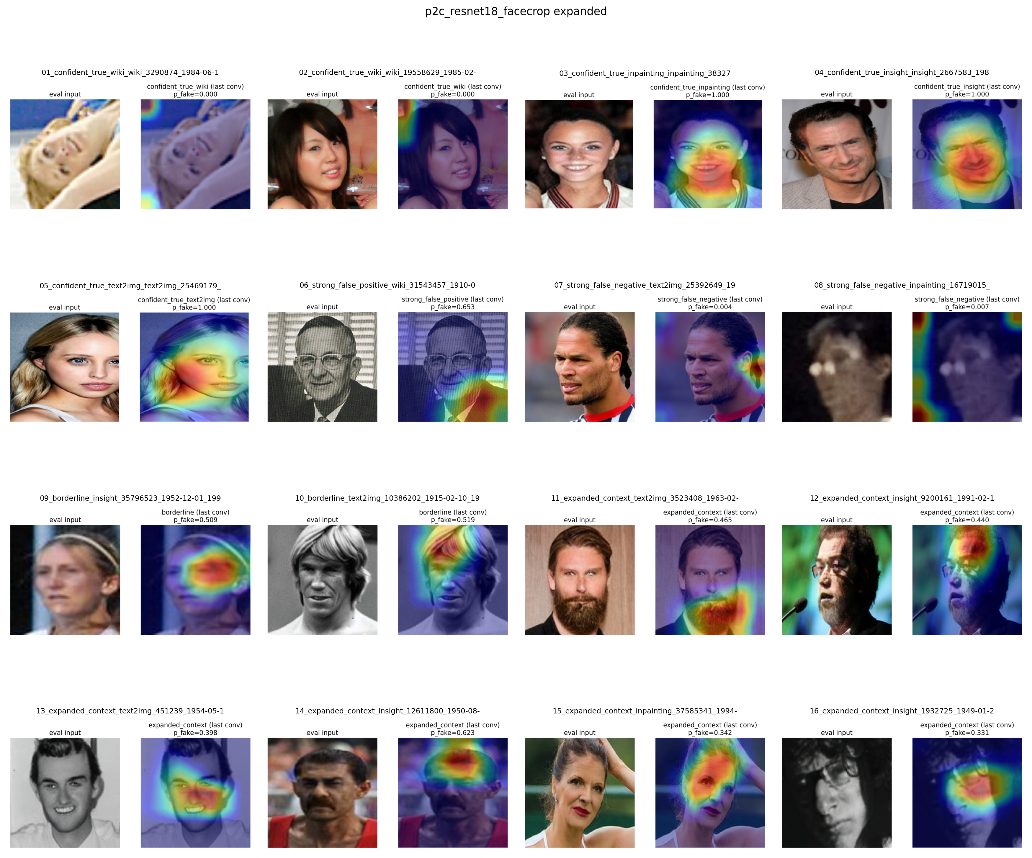
Grad-CAM provides qualitative localization evidence
What it can answer
• Is attention near the face?
• Does preprocessing reduce background attention?
What it cannot prove
• It is not causal evidence
• It does not prove shortcut removal
Use in this project
• Interpret false positives/false negatives
• Compare preprocessing variants
Final-model Grad-CAM panel
Grad-CAM is qualitative evidence, not proof of causality.
Part I - Classifier
13
Notes:
Purpose: Explain the role and limits of Grad-CAM.
Evidence: The expanded facecrop panel is used as qualitative localization evidence.
Conclusion: It supports interpretability but cannot prove causal reliance on any pixel region.
Transition: Next, compare Grad-CAM behavior across phases.

Slide 14
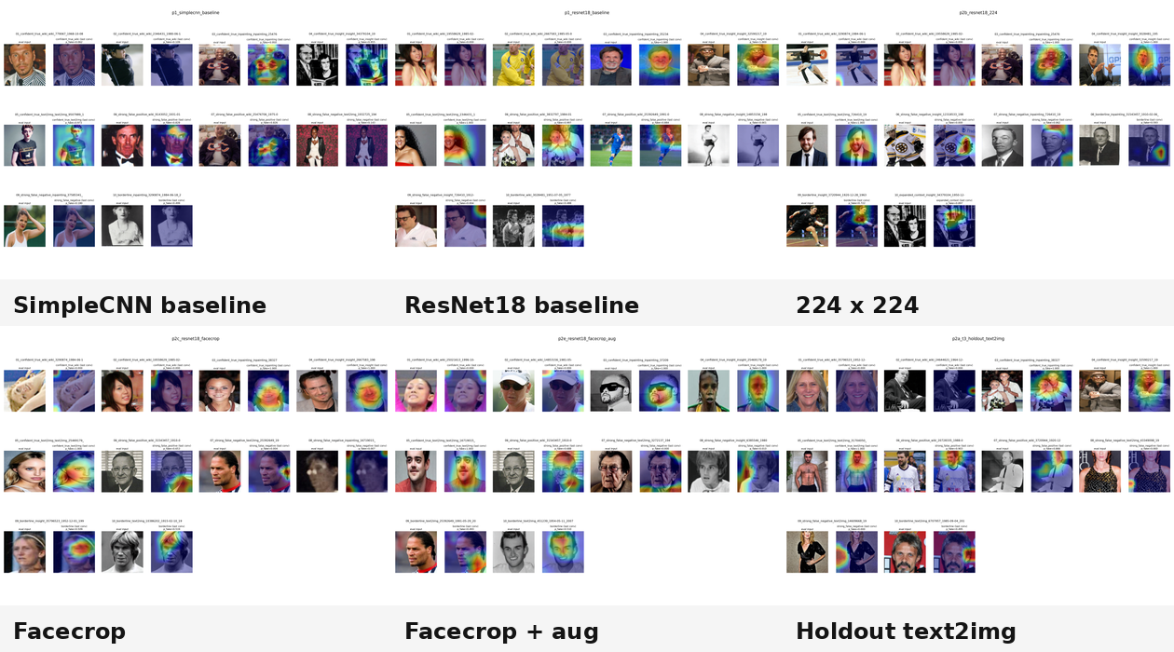
Grad-CAM attention evolves with the pipeline
Grad-CAM evolution across key classifier phases
Attention shifts toward face regions as the pipeline improves, but source generalization remains imperfect.
Part I - Classifier
14
Notes:
Purpose: Show interpretability as a story over time.
Evidence: The montage combines Grad-CAM panels from the baseline, 224x224, facecrop, augmentation, and holdout runs.
Conclusion: Preprocessing appears to localize attention more toward face regions; this does not eliminate holdout limitations.
Transition: Next, move from preprocessing to stronger pretrained model families.

Slide 15
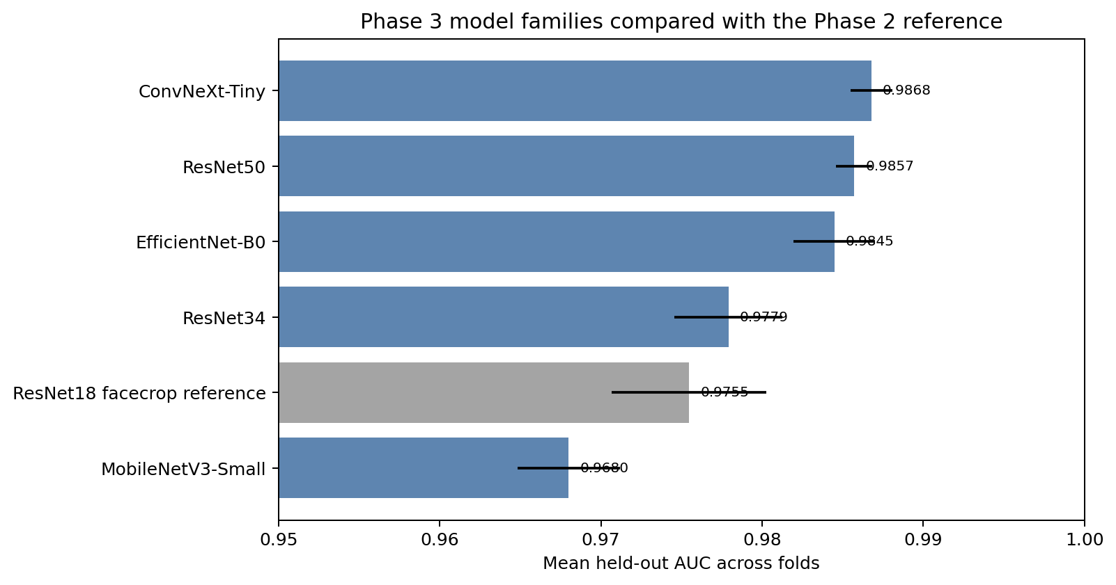
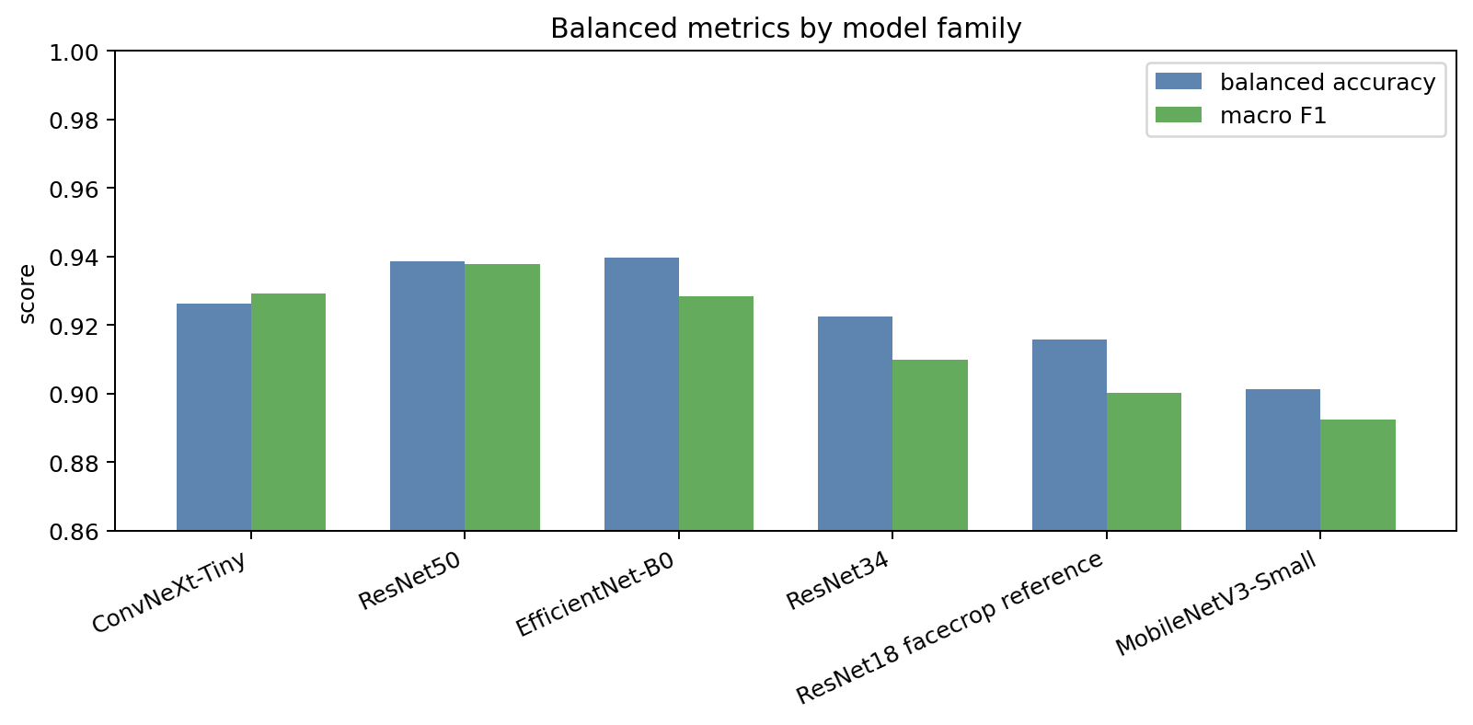
Phase 3 compares pretrained model families
Reference
Residual family
Efficient/mobile family
• ResNet18 facecrop pipeline
• ResNet34
• ResNet50
• EfficientNet-B0
• MobileNetV3-Small
Modern conv family
• ConvNeXt-Tiny
Ranked AUC
Balanced metrics
After preprocessing, model family becomes the next design lever.
Part I - Classifier
15
Notes:
Purpose: Introduce Phase 3 as a family comparison after pipeline lock-in.
Evidence: The ranked AUC and balanced metric figures summarize the stronger pretrained backbones.
Conclusion: The goal is not only top AUC but practical balance across accuracy, F1, and errors.
Transition: Next, read the Phase 3 result table.

Slide 16
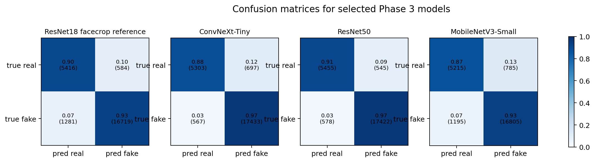
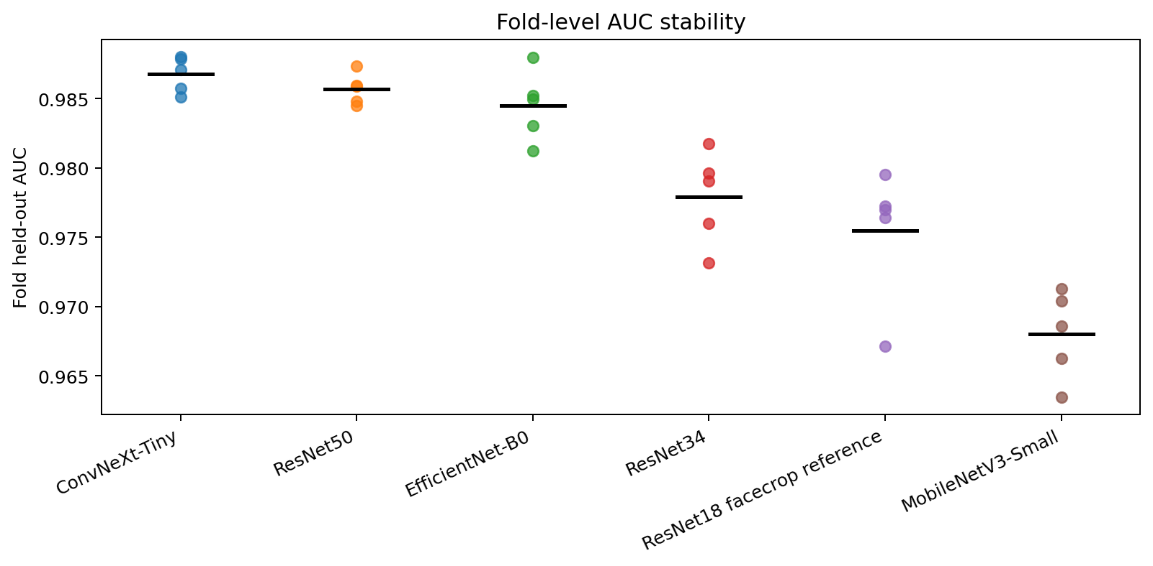
Phase 3 result: ResNet50 is the practical choice
Model
AUC
Accuracy
F1
ConvNeXt-Tiny
0.9868
0.9473
0.9650
ResNet50
0.9857
0.9532
0.9688
EfficientNet-B0
0.9845
0.9450
0.9628
ResNet34
0.9779
0.9305
0.9529
Selected confusion matrices
MobileNetV3-Small
0.9680
0.9175
0.9443
Fold AUC stability
ConvNeXt-Tiny has top AUC; ResNet50 has the strongest accuracy/F1/error balance.
Part I - Classifier
16
Notes:
Purpose: Summarize the Phase 3 winner decision.
Evidence: The table values are from the Phase 3 logs; confusion and stability figures provide supporting evidence.
Conclusion: ResNet50 is selected as the best practical model despite ConvNeXt-Tiny having marginally higher AUC.
Transition: Next, inspect whether stronger families improve source behavior.

Slide 17
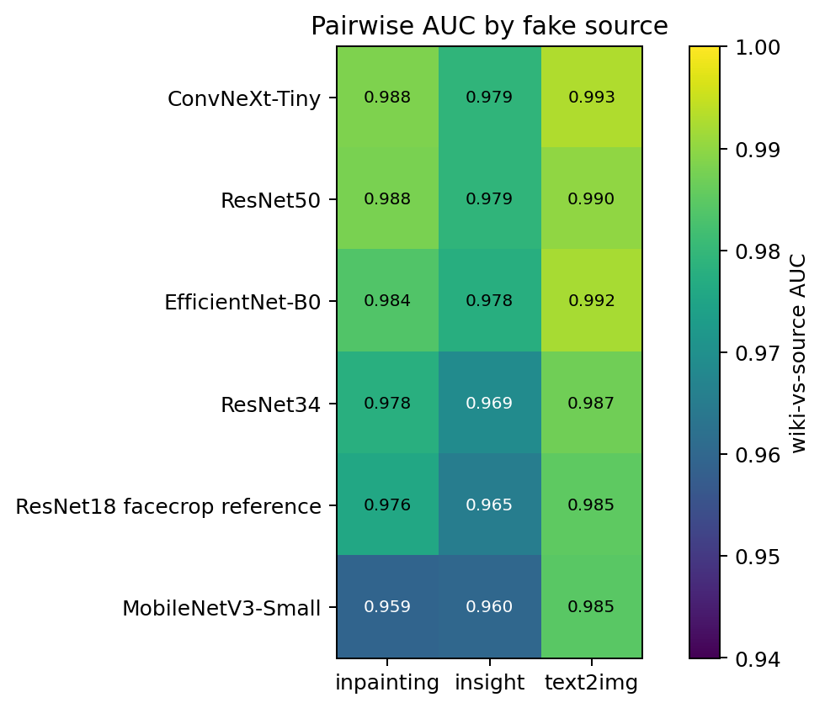
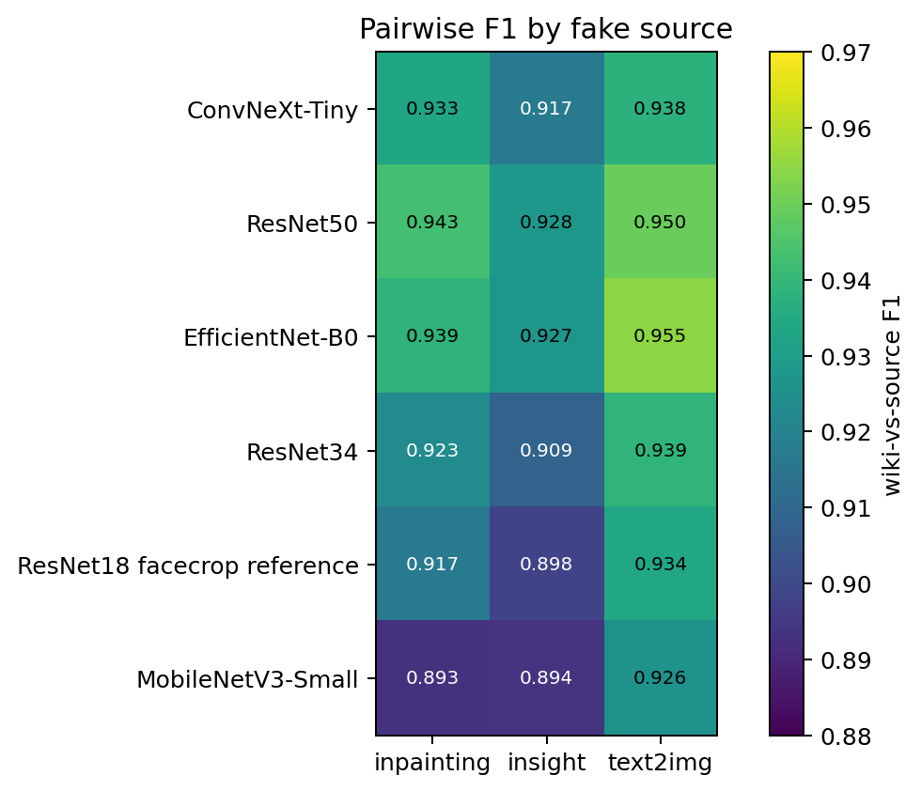
Phase 3 narrows source gaps but does not erase them
Pairwise AUC by fake source
Pairwise F1 by fake source
Stronger families reduce source gaps; source generalization is still reported as a limitation.
Part I - Classifier
17
Notes:
Purpose: Interpret Phase 3 through source behavior.
Evidence: Pairwise AUC and F1 heatmaps show how model families behave across fake sources.
Conclusion: The gap is reduced relative to earlier baselines, but the deck should not overclaim solved generalization.
Transition: Next, test whether more data improves the strongest families.

Slide 18
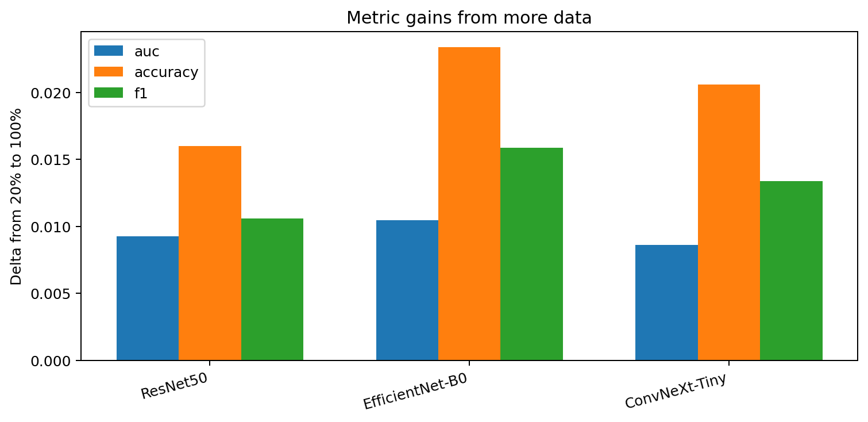
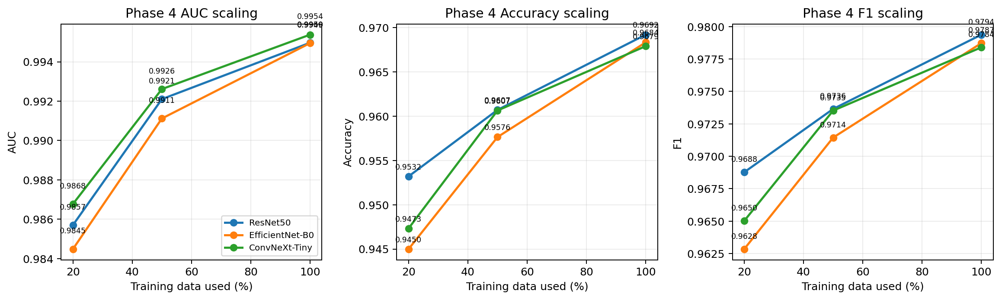
Phase 4 tests data scaling for strong backbones
Question
Models
Scales
• Does more data improve strong model families?
• ResNet50
• EfficientNet-B0
• ConvNeXt-Tiny
• 50% data
• 100% data
Global scaling curves
Metric gains
Scaling is tested after pipeline and family choices are stable.
Part I - Classifier
18
Notes:
Purpose: Introduce the scaling experiment.
Evidence: The global scaling and metric gains figures compare 50% and 100% data settings.
Conclusion: Scaling tests whether the chosen strong backbones still improve with additional data.
Transition: Next, summarize the 100% data results.

Slide 19
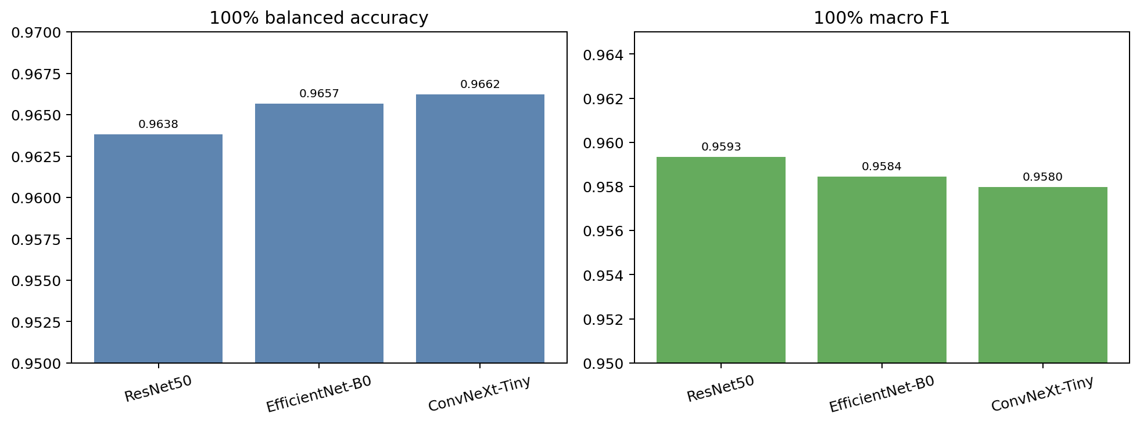
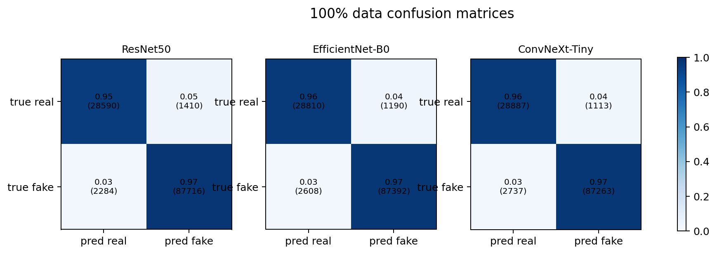
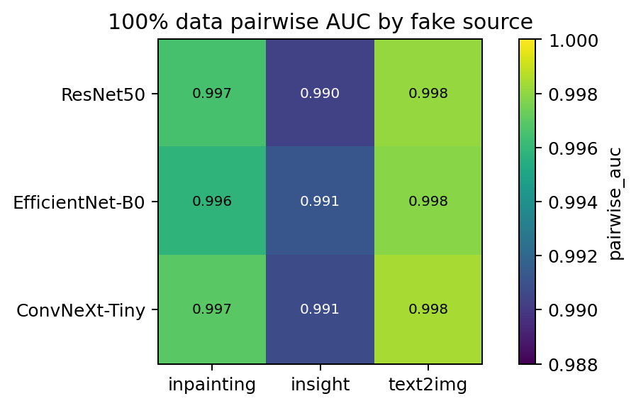
Phase 4 result: scaling improves all strong backbones
Model @ 100% data
AUC
Accuracy
F1
ResNet50
0.9950
0.9692
0.9794
EfficientNet-B0
0.9949
0.9684
0.9787
ConvNeXt-Tiny
0.9954
0.9679
0.9784
100% balanced metrics
100% confusion matrices
100% pairwise AUC
ConvNeXt-Tiny keeps top AUC; ResNet50 remains best practical accuracy/F1 choice.
Part I - Classifier
19
Notes:
Purpose: Report the final scaling metrics and decision.
Evidence: The table values are from Phase 4 logs; balanced metrics, confusion, and pairwise AUC figures support the decision.
Conclusion: All strong backbones benefit from scaling; ResNet50 has the best practical accuracy/F1 profile.
Transition: Next, state the final classifier recipe.

Slide 20
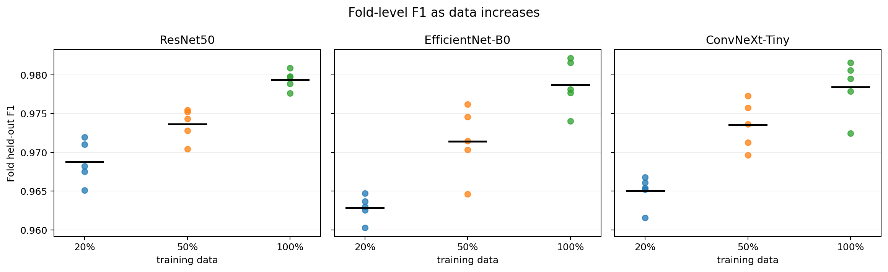
Final classifier decision
Model
Input
Normalization
• ResNet50
• 224 x 224 facecrop
• ImageNet/default
Augmentation
Limitation
Final result
• Disabled for current setting
• Source generalization
• AUC 0.9950
• Accuracy 0.9692
• F1 0.9794
Final model fold stability evidence
Best classifier result: ResNet50 at 100% data, AUC 0.9950, accuracy 0.9692, F1 0.9794.
Part I - Classifier
20
Notes:
Purpose: Close the classifier section with the selected recipe.
Evidence: The decision summarizes Phase 2 through Phase 4 evidence and the final Phase 4 metrics.
Conclusion: The classifier is strong but its source-generalization limitation remains explicit.
Transition: Transition to the generator branch, which follows a different phased structure.

Slide 21
Part II - Generator
Phase 0 baseline → Phase 1 pipeline lock-in → parallel GAN/VAE/DDPM branches → final comparison → showcase
Notes:
Purpose: Introduce the Part II - Generator section.
Evidence: The section divider separates the story into its major branch.
Conclusion: The next slides walk through controlled phases rather than notebook summaries.
Transition: Start with the goal and source structure.

Slide 22
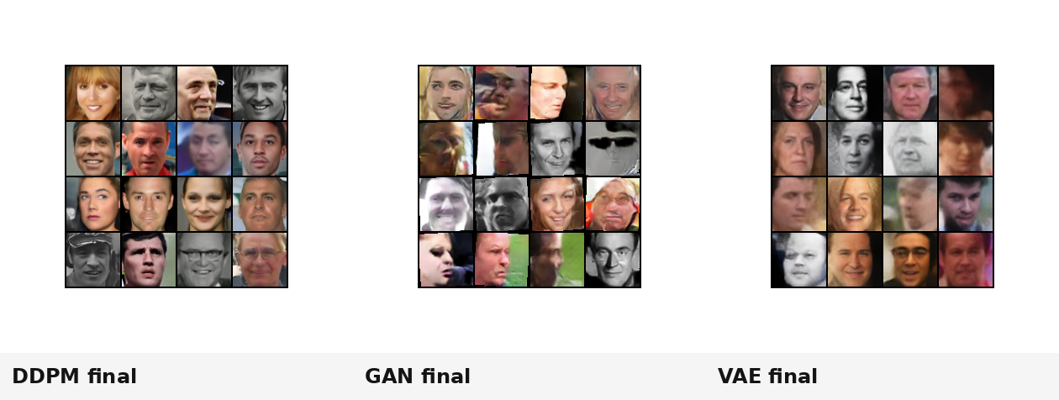
Generator goal: synthesize realistic face images
Input
Goal
Evidence
• Real face dataset
• Pipeline-controlled crops
• Generate realistic face samples
• Compare model families
• Sample grids
• FID
• Training progression
• Quality vs speed
• Selected samples
Final sample grids from the three model families
Generator evaluation uses both distribution-level FID and qualitative image grids.
Part II - Generator
22
Notes:
Purpose: Define the generator branch and its evidence.
Evidence: The final family grid montage previews the evidence used later.
Conclusion: The generator branch compares GAN, VAE, and DDPM recipes after pipeline selection.
Transition: Next, show the roadmap and the required fork structure.

Slide 23
Generator roadmap forks after pipeline selection
Phase 0
Phase 1
• baseline sanity
• pipeline selection
Phase 2
• GAN progression
Phase 3
Phase 5
Phase 6
• VAE progression
• final comparison
• showcase
Phase 4
• DDPM progression
Phases 2, 3, and 4 are parallel branches/forks after Phase 1.
Part II - Generator
23
Notes:
Purpose: Make the generator structure explicit.
Evidence: The diagram shows Phase 0 flowing to Phase 1, then forking into GAN, VAE, and DDPM branches before rejoining.
Conclusion: This prevents presenting the generator as disconnected notebook summaries.
Transition: Next, start with the Phase 0 sanity check.

Slide 24
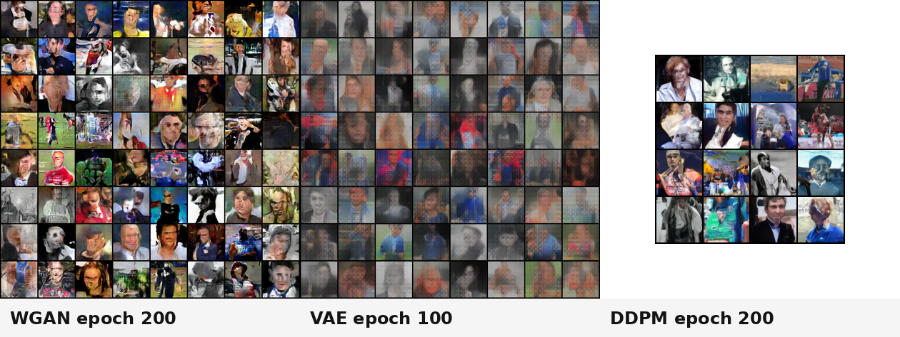
Phase 0 verifies loops before quality claims
What was tested
• Raw/un-aligned images
• Minimal WGAN, VAE, DDPM
• No FID tracked
What was learned
• Training loops work
• Raw data quality is the bottleneck
Phase 0 sample grids
Training loops work, but raw data quality is the bottleneck.
Part II - Generator
24
Notes:
Purpose: Explain Phase 0 as a sanity check rather than a final comparison.
Evidence: The Phase 0 sample montage shows rough behavior for WGAN, VAE, and DDPM.
Conclusion: Because no FID is tracked, conclusions are based on loss behavior and rough grids only.
Transition: Next, show the failure modes that motivated pipeline fixes.

Slide 25
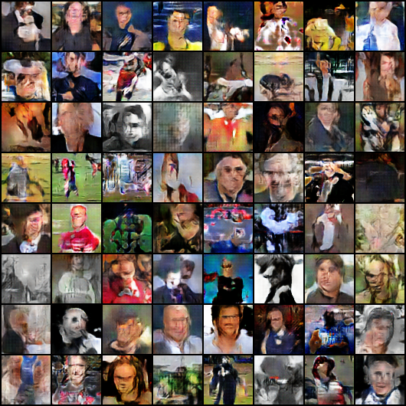
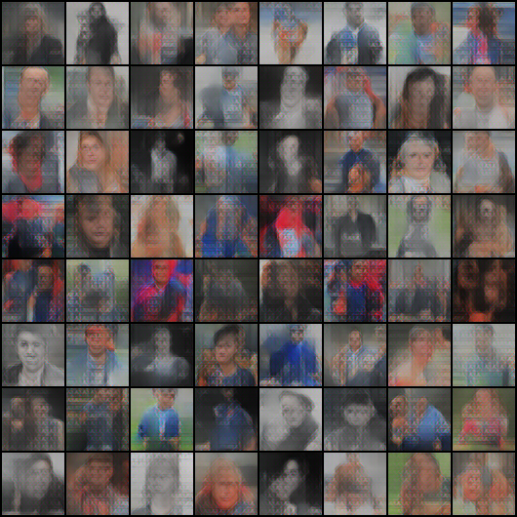
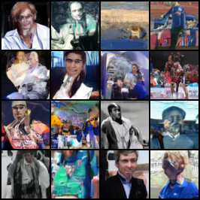
Phase 0 failure modes point to data bottlenecks
WGAN: blobs / weak face structure
VAE: blurry averages
DDPM: more texture but noisy
Decision: fix the data pipeline before comparing model families.
Part II - Generator
25
Notes:
Purpose: Make the negative baseline result visible.
Evidence: The saved Phase 0 grids show weak structure, blurriness, and noise depending on family.
Conclusion: The appropriate next decision is pipeline improvement, not model ranking.
Transition: Next, describe Phase 1 pipeline selection.

Slide 26
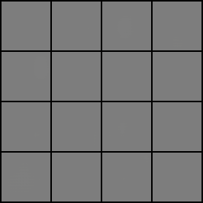
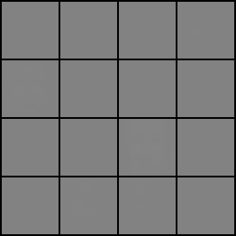
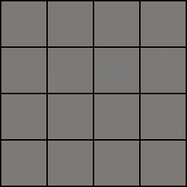
Phase 1 selects the generator data pipeline
Controlled ablations
Phase 1 proxy result
FID@50
Decision
• 64 x 64 vs 128 x 128
• raw/full vs MTCNN-aligned
• augmentation
• dataset mixing
• MTCNN-aligned crops
• 64 x 64
• aligned-only
• augmentation according to family configs
p1c_dcgan_full_aug
33.4
Full/raw proxy run
Aligned proxy run
Full + augmentation proxy run
Phase 1 is a pipeline proxy, not the final generator comparison.
Part II - Generator
26
Notes:
Purpose: Explain how Phase 1 locks the data pipeline.
Evidence: The Phase 1 sample grids and logged FID@50 proxy support choosing aligned 64x64 crops.
Conclusion: The p1c_dcgan_full_aug FID@50 of 33.4 is reported as a Phase 1 proxy only.
Transition: Next, explain why alignment matters.

Slide 27
Alignment reduces nuisance variation
Full/raw proxy output
MTCNN-aligned proxy output
Why it matters
• Alignment reduces pose, scale, and translation variance so model capacity can focus on facial structure instead of framing.
Alignment is the strongest pipeline lever.
Part II - Generator
27
Notes:
Purpose: Explain the mechanistic reason for choosing alignment.
Evidence: The raw/full and aligned proxy outputs show the practical impact of data framing.
Conclusion: Alignment reduces nuisance variation and improves how capacity is used.
Transition: Next, show that the selected pipeline forks into three parallel branches.

Slide 28
Three parallel generator branches
Phase 2: GAN
Phase 3: VAE
Phase 4: DDPM
• Adversarial generation
• Stability and collapse behavior
• Decision: selected GAN recipe
• Latent representation
• Composite reconstruction/perceptual/adversarial losses
• Decision: selected VAE recipe
• Iterative denoising
• Schedule and prediction target
• Decision: selected DDPM recipe
These branches start after Phase 1 and reunite only in Phase 5.
Part II - Generator
28
Notes:
Purpose: Set the mental model for the parallel branch section.
Evidence: The three branch cards map model families to their experimental purpose.
Conclusion: Phases 2 through 4 are not sequential improvements of one model; they are parallel family explorations.
Transition: Start with the GAN branch.

Slide 29
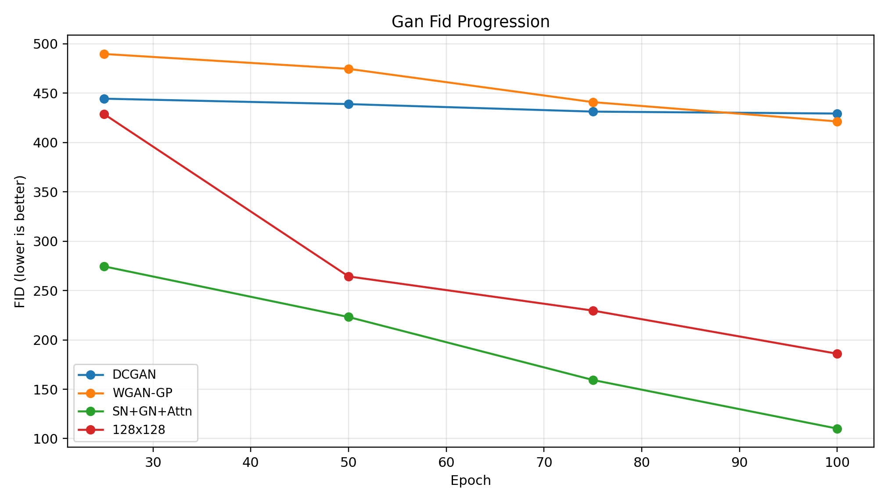
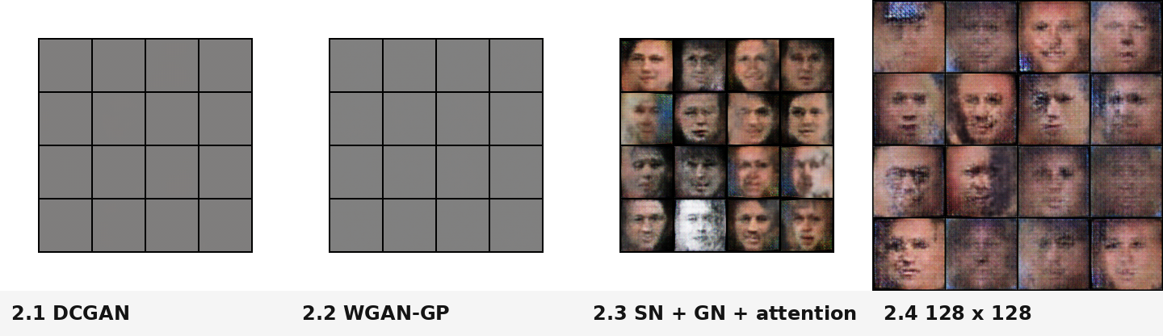
GAN branch: stability matters more than objective alone
2.1
2.2
2.3
2.4
• DCGAN baseline
• WGAN-GP
• spectral norm
• GroupNorm
• self-attention
• same recipe
• 128 x 128
GAN FID progression
GAN sample progression
Changing the objective alone was not enough; the stability package is the breakthrough.
Part II - Generator
29
Notes:
Purpose: Introduce the GAN branch progression.
Evidence: The branch moves from DCGAN to WGAN-GP, then adds spectral norm, GroupNorm, and attention before a 128x128 variant.
Conclusion: FID and visual progression show the stability package is the major improvement.
Transition: Next, report GAN branch metrics.

Slide 30
GAN results: the stability package is the gain
GAN run
Best FID
DCGAN baseline
429.3
WGAN-GP
421.3
+ SN + GroupNorm + Attention
110.1
128 x 128
186.0
FID over training checkpoints
Selected GAN recipe
• 64x64 WGAN-GP + spectral norm + GroupNorm + self-attention.
64x64 WGAN-GP + spectral norm + GroupNorm + self-attention becomes the selected GAN recipe.
Part II - Generator
30
Notes:
Purpose: Make the GAN decision evidence explicit.
Evidence: The table values are from the Phase 2 analysis and logs; the line chart visualizes FID checkpoints.
Conclusion: The 128x128 variant did not beat the stabilized 64x64 recipe in this protocol.
Transition: Next, show the saved sample grids, including collapse.

Slide 31
GAN visual progression includes collapse evidence
Saved GAN sample grids across Phase 2
Gray early GAN grids are saved collapsed outputs, not missing images.
Part II - Generator
31
Notes:
Purpose: Show that negative visual results remain part of the story.
Evidence: The montage includes saved outputs from early and stabilized GAN runs.
Conclusion: The gray grids represent actual collapse/weak outputs and should not be hidden.
Transition: Next, move to the VAE branch.

Slide 32
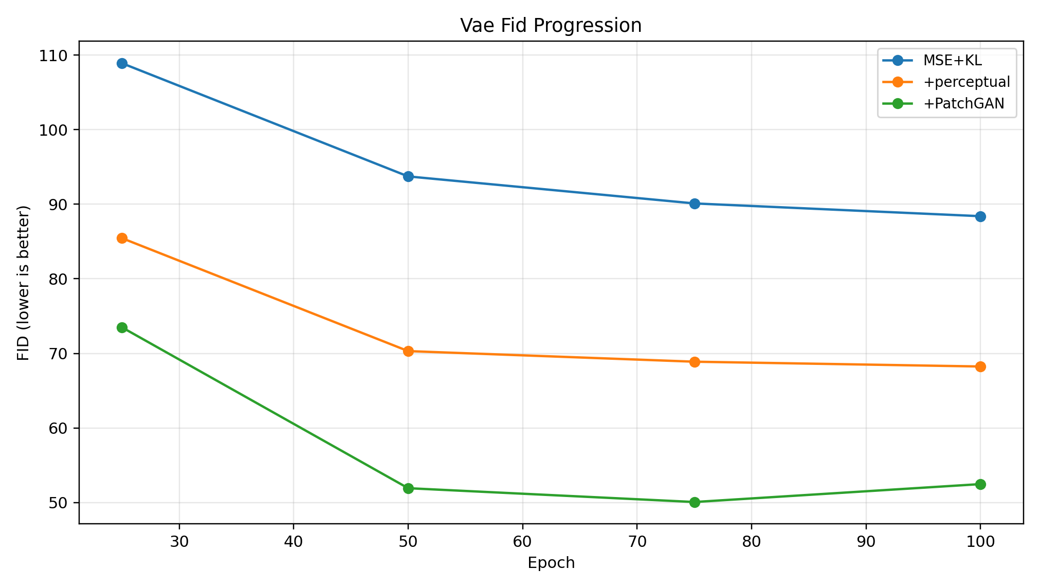
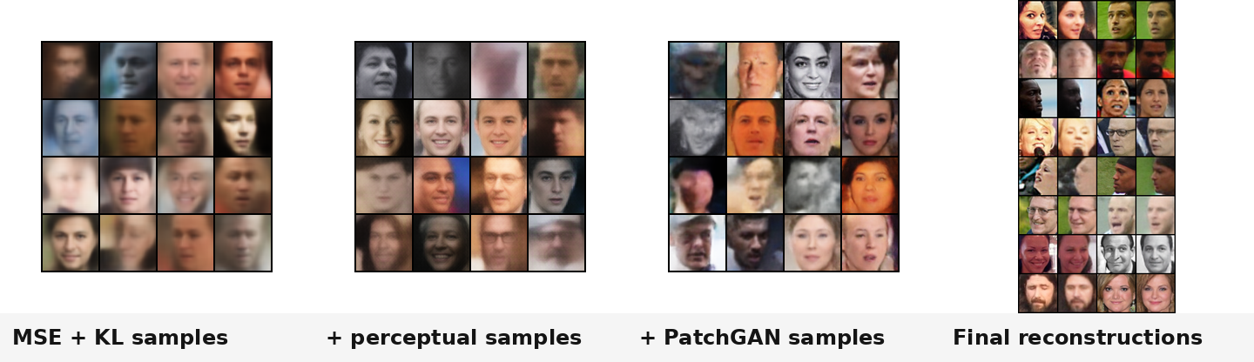
VAE branch: add perceptual realism to a latent model
3.1
3.2
3.3
• MSE + KL baseline
• + perceptual loss
• + PatchGAN adversarial loss
VAE FID progression
VAE sample and reconstruction progression
The VAE branch trades sharpness for stability and latent structure.
Part II - Generator
32
Notes:
Purpose: Introduce the VAE branch as a loss-composition study.
Evidence: The progression adds perceptual loss and then PatchGAN adversarial loss.
Conclusion: The purpose is to improve detail while retaining VAE stability and latent representation.
Transition: Next, report VAE branch metrics.

Slide 33
VAE results: perceptual and adversarial losses stack
VAE run
Best FID
MSE + KL
88.4
+ perceptual
68.2
+ PatchGAN
50.1
FID over training checkpoints
Interpretation
• Perceptual loss improves visual features; PatchGAN adds detail pressure. VAE stays fast and stable but remains smoother than GAN/DDPM.
Perceptual and adversarial losses are complementary.
Part II - Generator
33
Notes:
Purpose: Report VAE branch metrics and interpretation.
Evidence: The table and FID progression are taken from Phase 3 analysis/logs.
Conclusion: The final VAE recipe is substantially improved but is not the best final-quality generator.
Transition: Next, inspect VAE samples and reconstructions.

Slide 34
VAE visuals show stable but smoother samples
Prior samples and reconstructions
VAE is useful for reconstruction/prototyping, not the best final sample quality.
Part II - Generator
34
Notes:
Purpose: Show qualitative evidence for the VAE branch.
Evidence: The montage includes prior samples and final reconstructions from the VAE progression.
Conclusion: VAE is fast and stable but the images remain smoother than GAN and DDPM.
Transition: Next, move to the DDPM branch.

Slide 35
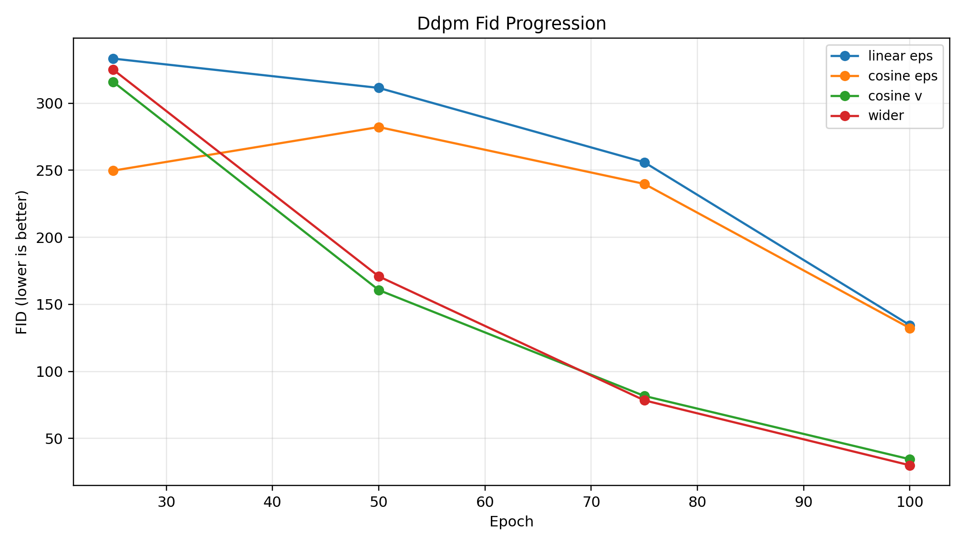
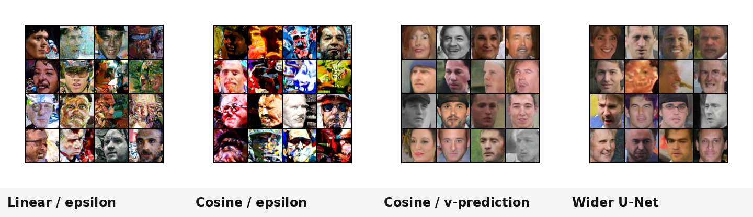
DDPM branch: denoising target is the key lever
4.1
4.2
4.3
4.4
• linear schedule
• epsilon prediction
• cosine schedule
• epsilon prediction
• cosine schedule
• v-prediction
• wider backbone
DDPM FID progression
DDPM sample progression
v-prediction is the major gain; width helps after the target improves.
Part II - Generator
35
Notes:
Purpose: Introduce DDPM as a schedule and prediction-target progression.
Evidence: The FID line chart and sample progression show improvements from linear/epsilon to cosine/v-prediction and wider U-Net.
Conclusion: The denoising target is the central improvement in this branch.
Transition: Next, report DDPM metrics.

Slide 36
DDPM results: v-prediction unlocks quality
DDPM run
Best FID
linear / epsilon
134.5
cosine / epsilon
132.3
cosine / v-prediction
34.5
wider DDPM
30.0
FID over training checkpoints
Selected DDPM recipe
• Cosine schedule + v-prediction + wider U-Net.
v-prediction is the major gain; width helps after schedule and target are improved.
Part II - Generator
36
Notes:
Purpose: Report DDPM branch metrics and selected recipe.
Evidence: The table and FID plot come from Phase 4 analysis/logs.
Conclusion: Cosine alone gives little change; v-prediction produces the large quality gain, and a wider backbone improves further.
Transition: Next, clarify how DDPM grids should be interpreted.

Slide 37
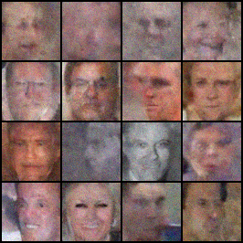
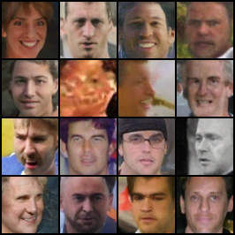
DDPM grids are stochastic distribution samples
How to read grids
• Reverse diffusion is stochastic
• Fresh samples may appear at each checkpoint
• Do not read panels as the same identities improving over time
Checkpoint sample A
Checkpoint sample B
DDPM progression shows distribution-level improvement, not the same faces being refined.
Part II - Generator
37
Notes:
Purpose: Prevent a common misinterpretation of DDPM sample grids.
Evidence: The saved checkpoint samples are stochastic reverse-diffusion outputs.
Conclusion: Unless fixed noise is explicitly stored, grids show new samples from the learned distribution.
Transition: Next, reunite the branches in the final family comparison.

Slide 38
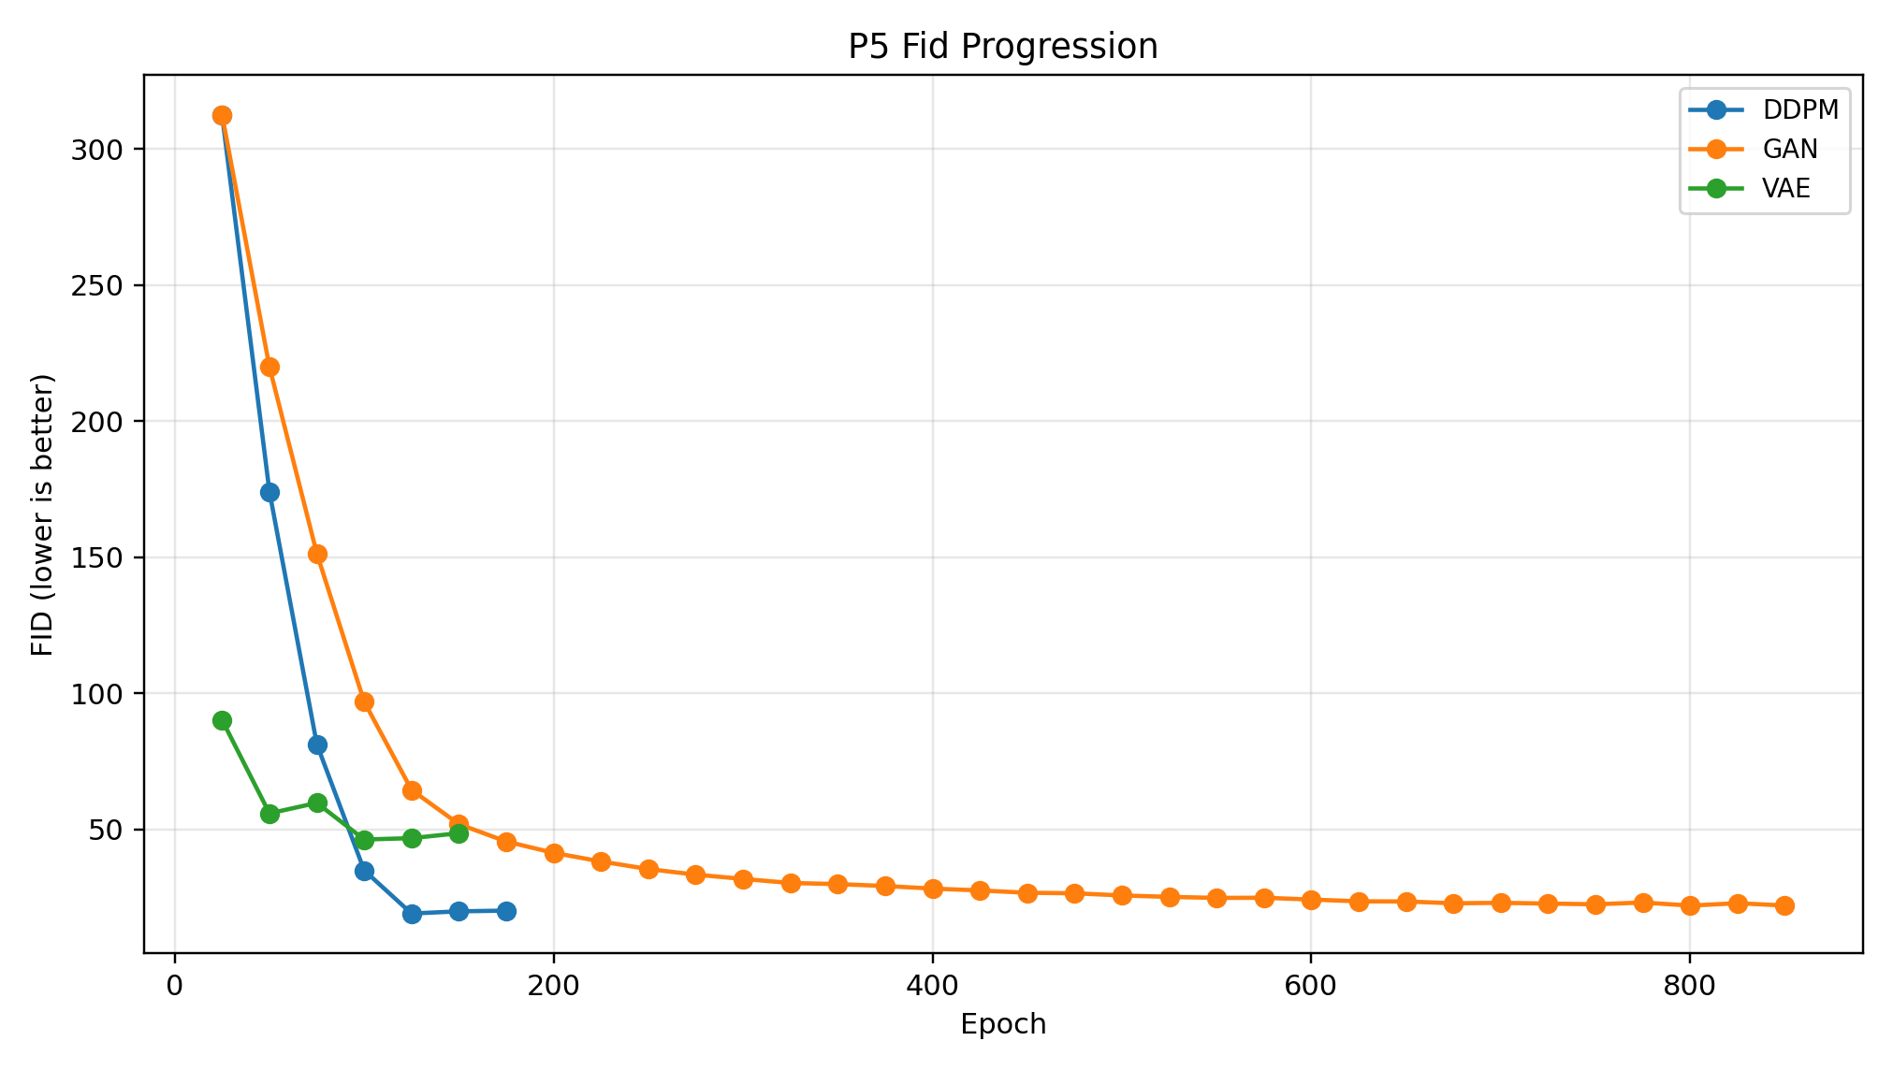
Phase 5 reunites the three selected recipes
GAN final recipe
VAE final recipe
DDPM final recipe
• WGAN-GP
• spectral norm
• GroupNorm
• self-attention
• MSE + KL
• perceptual loss
• PatchGAN adversarial loss
• cosine schedule
• v-prediction
• wider U-Net
Final comparison FID progression
Phase 5 compares final recipes, not intermediate branch variants.
Part II - Generator
38
Notes:
Purpose: Explain how the parallel branches reunite.
Evidence: The recipe cards define the final family representatives; the FID progression compares the final recipes.
Conclusion: This comparison is within the Phase 5 final protocol.
Transition: Next, compare quality and training time.

Slide 39
Final generator metrics show a quality/speed tradeoff
Family
Best FID
Train time
Best quality
DDPM
19.0
667.1 min
• DDPM: lowest FID
GAN
22.0
316.9 min
Best quality/speed compromise
VAE
46.2
50.2 min
• GAN: close FID with lower training cost
Fastest/prototyping
• VAE: fastest but lower final quality
DDPM wins quality; GAN is close with lower cost; VAE is fastest.
Part II - Generator
39
Notes:
Purpose: Report the final generator metrics and interpretation.
Evidence: Values are from Phase 5 logs: DDPM FID 19.0 in 667.1 minutes, GAN FID 22.0 in 316.9 minutes, and VAE FID 46.2 in 50.2 minutes.
Conclusion: The right model depends on whether the priority is quality, cost, or prototyping speed.
Transition: Next, visualize the quality/speed tradeoff and final grids.

Slide 40
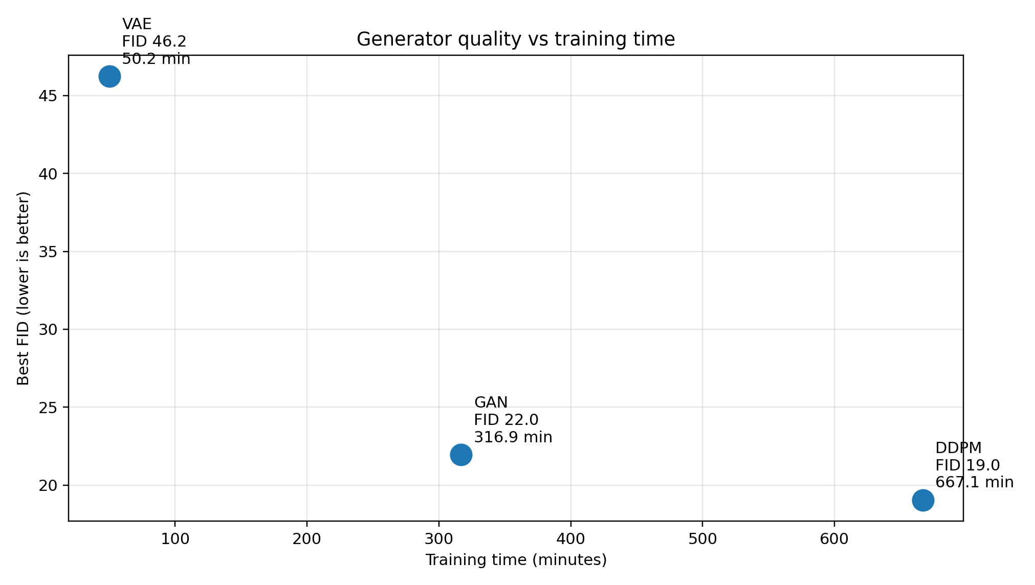
Quality and samples tell the same ranking
Quality vs training time
Final sample grids: DDPM, GAN, VAE
Reading the evidence
• FID evaluates distribution-level similarity; grids provide qualitative evidence.
DDPM wins quality, GAN is close at lower cost, VAE is fastest but smoother.
Part II - Generator
40
Notes:
Purpose: Combine final quantitative and qualitative generator evidence.
Evidence: The scatter plot uses Phase 5 FID and training time logs; the montage uses final comparison grids.
Conclusion: The visual and metric evidence support the same final ordering.
Transition: Next, explain the curated Phase 6 sample showcase.

Slide 41
Phase 6 showcase curates examples, not a new metric
Candidate pool
Heuristic
Interpretation
• 20 grids per architecture
• 16 images per grid
• 320 candidates per model
• 960 candidates total
• exposure
• contrast
• detail/sharpness
• color
• Curation for presentation
• Not a new scientific metric
Top 3 selected samples per architecture
The showcase supports presentation, while Phase 5 metrics carry the ranking.
Part II - Generator
41
Notes:
Purpose: Clarify how the final showcase was selected.
Evidence: The Phase 6 panel is the provided top-three panel selected by a deterministic visual-quality heuristic.
Conclusion: This is curation for presentation, not a distribution-level metric.
Transition: Next, close the generator section and combine conclusions.

Slide 42
What we learned
Classifier
Generator
• Strong pretrained classifiers are needed
• Facecrop and 224x224 improve performance
• ResNet50 is the best practical classifier
• Source generalization remains the main limitation
• Raw images are not enough; pipeline quality matters
• GAN required SN + GroupNorm + attention
• VAE improves with perceptual + adversarial losses
• DDPM wins quality through v-prediction and width
Controlled ablations converted evidence into final design decisions.
Final conclusions
42
Notes:
Purpose: Synthesize the two major parts.
Evidence: The classifier and generator cards summarize the experimental findings from their respective phases.
Conclusion: Both branches show that preprocessing and controlled ablations matter as much as model family.
Transition: Next, list the final decisions.

Slide 43
Final decisions
Track
Final decision
Key result / limitation
Classifier
ResNet50; 224x224 facecrop; ImageNet/default normalization; augmentation disabled
AUC 0.9950, accuracy 0.9692, F1 0.9794; limitation: source generalization
Generator
Best quality: DDPM; quality/speed: GAN; fastest/prototype: VAE
Final quality: DDPM FID 19.0; limitation: samples still need qualitative inspection
Classifier final evidence
Generator final evidence
Final decisions match the logs: ResNet50 for detection and DDPM for best generation quality.
Final conclusions
43
Notes:
Purpose: State the final project outputs in one compact table.
Evidence: The classifier decision uses Phase 4 metrics; the generator decision uses Phase 5 FID/time and Phase 6 showcase evidence.
Conclusion: The table keeps limitations attached to the decisions.
Transition: Next, be explicit about limitations.

Slide 44
Limitations remain visible
Classifier limitations
Generator limitations
• Source-specific cues can remain
• Grad-CAM is qualitative, not causal
• Performance may change on unseen fake generators
• FID is useful but incomplete
• Final showcase is curated, not distribution-level
• Compute budget affects DDPM and higher-resolution GAN results
The strongest results are reported with their failure modes, not separated from them.
Final conclusions
44
Notes:
Purpose: Close with explicit limitations to avoid overclaiming.
Evidence: The slide lists classifier and generator limitations that were visible in the provided analyses.
Conclusion: Limitations are part of the final interpretation and not hidden negative results.
Transition: Next, end with the single project takeaway.

Slide 45
Closing takeaway
Careful preprocessing and controlled ablations are as important as model choice: the classifier becomes reliable through stronger pretrained backbones and scaling, while the generator reaches best quality through the DDPM branch.
Questions?
Notes:
Purpose: End with the core project message.
Evidence: The final takeaway combines the classifier and generator branches without adding new evidence.
Conclusion: The project is best understood as controlled experimentation leading to decisions.
Transition: Invite questions.

